Slide 1
Alzheimer’s Disease and Related Dementias: The Healthy Brain Initiative Road Map Prevention Strategies
Amy Madden, MD
HealthReach
Jill Carney
Alzheimer’s Association
Alfred May, MPH
Maine CDC
Maine Geriatric Conference: May 24, 2024

Slide 2
Objectives
Participants in today’s session will:
Learn about the public health approach to preventing Alzheimer’s disease and related dementias (ADRD) as outlined in the Healthy Brain Initiative.
Understand the importance of early detection and learn about the common tools used for diagnosis.
Understand the role that care planning plays in supporting a better quality of life for people living with ADRD and their care partners.

Slide 3
What is Dementia and Alzheimer’s Disease?
Dementia is not a normal part of aging
It is caused by damage to brain cells that affect their ability to communicate.
It affects cognitive function, thinking, behavior, and feelings.

Slide 4
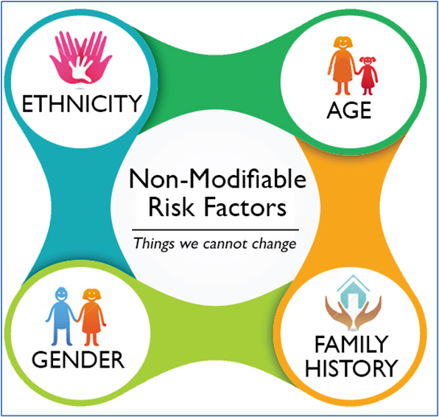
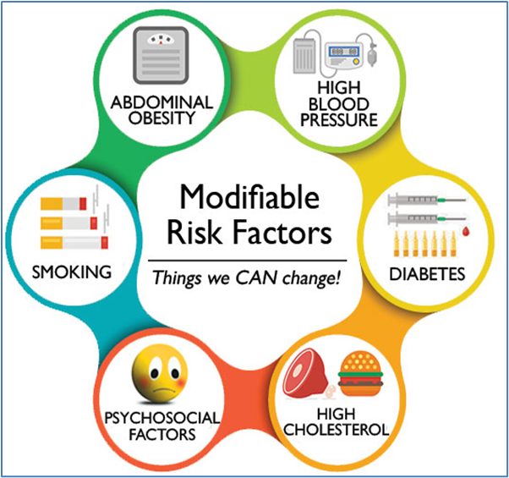
Dementia Risk Factors

Slide 5
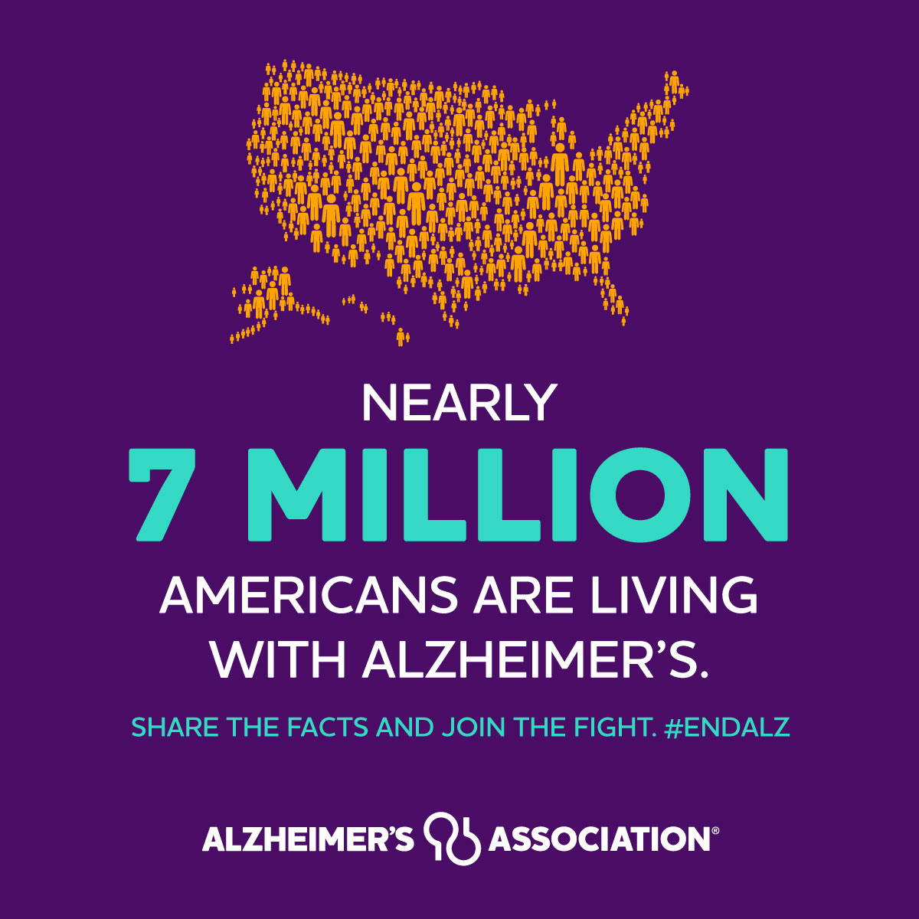
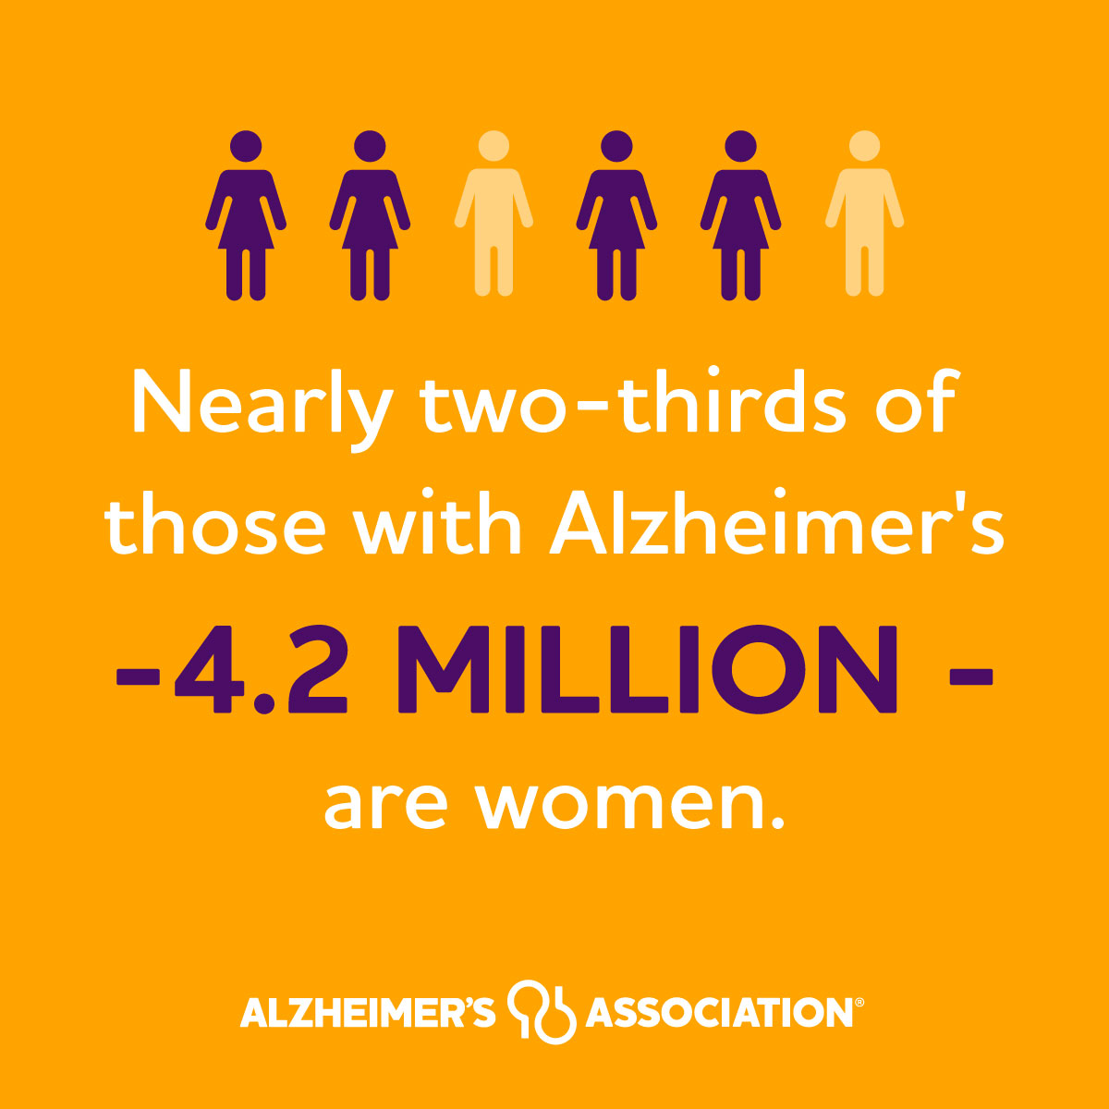
Scope of the ADRD Public Health Crisis

Slide 6
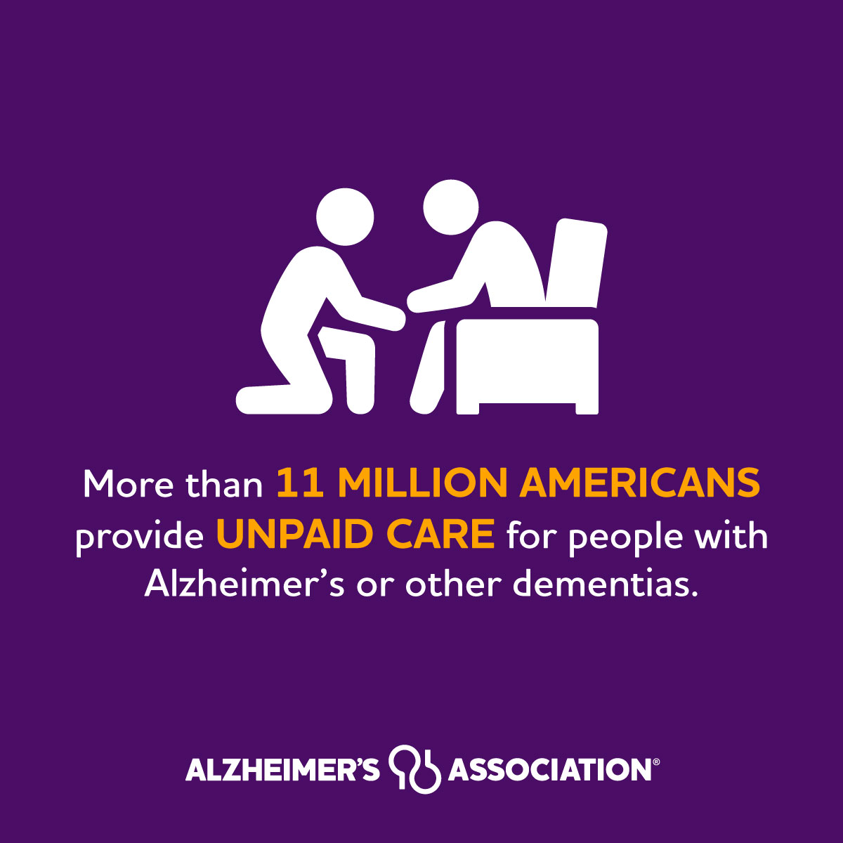
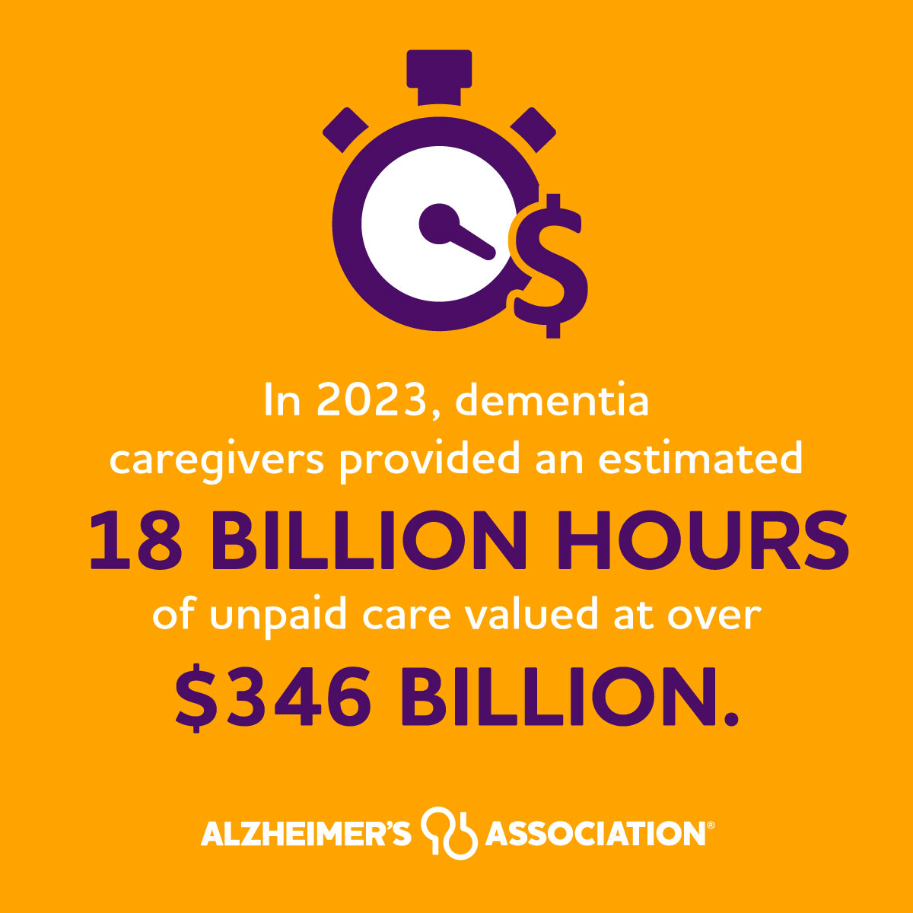
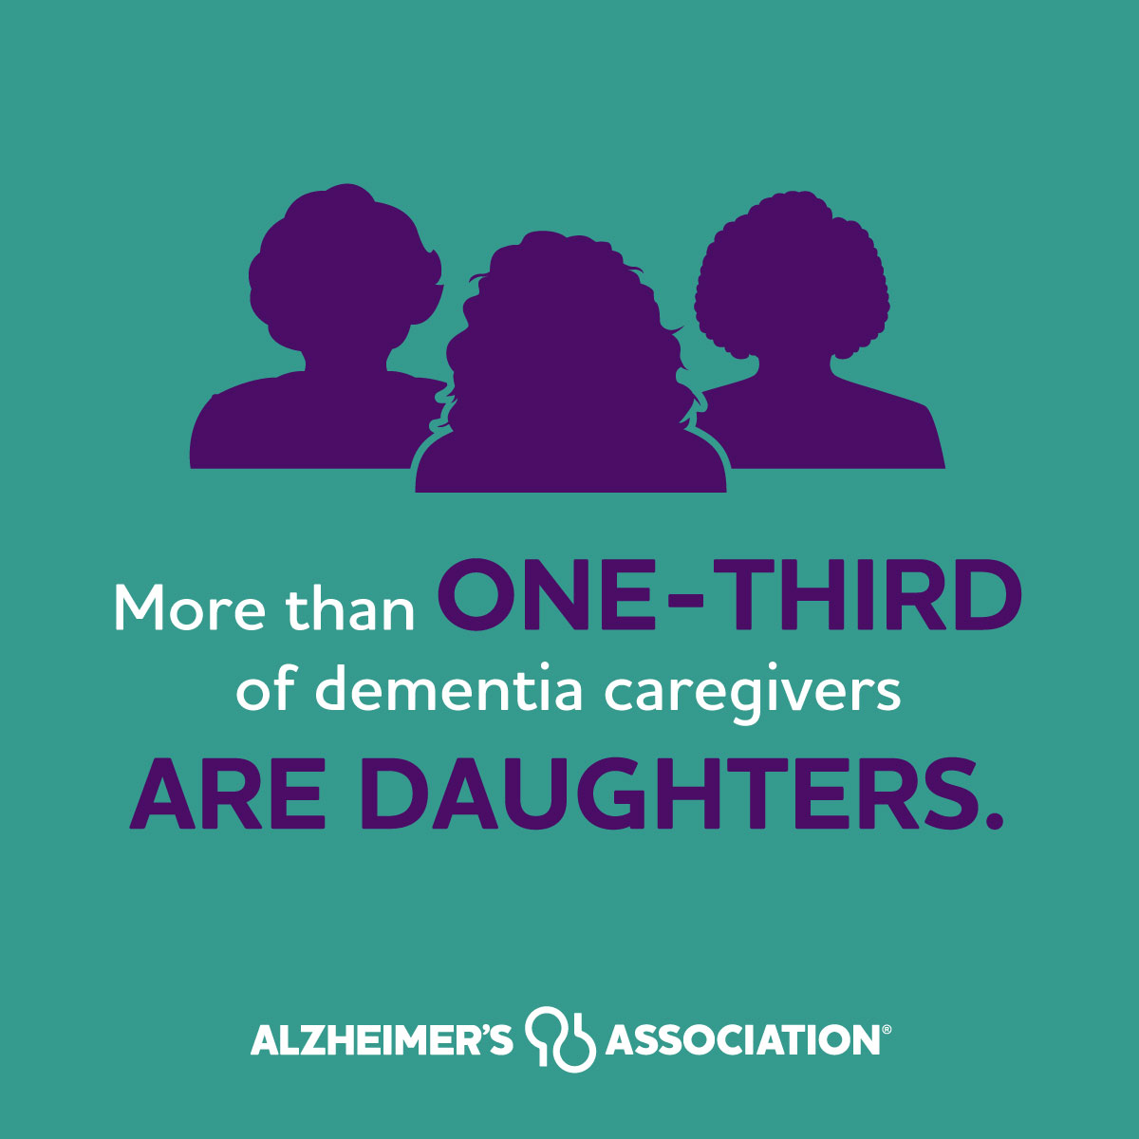
Dementia Caregivers

Slide 7
PUBLIC HEALTH MUST ACT NOW
THE NUMBER OF PEOPLE LIVING WITH COGNITIVE DECLINE INCREASES WITH AGE.
PROJECTED ALZHEIMER’S PREVALENCE
AND COSTS
IN 2023, AN ESTIMATED 6.7 MILLION AMERICANS ARE LIVING WITH ALZHEIMER’S.
BY 2060, IT IS EXPECTED TO DOUBLE.
$339
$301
$261
$219
$177
$141
$123
ALZHEIMER’S KILLS MORE PEOPLE THAN BREAST CANCER AND PROSTATE CANCER COMBINED.
Costs to Medicare/Medicaid
(in billions of 2023 dollars)
Costs to Private/Out-of-Pocket/Other
(in billions of 2023 dollars)
Number of People Living with Alzheimer’s Dementia
(in millions)
Citation: Alzheimer’s Association and Centers for Disease Control and Prevention. Healthy Brain Initiative: State and Local Road Map for Public Health, 2023–2027. Chicago, IL: Alzheimer’s Association; 2023.
Notes:
The impact of Alzheimer's and dementia is growing — and so is the hope among our communities that we will be able to make change.
Talking Points
Purple Line Graph: With the aging of the baby boom generation, the number of Americans aged 65 and over with Alzheimer’s is expected to dramatically escalate — from 6.7 million in 2023 to 12.7 million in 2050.​
Blue Bar Chart: The costs of caring for individuals with the disease will also expand in lock step. In 2023, caring for people with Alzheimer’s and other dementias will cost society an estimated $345 billion, including $222 billion by the government (Medicare and Medicaid). In 2050, costs to society of caring for people with Alzheimer’s will total nearly $1 trillion, with the costs to Medicare and Medicaid totaling a combined $644 billion. And that’s in today’s dollars — before inflation.​
Public health has the potential to impact this trajectory and help reduce prevalence and lower costs.
And as new treatments role out, there is an even bigger role for public health to play to ensure people have access to early detection and treatment
This graphic comes from page 13 of the HBI State and Local Road Map for Public Health, 2023-2027

Slide 8
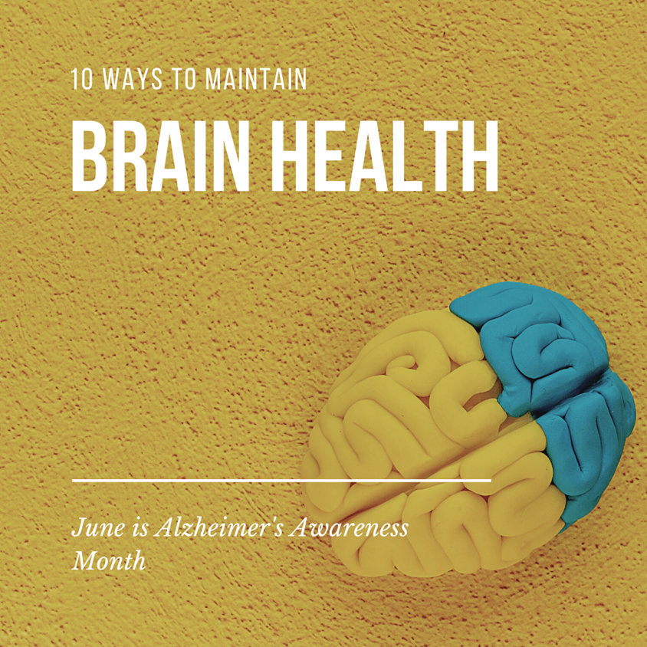
Healthy Brain Initiative (2005)
Everyone deserves a life
with the healthiest brain possible..
Promote brain health
Address dementia
Support people with dementia
and their caregivers.
Improves understanding of brain
health as central part of
public health practice.

Slide 9
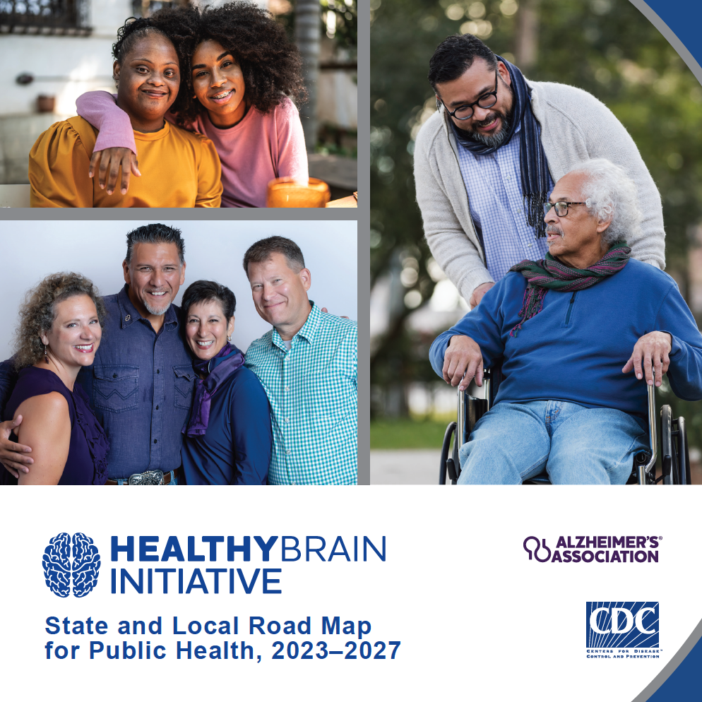
THE HBI ROAD
MAP IS A PUBLIC HEALTH STRATEGY
Backed by leading subject matter experts.
Drawn from the most recent evidence-based research.
Committed to decreasing the risk factors that may contribute to cognitive decline.
Notes:
The Healthy Brain Initiative (HBI) State and Local Road Map for Public Health, 2023-2027 (HBI Road Map) was released in July 2023.
Talking Points
This is the fourth edition of the HBI Road Map designed for state and local public health departments and their partners
The HBI Road Map was developed in collaboration with over 100 leading subject matter experts, including people living with dementia
The HBI Road Map is a guidebook for state and local public health departments to take action on brain health, dementia and caregiving
It offers a flexible menu of 24 actions to guide public health efforts

Slide 10
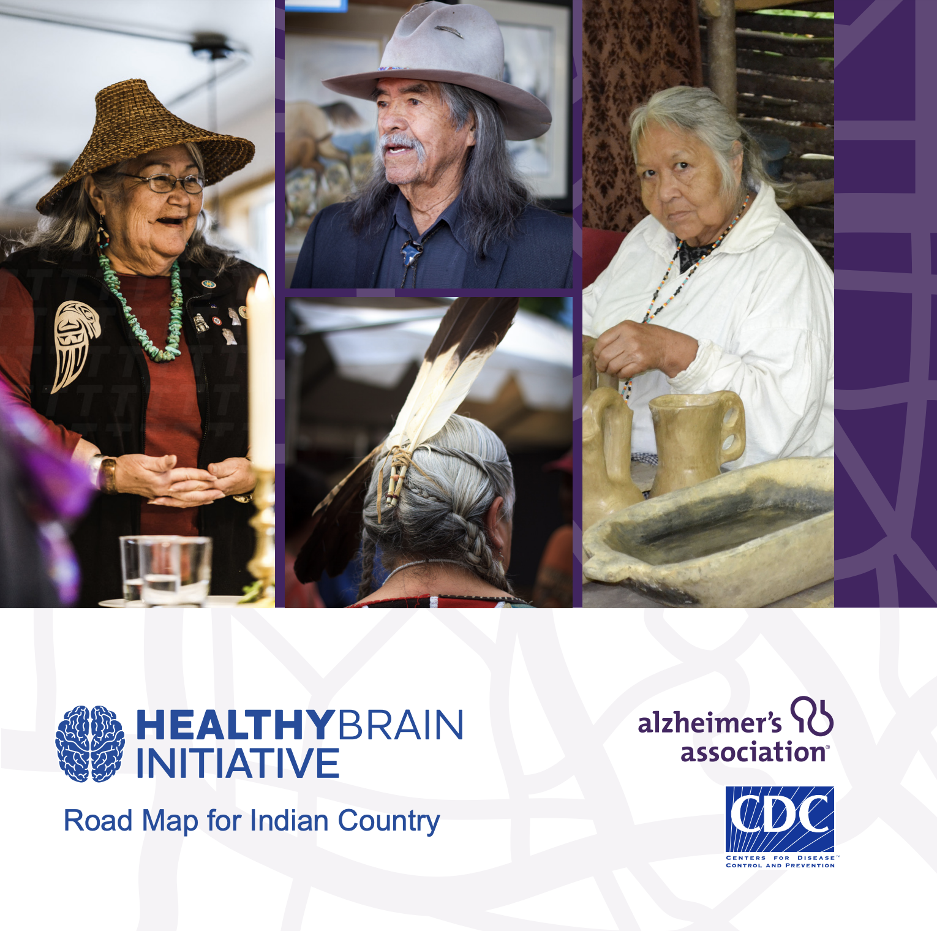
THE HBI ROAD
MAP FOR INDIAN COUNTRY
First ever public health guide for dementia for American Indian/Alaska Native communities .
Conversation starter for addressing brain health.
Notes:
The Healthy Brain Initiative (HBI) Road Map for Indian Country (HBI Road Map for Indian Country) was published in November 2019.
Talking Points
The HBI Road Map for Indian Country is the first ever public health guide on dementia for American Indian and Alaska Native (AI/AN) peoples
This public health guidebook is designed to start conversations about brain health, dementia and caregiving among AI/AN communities
It offers a flexible menu of 8 actions for tribal leaders and public health professionals
The HBI Road Map for Indian Country was developed because of the unique infrastructure and sovereignty of Tribal Nations

Slide 11
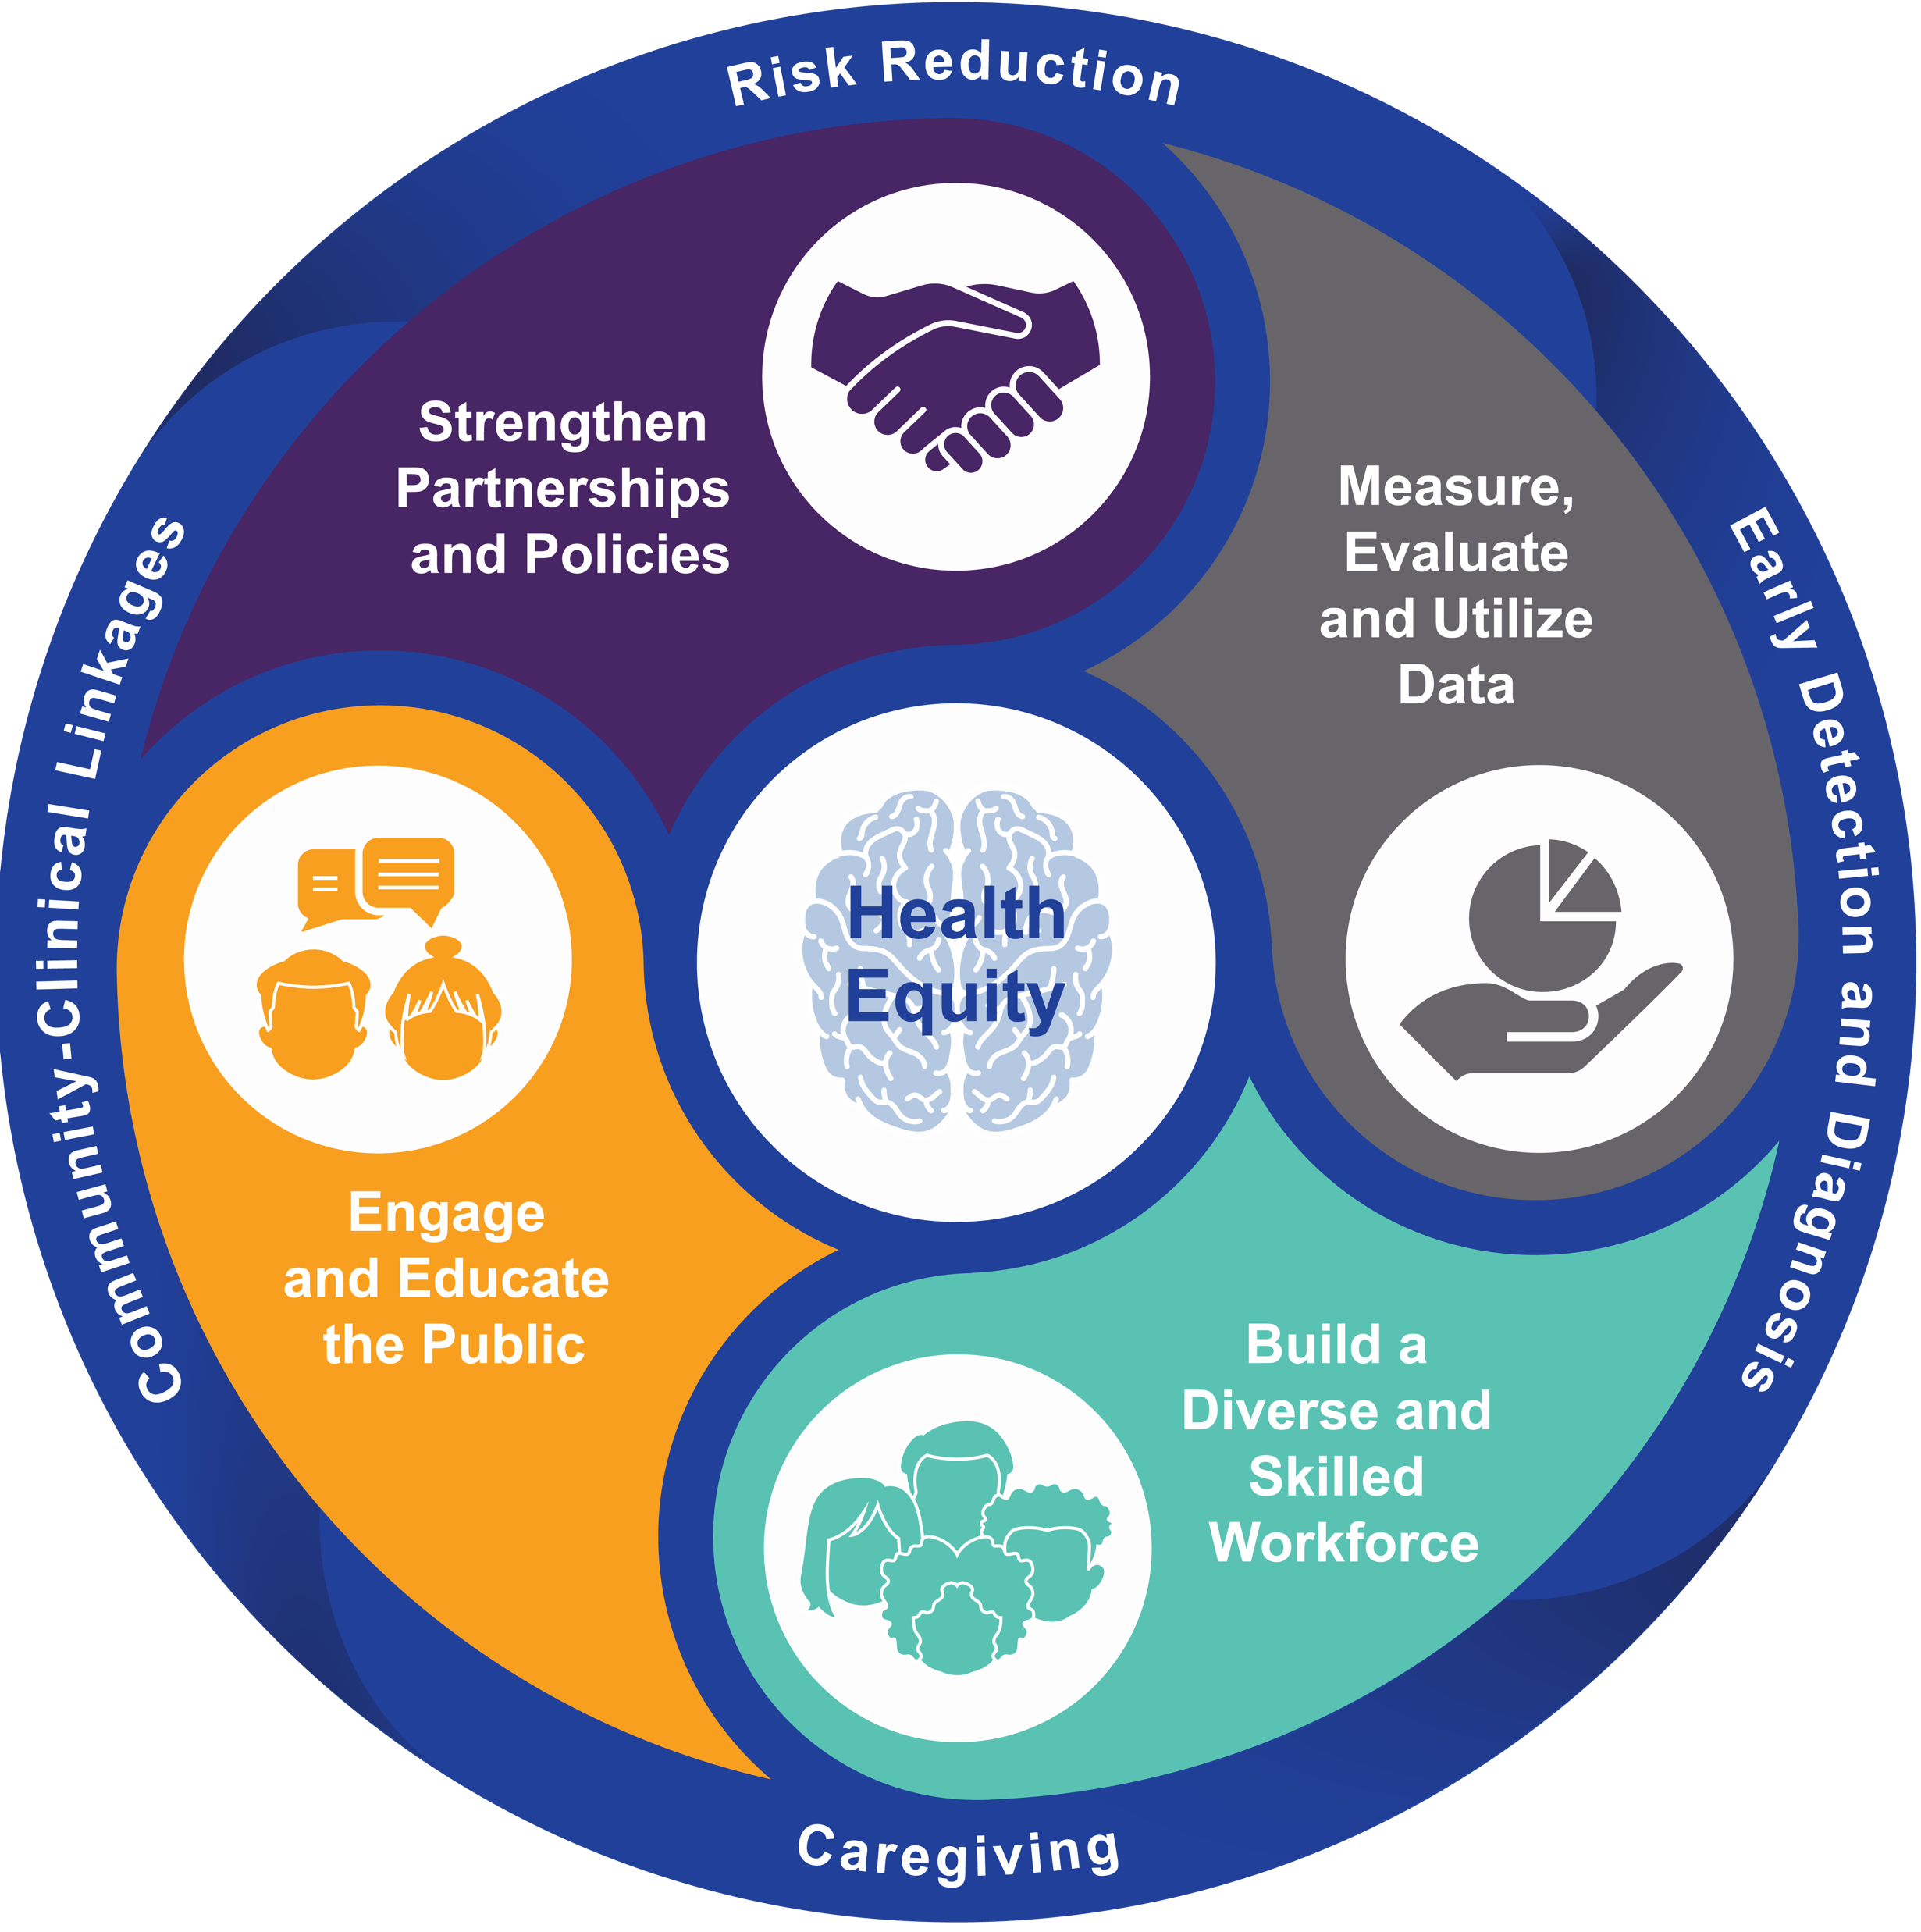
ACTION
FRAMEWORK
The framework of the HBI Road Map consists of four domains built from the Essential Public Health Services.
The framework is centered by the principles of health equity and surrounded by the areas of practice across the life course.
11
THE HEALTHY BRAIN INITIATIVE
Notes:
There are four domains of the HBI Road Map, built from the 10 Essential Public Health Services.
Talking Points
Action framework was designed to help state and local public health departments reach multiple populations using a variety of public health tools and techniques
The four domains build on one another, helping to drive community impact — the domains are:
P Domain: Strengthen Partnerships and Policies
M Domain: Measure, Evaluate and Utilize Data
W Domain: Build a Diverse and Skilled Workforce
E Domain: Engage and Educate the Public
Around the outer ring are the four areas public health practice that the HBI Road Map advances: risk reduction, early detection and diagnosis, caregiving, and community-clinical linkages
Health equity centers the framework, ensuring attention to equity is included across all action
This graphic comes from page 21 of the HBI State and Local Road Map for Public Health, 2023-2027

Slide 12
THE HBI ROAP MAP IS FOCUSED ON REDUCING THE RISK AND IMPACT OF DEMENTIA FOR THE GREATEST NUMBER OF PEOPLE POSSIBLE
COMMUNITY PARTNERSHIPS ARE ESSENTIAL AND FOUNDATIONAL.
HEALTH EQUITY IS
FULLY INTEGRATED INTO
ALL ACTIONS.
EVALUATION TOOL ENSURES MEASURABLE ACTION.
Notes:
The HBI Road Map uses public health approaches to reduce the risk and impact of dementia for the greatest number of people possible.
Talking Points
New and expanded elements in the HBI Road Map include:
Community partnerships are essential and foundational. The domains were reordered to ensure that partnerships begin the public health work of the HBI Road Map.
Healthy equity is fully integrated into all actions in the HBI Road Map, just as it needs to be a part of all public health action more broadly.
For the first time, this HBI Road Map also has an accompanying evaluation tool to ensure measurable action across the country
Each edition of the HBI Road Map incorporates the latest evidence and public health practice to ensure recommended actions are current and actionable.

Slide 13
OPPORTUNITIES FOR PUBLIC HEALTH INTERVENTION ACROSS THE DEMENTIA LIFE COURSE
13
THE HEALTHY BRAIN INITIATIVE
Notes:
Public health can take action at any stage of life, at any age. Though often depicted as an issue solely impacting older adults, public health has a role to play at every stage of life. Looking at the dementia life course is an effective way to visualize different areas of public health practice and their application to dementia.
Talking Points
The purple bar references the continuum of dementia while the people represent the potential impact of public health interventions across the life course.
Risk reduction (also called primary prevention) can have the biggest impact across a population. Much can be done to reduce risk of cognitive decline and possible dementia. Examples include lowering blood pressure, healthy eating, and physical activity.
Early detection and diagnosis (also called secondary prevention) can improve access to and knowledge of diagnostic services and supports, and the early warning signs of dementia. Public health action on early detection can include work to that changes the culture around talking about memory and thinking problems, both among the public and among health care providers. Diagnosis is important and can help enable access to care planning, financial and legal planning, access to support programs, clinical trials. And, as more treatments become available, early detection and diagnosis becomes essential.
Safety and quality of care (also called tertiary prevention) can help support people living with dementia and their caregivers. Public health action can help ensure access to and knowledge of supports and services, improve community-clinical linkages, and strengthen training of care providers.
No matter the focus, there are actions that can be taken at any stage of life to improve outcomes related to brain health, dementia and caregiving.
This graphic comes from page 8 of the HBI State and Local Road Map for Public Health, 2023-2027

Slide 14
Early Detection
Screening:
Inexpensive, sensitive, and easily utilized tool used to detect presence of a condition in asymptomatic populations.
Identify conditions for which evidence-based interventions are recommended and change outcomes.
Case Finding:
Identify condition when symptoms are present.
Early Detection: (specific to cognitive impairment in older adults)
Detect the situation and intervene before a crisis occurs.

Slide 15
The Case for Early Detection
29,600 Mainers are living with Alzheimer’s, but as many as half of them are not formally diagnosed.
Diagnosis leads to lower costs of care for people living with dementia. In a 2018 analysis, diagnosis led to projected cost savings of approximately $63,000 per person.
Detects a condition and prompts intervention before a crisis occurs.
People in earlier stages of dementia retain decision-making capacity, self-direction, autonomy.
Allows time to change factors that may be adversely affecting brain health.
Awareness for care partners.
Longer time to prepare for increasing loss of function.
Recent approval of drugs that target people in early stages of disease (lecanemab, upcoming donanemab).

Slide 16
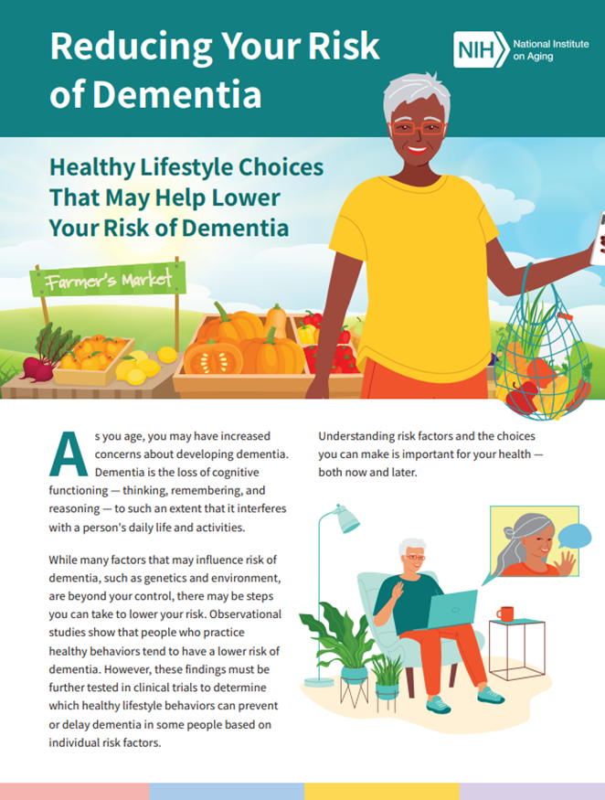
Normalize Conversations about Cognition
Positive framework
“Just like it is important that you know what your blood pressure is, knowing about your memory and thinking ability is important as well.”
“Scripting” the conversation
“Many of us are concerned about our memory or thinking in general. It's good to have a sense of just how well we are doing.”
“Sometimes people are concerned about their memory. Do you have any concerns like this?”
Opportunity to educate about brain health and what might prompt further evaluation
Toolkit for Early Detection (NYU Langone PHCOE):
BOLD_Toolkit_010323.pdf (bolddementiadetection.org)

Slide 17
Brain Health Counseling Elements
Protect against neurovascular threats (manage diabetes, high blood pressure, smoking, etc.)
Encourage regular physical activity
Sleep quality
Diet (Mediterranean, DASH, or the combo MIND – all focus on foods that are minimally or unprocessed, high in nutritional value)
Social activity and connectedness
Cognitive stimulation
Emotional and spiritual wellbeing
Substances that affect brain health (including medications, smoking, THC, and alcohol)

Slide 18
Steps Leading to Diagnosis
Detection: Signals of possible cognitive impairment may be detected anywhere, especially in community settings like banks, coffee shops, or pharmacies: examples can be missed refills of long-term medications, or a change in a person’s behavior when picking up medication.
Assessment: Logical next step after a signal is detected: the pharmacist can encourage that person or someone close to that person, such as a friend or family member, to follow up with a clinician for a cognitive assessment.
Diagnosis: Requires a clinical evaluation.

Slide 19
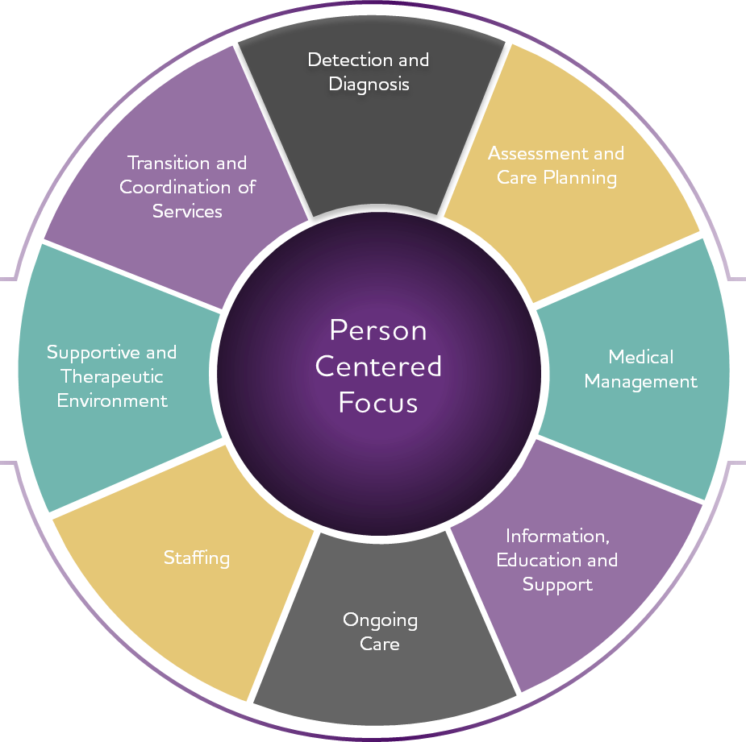
Dementia Care Planning
Improve quality of life.

Slide 20
Care Planning: Medical Plan
Following diagnosis, or even with diagnostic workup ongoing, there are specific elements to consider as part of a holistic care plan for people living with ADRD and care partners
Medicare CPT® code 99483 provides reimbursement for a clinical visit that results in a comprehensive care plan.

Slide 21
Care Planning: Medical Plan
Cognition-focused evaluation (MOCA, Clinical Dementia Rating Scale).
Functional assessment (Basic and Instrumental Activities of Daily Living).
Medication reconciliation and review for high-risk medications.
Evaluation for neuropsychiatric and behavioral symptoms, including depression, anxiety, delusions, sleep quality.
Evaluation of safety, including med management, home safety, motor vehicle operation, guns, and physical wellness (fall risk, etc.).
Identification of care partners and assessment of knowledge, needs, and social supports. Willingness and capacity of partners to take on tasks to assist in care. Resources for care partner support and training.
Advance care planning - early and often.
Creation of a care plan, including plans to address any neuropsychiatric symptoms and referral to community resources.

Slide 22
Care Planning: Non-Medical Plan
Constructed collaboratively by the person living with ADRD, family, other care partners.
Creating a care plan includes assessment of resources (including financial) and goals for person with ADRD and care partners
Can Include: daily/weekly schedule of appointments, treatments, medications with instructions, and types of assistance needed.
Assigned tasks for family members, other care partners, and neighbors.
Emergency contacts
List of patient needs for assistance and who can assist: eating patterns and food preparation, toileting, housing changes, recreational/socialization, and caregiver supports (respite).

Slide 23
Care Planning Supports Patient and Caregiver
Dementia caregiving poses many challenges as a complex, growing public health problem.
Need for dementia caregiving is expected to rise in tandem with the projected increase for people living with Alzheimer’s.
Dementia caregiving often entails long and intense assistance (more hours per day and higher level of skill compared to caregiving for other chronic disease).
Caregivers’ health, well-being and productivity will be stressed and may decline.
One in three report that health has gotten worse.
About forty percent report symptoms of depression.
Caregiver supports are important.
Community level, structured and consistent.
Build support relationships and mentors.

Slide 24
Case Study
Mrs. Gagnon is a 79-year-old woman who lives alone in a single-story home in Buxton.
Her only daughter lives about two miles away and helps her with heavy chores around the house as well as takes her mother grocery shopping once a week.
Mrs. Gagnon’s daughter has started to notice that her mother has been having trouble remembering when to take her medication, so she has been calling her twice a day to remind her.
Mrs. Gagnon doesn’t drive due to problems with her vision, but she does all her own housework, meal preparation, and finances. She goes to church weekly with her daughter.

Slide 25
Small Group Activity
Early Detection Groups
Review three tools that are commonly used in early detection.
Discuss ‘best practices’ for early detection strategies
Report out with brief summary of your discussion.
Time frame: 20 minutes
Care Planning Groups
Brainstorm a care planning tool or process.
What elements should be in the care plan?
Who should be involved in the care plan?
Based on discussion, create a draft care plan to share.
Time frame: 20 minutes

Slide 26
Group Sharing

Slide 27
Thank You!
Amy Madden, MD
HealthReach
amy.madden@healthreach.org
Jill Carney
Alzheimer’s Association, Maine Chapter
jecarney@alz.org
Al May, MPH
Maine CDC Downeast Public Health District
alfred.may@maine.gov

