Slide 1
Architectural Design as a Determinant of Health
Fireside Chat
Diana Anderson, MD, M.Arch, FACHA
Assistant Professor of Neurology, Boston University
Co-Founder, MGB Health Design Lab
Healthcare Principal, Jacobs
@dochitect www.dochitect.com diana.anderson@dochitect.com

Slide 2
Funding Sources:
Alzheimer’s Association Clinician Scientist Fellowship
Mass General Brigham – Health Design Lab
@dochitect www.dochitect.com diana.anderson@dochitect.com

Slide 3
Health Architecture is a Public Health Issue
Virtual Technology
Placemaking and the Role of the Arts
Health in the City
Who should fund and conduct the evidence-based research / functional performance?
People in the City
1- Standardization of stakeholder feedback
2- Design frameworks to ensure inclusivity
3- Funding and conducting research / functional performance
Wellness

Slide 4
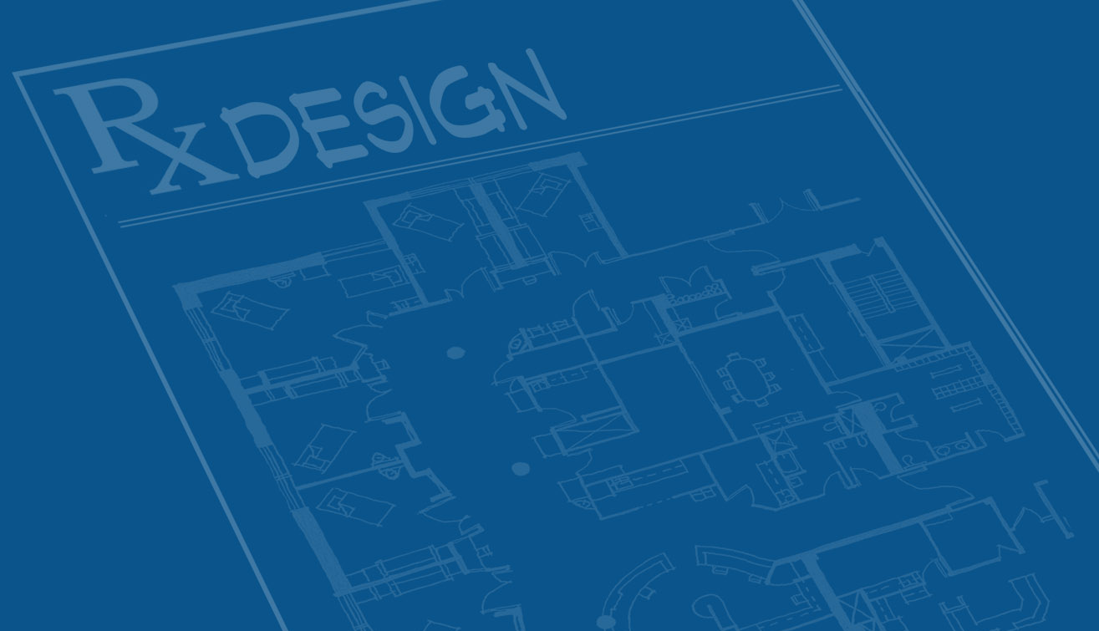
How can we standardize the process of stakeholder feedback?
Notes:
EBD is primarily focused on patient outcomes, and began that way. Everywhere you see the headlines “putting patients first”, “transforming the patient experience”. But whose voice should be prioritised when funding and designing hospitals and health services? In other words, who are we designing hospitals for­­- the clinicians, the patients and their families, the administrators?
By “our” I don’t mean only the architects but also the policy makers, administrators etc
Stakeholder engagement /design equity, and inclusivity User feedback - Clinician and not Clinician Peer review and post occupancy Evidence integration
Who what when where why?
How to integrate these into design process.
Who should do it? Should there be a national level thing or individual firms
When should this occur in the design process. On multiple points or just at the start or at the end
Discussion of design versus standardization with subthemes. And questions. Use shari graphic printed? Cards and markers?
Fireside session
Ask questions and brainstorm answers? Ie: who should do this research, funding, etc
Print stuff and have cards and markers
Design equity – stakeholder engagement
5Ms? Framework
POE
“Who should decide whether and how stakeholders’ needs are met?”
can be answered in the same way we make other decisions in healthcare that involve technical expertise and normative concerns: shared decision-making.
Shared decision-making allows for a role delineation for healthcare providers and patients or their families; providers are responsible for determining the range of appropriate options based on the best available evidence. When that is lacking, providers rely on clinical judgment borne out of long practice.

Slide 5
Design Intent
User Experience
Notes:
Can architecture have the power to support caregivers’ ability to heal and delivery of care? There is often a gap between design intent and user experience. The classic urban planning example of this is seen with campus planning.

Slide 6
Stakeholder
Inclusivity
Technically, Logistically, & Financially Possible Options
Range of possible options
Evidence-Based Preferences
Options reduced by evidence
Value Preferences
> 1 evidence-based option exists, benefits are in equipoise or unknown: stakeholders voice
Successful decision-making involving the available range of options, evaluated by evidence, and a consensus approach with stakeholders affected by the decision.
Balanced Stakeholder Representation
Anderson D, Teti S. Shared Decision-Making in Healthcare Facility Design. AMA Journal of Ethics. 2024 (Accepted for Publication).
Notes:
Range of technically possible options
Wide options reduced by evidence-based performance assessment; where is the most benefit accrued?
Where more than one evidence-based options exists, or benefits are in equipoise (or unknown), stakeholders affected should have a voice

Slide 7
Application of design frameworks to ensure inclusivity (e.g.: 5Ms)?
Notes:
EBD is primarily focused on patient outcomes, and began that way. Everywhere you see the headlines “putting patients first”, “transforming the patient experience”. But whose voice should be prioritised when funding and designing hospitals and health services? In other words, who are we designing hospitals for­­- the clinicians, the patients and their families, the administrators?
By “our” I don’t mean only the architects but also the policy makers, administrators etc
Stakeholder engagement /design equity, and inclusivity User feedback - Clinician and not Clinician Peer review and post occupancy Evidence integration
Who what when where why?
How to integrate these into design process.
Who should do it? Should there be a national level thing or individual firms
When should this occur in the design process. On multiple points or just at the start or at the end
Discussion of design versus standardization with subthemes. And questions. Use shari graphic printed? Cards and markers?
Fireside session
Ask questions and brainstorm answers? Ie: who should do this research, funding, etc
Print stuff and have cards and markers
Design equity – stakeholder engagement
5Ms? Framework
POE
“Who should decide whether and how stakeholders’ needs are met?”
can be answered in the same way we make other decisions in healthcare that involve technical expertise and normative concerns: shared decision-making.
Shared decision-making allows for a role delineation for healthcare providers and patients or their families; providers are responsible for determining the range of appropriate options based on the best available evidence. When that is lacking, providers rely on clinical judgment borne out of long practice.

Slide 8
5Ms for Design?
Mobility
- Community Context -
Matters Most
Mind
Matters Most
Mind
Hospital / LTC
Medication
Medication
Multi-complexity
Multi-complexity
Reference: http://www.ihi.org/Engage/Initiatives/Age-Friendly-Health-Systems/Pages/default.aspx
Notes:
Set of 5 evidence-based elements of high quality care
When implemented together shifts focus towards user needs
Inclusive of complex biopsychosocial situations
Application across spatial scales:
patients & caregivers
healthcare buildings
urban fabric & community

Slide 9
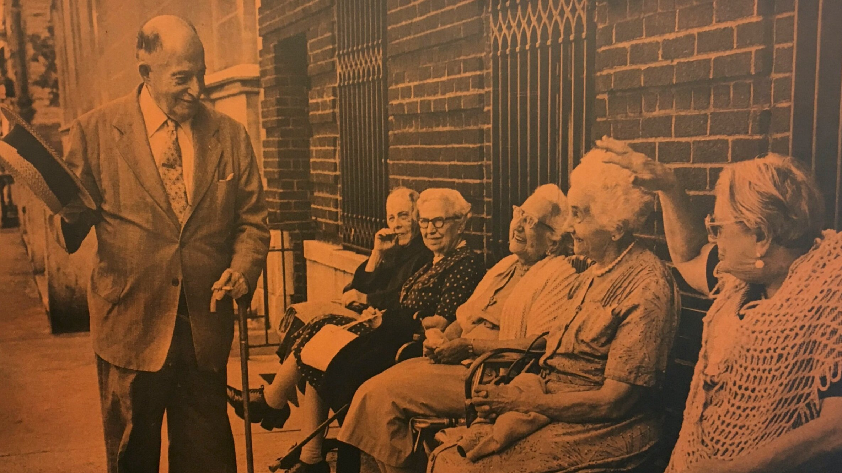
Mind
Reference: Platform: https://www.platformspace.net/home/viewing-watching-observing-aging-and-the-architecture-of-intermediate-space
Notes:
street ballet, to invoke Jane Jacobs

Slide 10
Medications
Photo credit: Diana Anderson

Slide 11
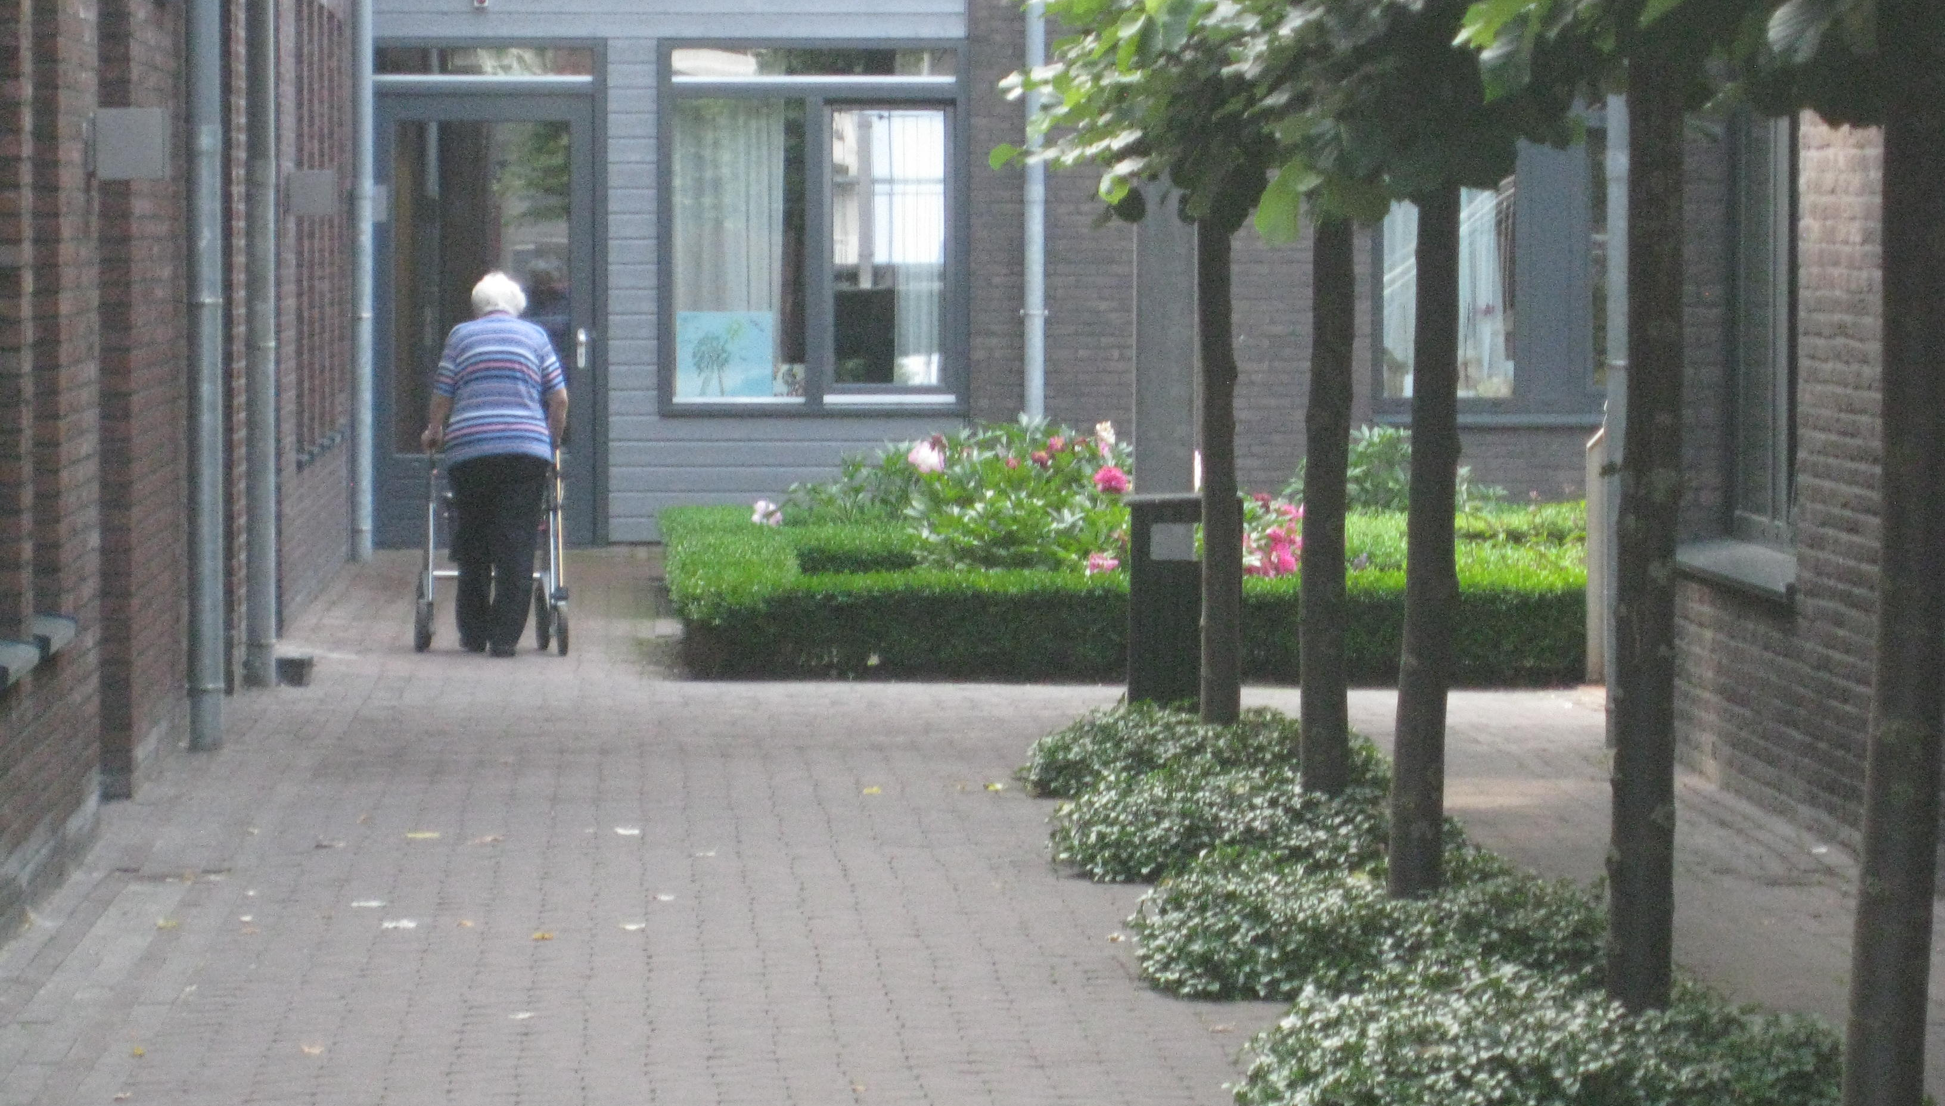
Mobility
De Hogeweyk, Dementia Village
Weesp, The Netherlands
Molenaar & Bol & VanDillen

Slide 12
Multicomplexity

Slide 13
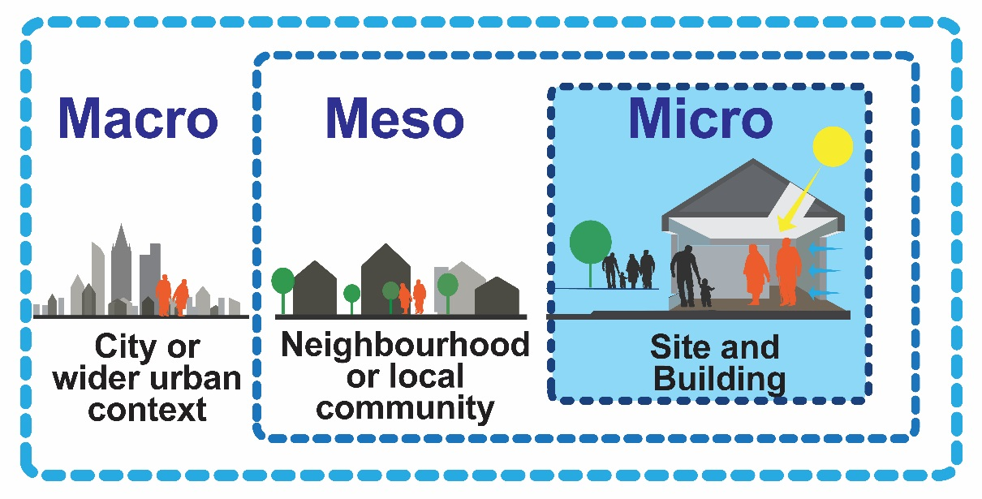
Matters Most
Graphic: Thomas Grey, Trinity College, Dublin

Slide 14
How to advance evidence-based research / functional performance assessments?
Notes:
EBD is primarily focused on patient outcomes, and began that way. Everywhere you see the headlines “putting patients first”, “transforming the patient experience”. But whose voice should be prioritised when funding and designing hospitals and health services? In other words, who are we designing hospitals for­­- the clinicians, the patients and their families, the administrators?
By “our” I don’t mean only the architects but also the policy makers, administrators etc
Stakeholder engagement /design equity, and inclusivity User feedback - Clinician and not Clinician Peer review and post occupancy Evidence integration
Who what when where why?
How to integrate these into design process.
Who should do it? Should there be a national level thing or individual firms
When should this occur in the design process. On multiple points or just at the start or at the end
Discussion of design versus standardization with subthemes. And questions. Use shari graphic printed? Cards and markers?
Fireside session
Ask questions and brainstorm answers? Ie: who should do this research, funding, etc
Print stuff and have cards and markers
Design equity – stakeholder engagement
5Ms? Framework
POE
“Who should decide whether and how stakeholders’ needs are met?”
can be answered in the same way we make other decisions in healthcare that involve technical expertise and normative concerns: shared decision-making.
Shared decision-making allows for a role delineation for healthcare providers and patients or their families; providers are responsible for determining the range of appropriate options based on the best available evidence. When that is lacking, providers rely on clinical judgment borne out of long practice.

Slide 15
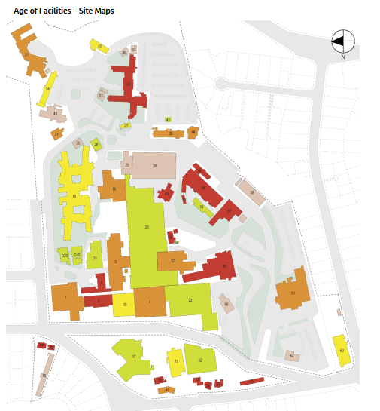
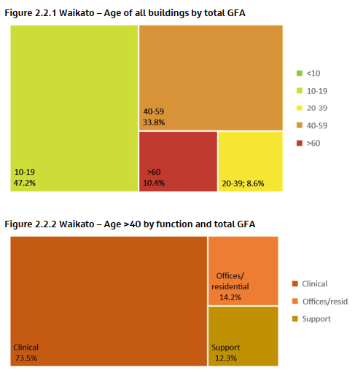
Building Performance
Age
Resilience (seismic)
Fabric & Service Condition
Building Physical Rating
Optimal Good Satisfactory Limited Poor

Slide 16
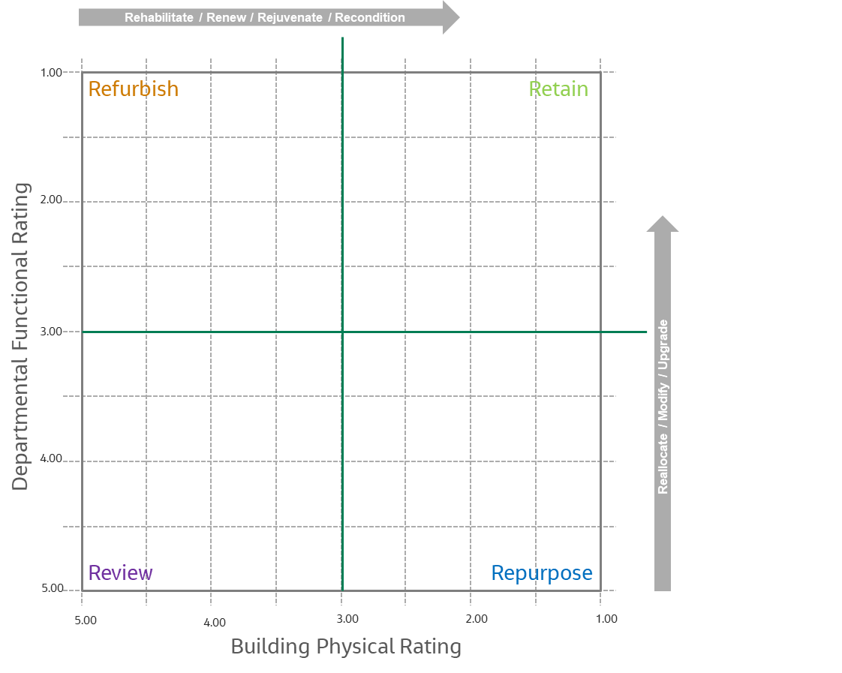
Rating Matrix
Building Physical Rating
Building Functional Rating
Departmental Functional Rating
Retain
Buildings that achieve a high score in physical and functional performance.
Refurbish
Buildings that achieve a physical performance of under 50% but achieve a great functional performance
Repurpose
Buildings that achieve a low functional score but are physically performing well
Review
Low score in both functionality and physical performance.

Slide 17
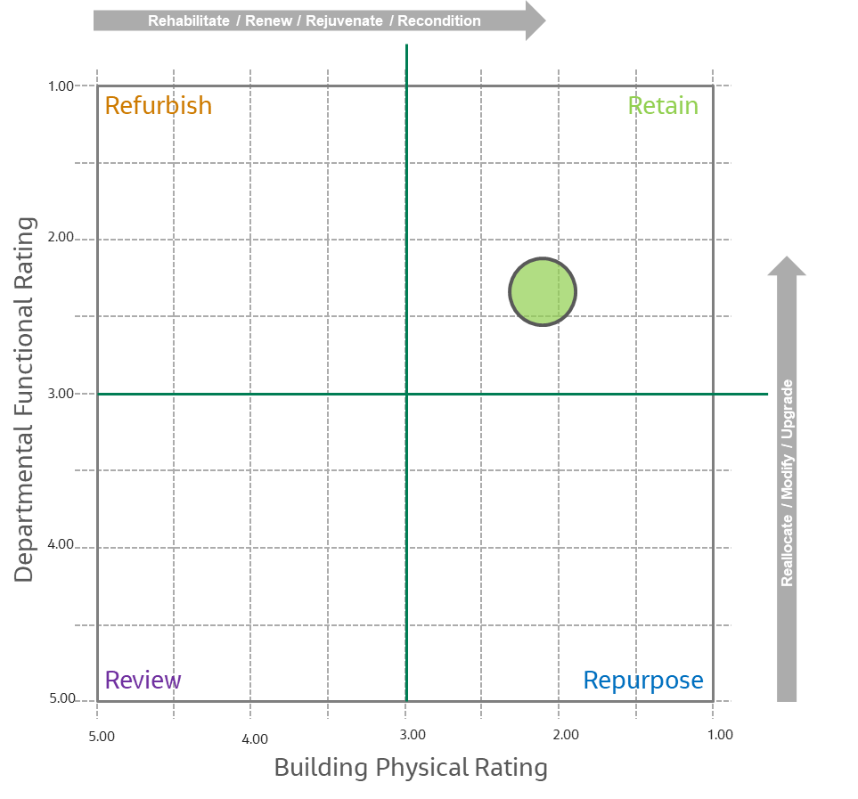
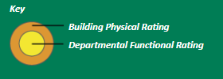
Combined Assessment Maps
Regional Ratings by Department
Building Physical Rating
+
Departmental Functional Rating
Geographical info by assessed site
+/-
Demographic overlay
Notes:
Geographical info by assessed site
Demographic Overlay

Slide 18
Discussion

Slide 19
Thank You!
Diana Anderson, MD, M.Arch, FACHA
Assistant Professor of Neurology, Boston University
Co-Founder, MGB Health Design Lab
Healthcare Principal, Jacobs
@dochitect www.dochitect.com diana.anderson@dochitect.com

