Slide 1

Bridging the Gap in Aroostook County
Memory Care
31st Maine Geriatrics Conference
Friday, May 24, 2024
Bar Harbor, ME

Slide 2



This project is supported by grant# 90ADPI0094-01-01 that is supported by the Administration for Community Living (ACL), U.S. Department of Health and Human Services (HHS) as part of a financial assistance award totaling $977,315 with 75 percent funded by ACL/HHS and $324,132 funded by non-government source(s). The contents are those of the authors (s) and do not necessarily represent the official views of, nor an endorsement, by ACL/HHS, or the U.S. Government.

Slide 3
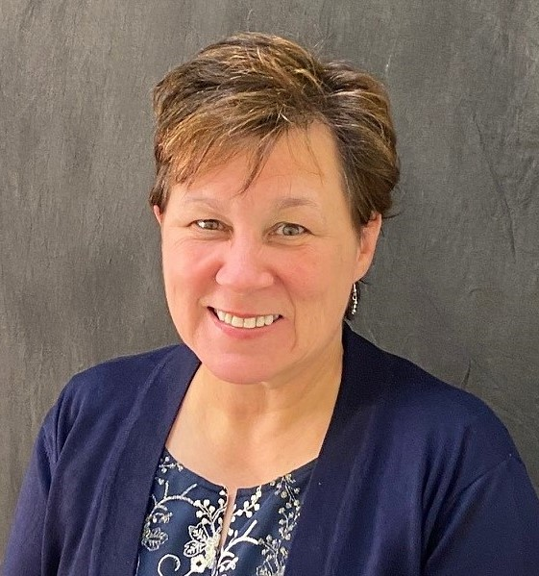
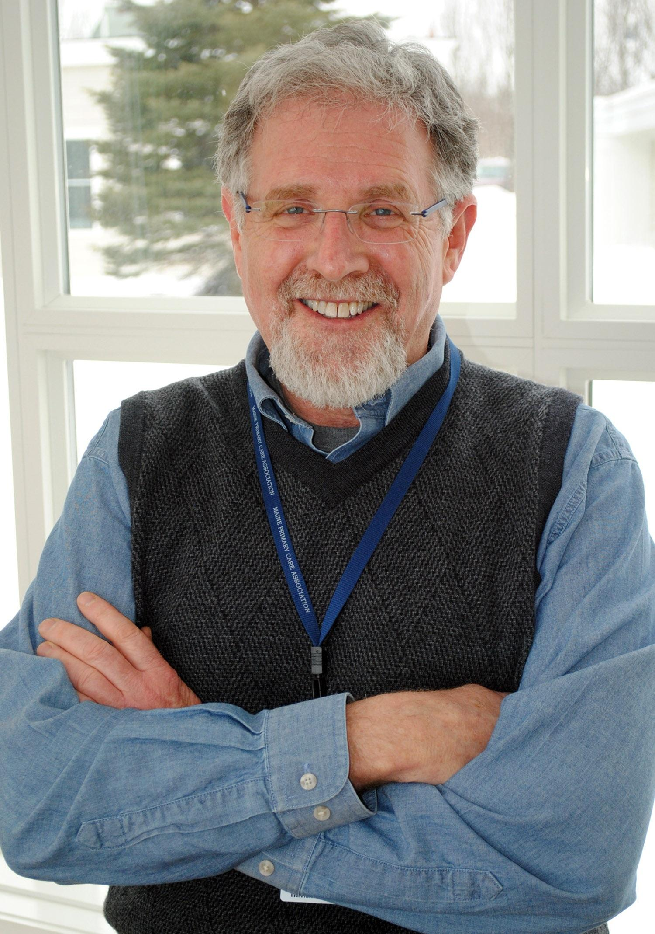
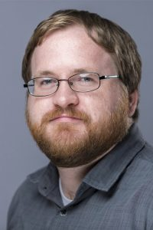
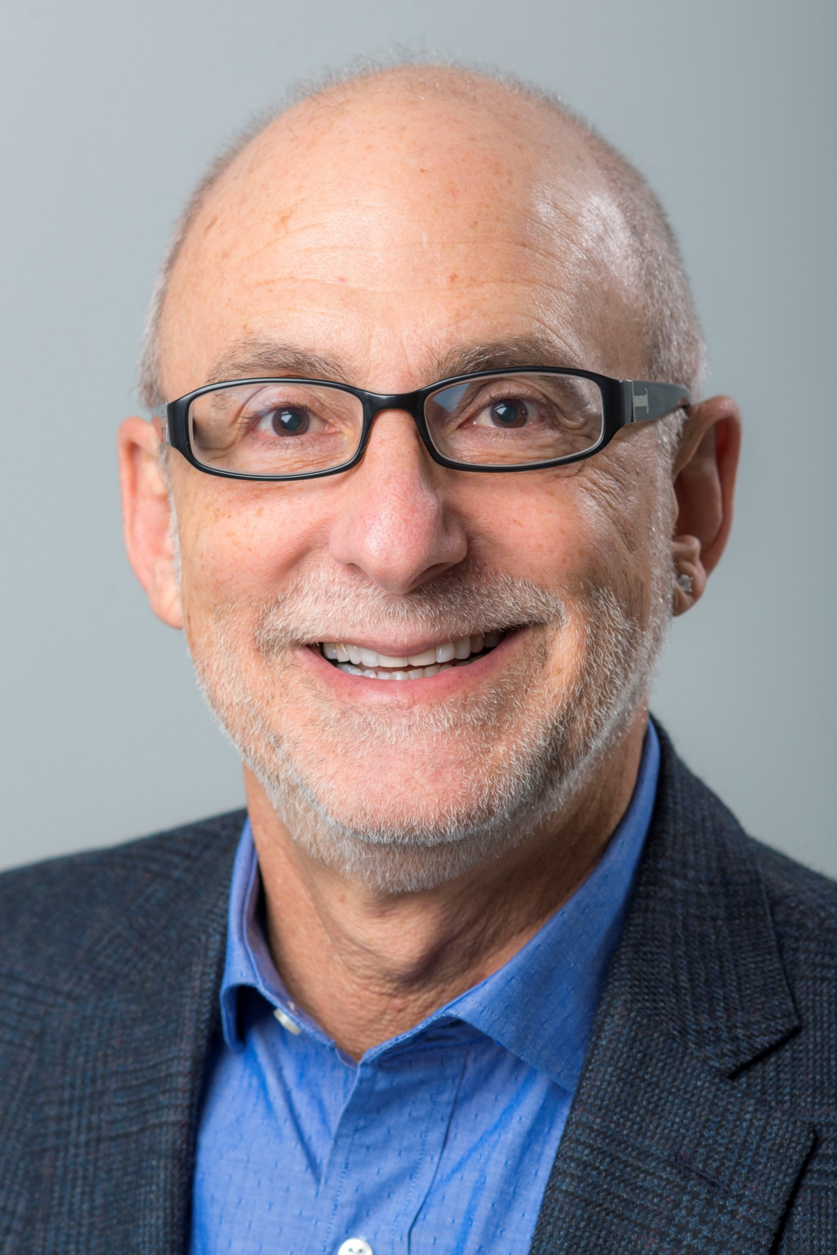

Meet the Team
Vi Belanger, CDP
Memory Center Manager
Aroostook Agency on Aging
260 Main Street, Suite A
Presque Isle, ME 04769
Clifford Singer, MD, DFAPA, AGSF, Chief
Center for Geriatric Cognitive and Mental Health
Northern Light Acadia Hospital
268 Stillwater Ave
Bangor, ME 04401
David Wihry, MPA
Senior Project Manager
UMaine Center on Aging
Camden Hall
25 Texas Avenue
Bangor, ME 04401
Lenard Kaye, DSW, PhD
Director and Professor
UMaine Center on Aging
Camden Hall
25 Texas Avenue
Bangor, ME 04401

Slide 4
Funding Model and Partnerships
FUNDING:
3-year Administration for Community Living grant awarded to Aroostook Agency on Aging, designed to focus on increasing awareness within Aroostook County of dementia, those experiencing cognitive decline.
ROLE OF PARTNERS:
Home of all memory care services including education, training, referral, and other supportive services.
NLH Mood and Memory Clinic – Provides case review, diagnoses, and clinical treatment recommendations for primary care partners.
UMaine Center on Aging – Lead on evaluation and quality improvement activities - design of assessments, data analysis, and reporting.

Slide 5
Goals
To be a local guide on the path to delivering comprehensive person-centered services and supports specific to individuals, families and caregivers impacted by Alzheimer’s Disease and Related Dementias

Slide 6
Aroostook County - Access Barriers
Lack of local resources, resistance to seeking help
Aroostook County has the highest Alzheimer’s prevalence of those 65+ in Maine (10.7%)
Access Barriers
Few providers, long wait lists
Access to
Transportation

Slide 7
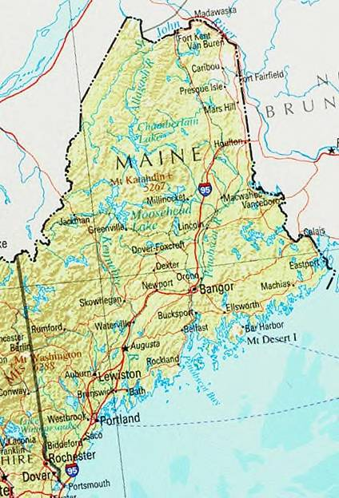
NLH Dementia Speciality Services
Northern Light Acadia Hospital Mood and Memory Clinic
Est. 2011
Multidisciplinary. Follow about 1000 patients (½ mood, ½ memory)
~25 patients/day, 4-6 new referrals/day. 6-18 month wait list
Integrated Alzheimer’s disease clinical trial program
Anti-amyloid infusion capable

Slide 8

Meet Gwendolyn
Gwendolyn is a 79 year old female experiencing cognitive decline and memory loss. Married to Oliver for 58 years.
Staff reviewed services, administered assessments, and provided supports and education for both Gwen and her husband.
Gwen cried and shared with us and her husband for the first time the depth of her concerns about her memory and worries for their future. What were her worries? What can you guess was his reaction?
A case review with NLH Mood and Memory Clinic’s Dr. Clifford Singer resulted in referral of Gwen to his clinic to evaluate and initiate potential treatment.
“I have people that
understand me!”

Slide 9
Memory Center Services
Intake
Case Review
Referral to NLH
Dementia Care Coordination
Cognitive, functional and behavioral screenings
On-site or in-home (if non-ambulatory)
Case reviews with NLH with care planning and treatment recommendations
Referrals to/from Dementia Specialty Services (Mood and Memory Clinic, Neuropsych)
Personalized care planning
Person centered dementia care education
Behavior symptom management education
Referrals to local support services

Slide 10
A Focus on Caregivers
Stress/burden screening
Education
Support groups
Referral to Area Agency on Aging services
Adult respite services
Giving caregivers more tools in their toolbox:
  Building Better Caregivers
  IDEA! Strategies Program

Slide 11
Innovative Approach
01
Minimize wait times, reduce need for travel
Connecting local dementia care with speciality dementia services
Fast tracking services
02
Education and assessment provided locally
Manager and LSW certified in MoCA administration and as dementia care educators/practitioners
03
Linking Memory Center with PCPs
Education to PCPs on brain health, referral pathway to Memory Care Center and clinical decision making for dementia
04
Gatekeepers Program
Close collaboration with local businesses
Additional support for those with dementia and living alone
05
Education on dementia and intellectual/developmental disabilities
Close collaboration with Central Aroostook Association and direct care workers, case managers, and caregivers

Slide 12
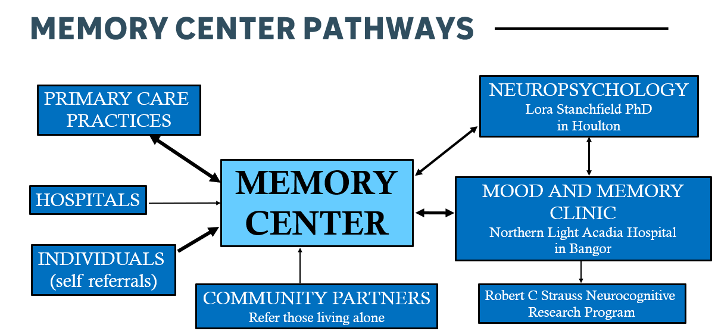
Memory Center Pathways
Notes:
Tag team with Dr. Singer

Slide 13
Caregiver Outcomes
Preparedness
Stress
Isolation
Can manage challenges
Know available resources
Know where to go for assistance
Have opportunities for respite
Can manage stress
Have people they can rely on for help and support
Have people to talk to about caregiving

Slide 14
Persons With Dementia Outcomes
Service Access
Quality of Life
Preparedness
Quality of life is supported (physical and mental health; economic; and social wellbeing; etc.)
Are evaluated, referred to, and access to needed supportive resources
Can manage challenges
Knows resources available to them
Knows where to go for more assistance

Slide 15
Results to Date
27 cases reviewed with Acadia team (MD, RN)
Only 4 cases referred on to Acadia Mood and Memory for in person evaluation
Other cases sent back to primary care provider with recommendations:
  Brain imaging
  Sleep lab referrals
  Driving evaluation
  Palliative care referral
  Medication recommendations
  Maximus assessment for in home services

Slide 16
Off to a Positive Start!
Developing positive relationships with local healthcare providers
Reduced turnaround for services and need to travel long distances
Positive feedback from clients
Positive case outcomes

Slide 17
Challenges and Lessons Learned
Timing to build center, gain approvals, open, and initiate services (1yr process)
Data tracking
Closing the loop between PCPs and speciality services
Managing expectations of referrals to specialty services
Structuring for sustainability
Deferred diagnosis
Notes:
Vi - timing, Data tracking - David, Dr. Singer, Sustainability - Vi, Dr. Singer

Slide 18
Q&A

