Slide 1
Advancing Policy for Older Mainers 31st Maine Geriatrics Conference
Jeanne Lambrew, PhD
Commissioner
Maine Department of Health and Human Services
May 24, 2024

Slide 2
Outline
Maine’s Cabinet on Aging
Community Supports
Long-Term Services and Supports
Workforce Development
Future Directions

Slide 3
1. Maine’s Cabinet on Aging
Created by Executive Order of Governor Mills in 2022
Builds on Governor Mills’ designation of Maine with AARP as an Age-Friendly State in 2019.
Consists of the leaders of:
Staffed by Elizabeth Gattine in the Governor’s Office of Policy, Innovation, and the Future
Department of Health and Human Services | Department of Labor
Department of Public Safety | Maine State Housing Authority
Department of Economic and Community Development | Department of Professional and Financial Regulation
Department of Administrative and Financial Affairs
https://www.maine.gov/future/aging

Slide 4
The Cabinet’s Purpose and Role
To coordinate and advance policy and programming across state government so we can all age safely, affordably, and in ways that best serve our needs and preferences.
To elevate opportunities for inclusion and engagement of older adults.
To promote coordination across State government.
Elevate the Governor's priorities for aging.
Anchor joint staff work.
Communicate across cross-sectoral work and strengthen community partnerships.
To include an "aging lens" across state policies, systems, and
planning.

Slide 5
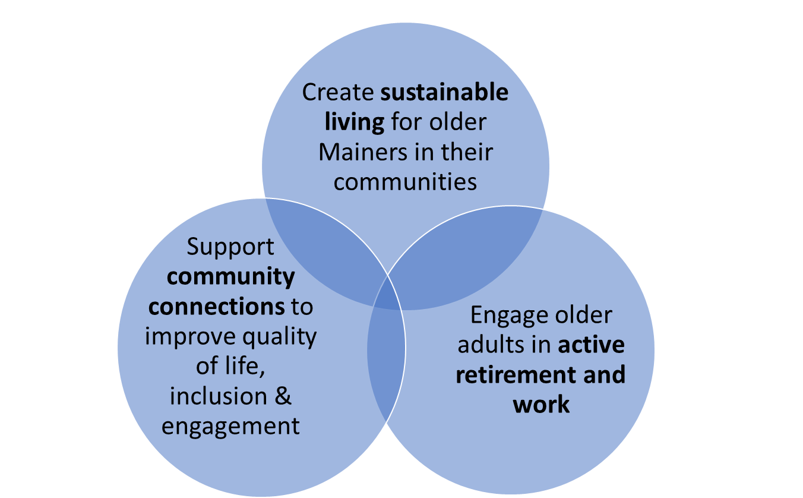
Cabinet’s Focus Areas

Slide 6
Examples of Cabinet’s Strategies
Sustainable Living:
Home sharing programs bring together people who have an extra room in their house with individuals seeking a place to live.
Home sharing can provide companionship and extra income to the homeowner.
Following an RFP process, MaineHousing has contracted with Nesterly for statewide implementation

Slide 7
2. Community Supports
Community Connections Initiative
Purpose is to align strategies around our shared goals and empower Lifelong communities in their work and knowledge of their communities.
Received federal approval for a $2.5 million initiative from the American Rescue Plan to:
Support and training for Lifelong communities to develop pilots to help their fellow residents identify and access desired supports and make it more comfortable to accept help or to participate in social opportunities.
Provide mini-grant funding opportunities for Lifelong communities.
Increase capacity of Area Agencies on Aging to strengthen community partnerships.
Key partners: University of Maine’s Center on Aging and Maine’s Area Agencies on Aging.

Slide 9
Connecting Older Residents to Nutrition, Social, and Health Services
Home-Delivered Meals
$5.5 million annually in state funds to supplement Older Americans Act home-delivered meals – which is also a key program to connect homebound residents to social and mental health supports
Eligibility Assistance
$500,000 million annually in state funds to strengthen Aging and Disability Resource Centers at Area Agencies on Aging
20 Eligibility Specialists to meet growing demand for MaineCare and SNAP
Maine Virtual Access Manager in testing: web-based tool to help individuals conduct self-screenings for services
Expanding Access to Medicare Savings Program

Slide 10
Caregiver Supports: Respite for ME
Funded through the Governor’s Maine Jobs & Recovery Plan
Launched as a pilot program in October 2022
Provides grants for unpaid family caregivers providing care to loved ones at home
Year 1 results at $2,000 per grant:
50% of caregivers had lower overall burden scores.
Negative impacts on job performance decreased by 16%
High financial strain decreased by 13%.
339 family caregivers served
$541k in grant funds expended
Year 2 results (as of May 1, 2024) at $5,171 per grant:
572 family caregivers served
$1.16m in grant funds expended
Caregiver outcomes pending
Notes:
50% of caregivers had lower overall burden scores.
Negative impacts on job performance decreased by 16%.
High financial strain decreased by 13%.

Slide 11
Caregiver Supports: TCARE
TCARE® is the Tailored Caregiver Assessment and Referral care management protocol
Grounded in Caregiver Identity Theory and is designed to identify measures of caregiver burden and stress
TCARE® measures:
Identity Discrepancy
Intention to Place
Relationship Burden
Objective Burden
Stress Burden
Depression
Uplifts
TCARE® has been incorporated for caregivers participating in the Respite for ME Grants pilot program and will be used more broadly in the future

Slide 12
Caregiver Supports: Adult Day
Developing pilot initiative for licensed Maine-based Adult Day Centers to improve access to Adult Day Services
Pilots must address one of three areas of focus:
Enhancing person-centered programming
Improving access to Adult Day Services
Increasing Adult Day Service utilization
Rebrand and market to promote the benefits of Adult Day Services for caregivers and eligible individuals

Slide 13
Caregiver Supports:
Mental Health First Aid and Family to Family
Contracted with the National Alliance of Mental Illness (NAMI) Maine to deliver two national best-practice education programs: Mental Health First Aid (MHFA) and Family to Family(F2F)
Focuses on providing strategies and tools to family and/or formal caregivers supporting adults living with physical disabilities and mental health challenges
Completed 9 sessions to a total of 71 caregivers since May 2023
Training will continue quarterly until March 2025

Slide 14
Strengthening Elder Justice
Provided permanent state funding for Elder Service Connections, operated by Maine Elder Abuse Institute to provide auxiliary supports to older adults in Adult Protective Services (APS) situations and help them make positive changes in their lives
Added 10 APS positions, including a dedicated supervisor for the financial exploitation team
Reintroduced the annual APS report
Adoption of APS rule revisions to, among other improvements, make all substantiated perpetrators subject to listing on the registry (previously only applied to those working in intellectual disability)

Slide 15
3. Long-Term Services and Supports
Strengthening Home Care
State funded home care (Section 63) received sufficient funding to increase enrollment by 50%
MaineCare home care programs have also expanded although one of those programs (Section 96) is currently constrained by service coordination capacity
Implementing this summer the Department’s proposal to license personal care agencies to improve quality, person-centeredness, and consistency of care

Slide 16
Expanding Enrollment in Home Care

Slide 17
Nursing Facility Challenges
Occupancy has improved sine the depths of the pandemic but has not fully recovered

Slide 18
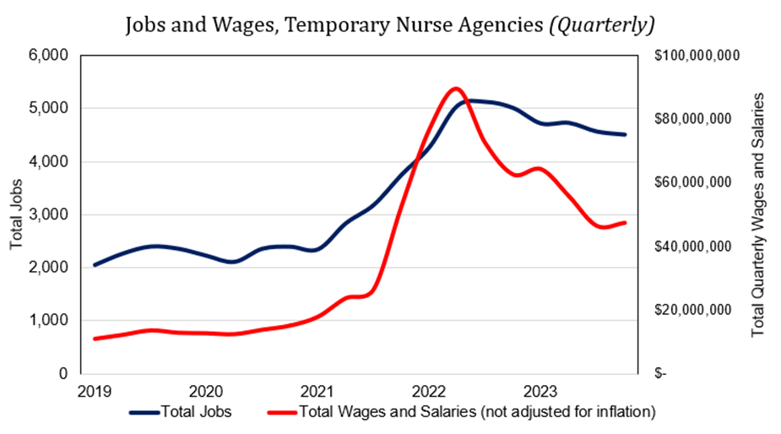
Temporary Staff Costs Remain High

Slide 19
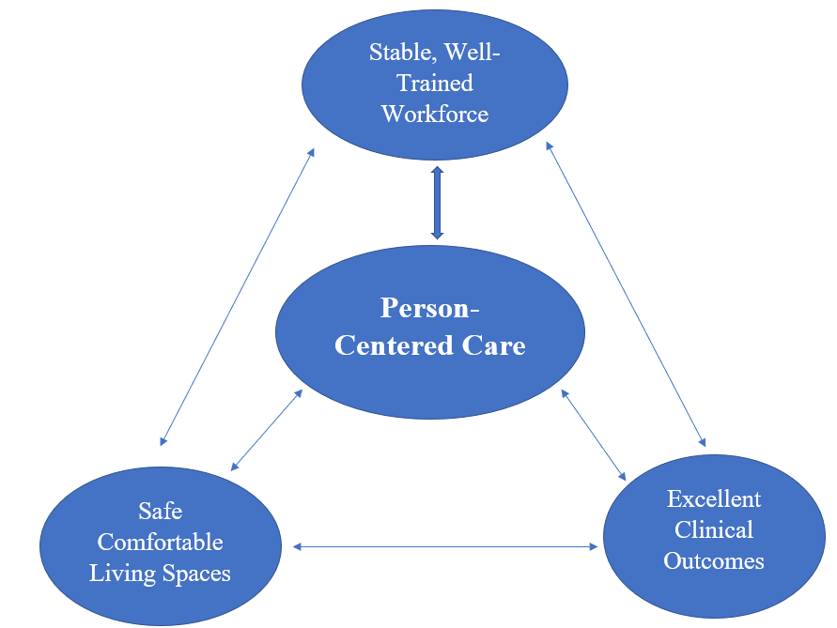
Improving Nursing Facility Access and Quality
Supplemental Budget
Rate reform supported by the supplemental budget will:
Emphasize direct care staffing, providing funding for staffing well above state and federal minimums
Provide incentives to reduce contract staffing
Tie payment to quality for the first time
Reduce administrative burden for providers and the department
Take effect January 2025

Slide 20
4. Workforce Development
Intensified Work after the Pandemic
Recruitment and Retention:
$121 million in direct care worker bonuses
MaineCare rate reform
Sharing of best practices; Health Workforce Summit
Workforce Development and Training:
Jobs for Maine Graduates, Pre-apprenticeships
Tuition remission programs, Navigators
Credentialing Alignment:
Moving toward greater consistency (e.g., minimum age to do a certain task)
Crosswalk existing curricula against national best practice standards.
Align baseline credentials to create a more portable credential across provider types and settings

Slide 21
Direct Care and Support Media Campaign
Building on Caring for ME, a new media campaign titled:
Careers with Purpose
Connecting Lives, Advancing Community
is currently being developed and will be rolled out in the Summer of 2024

Slide 22
Maine’s First Direct Care and Support Professional Advisory Council
Direct Care and Support Advisory Council
Mission: Create a strong collective voice that offers expertise and guidance to policymakers and legislators on key workforce issues and initiatives
Vision: Recognized by policy makers as Maine’s primary resource for workforce issues
Membership: Council membership represents the diversity of Maine’s workforce. Members are employed across all long-term care service and support settings

Slide 23
5. Future Directions
Finish the Job
Prepare for the Unexpected
Climate change impact
Violence prevention
Solidify and Institutionalize Processes and Systems
Improve Inclusiveness From Start to Finish – and Then Some – in State Programs for Older Mainers

