Slide 1


Harnessing our Power in Aging
Changing the Conversation about Aging in Maine
Hosted by the Maine Council on Aging ● Funded by the Point32Health Foundation
_________________________________________________________________
Jess Maurer, Executive Director, Maine Council on Aging
Maureen O’Connor, Director, Power in Aging Project

Slide 2
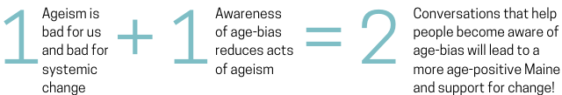
Power in Aging – Built on Simple Math!
Notes:
In 2021, MCOA launched an anti-ageism movement in Maine called the Power in Aging Project, funded by the Maine Community Foundation, Maine Health Access Foundation, Point32Health Foundation, John A. Hartford Foundation and others.
The goal of Power in Aging is to build a more age-positive culture in Maine through conversation and action.
To support action, we are building a cadre of “power trainers” available to follow up with in-depth presentations/conversations and technical assistance at your workplace.

Slide 3
Why do we need to harness our power in aging?
Older people are our .

Slide 4
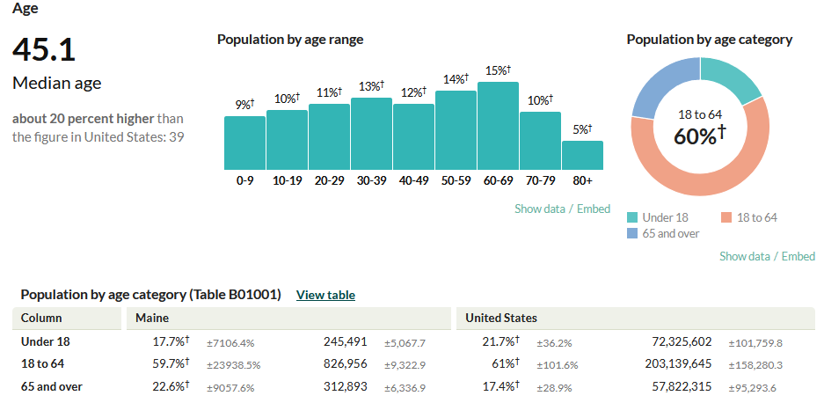
Maine’s Demographics

Slide 5
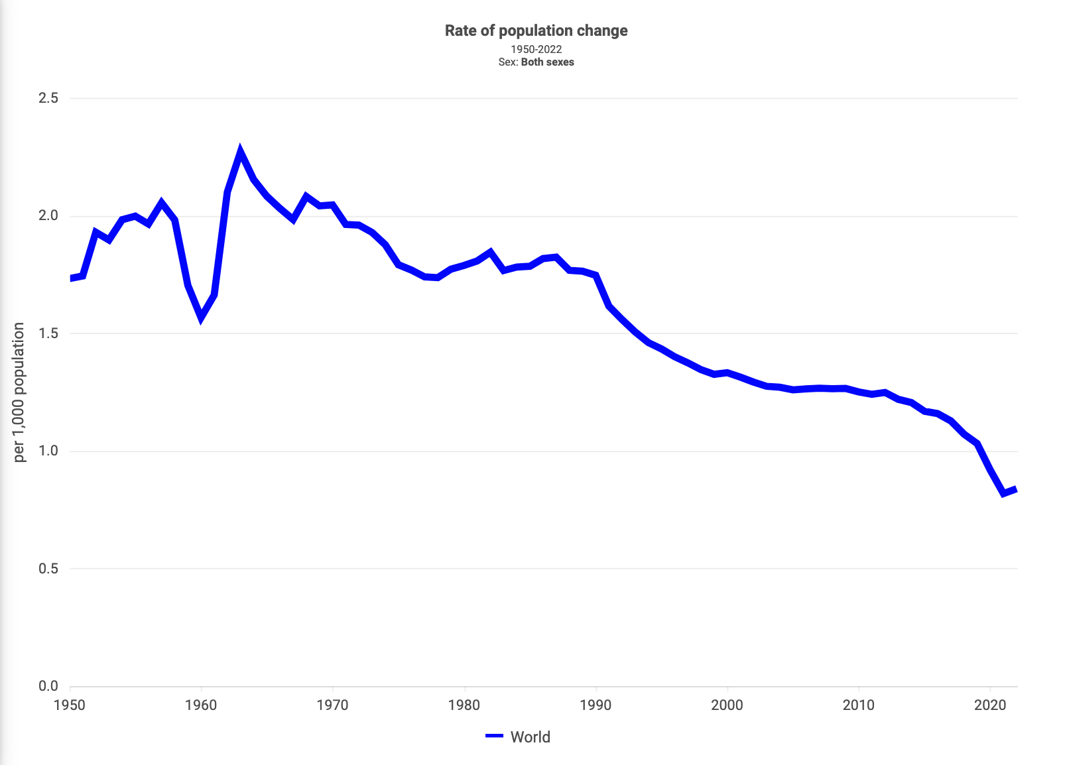
Source:
Jennifer Sciubba,
Author, 8 Billion & Counting

Slide 6
Worldwide Birthrate shift
Year 1968
Year 2022
Women had 5+ children on average
Women had ≤2 children on average
Source:
Jennifer Sciubba
“This shift towards fewer babies is permanent and not a problem to be solved…That’s why I always start by putting this in global context. This is not some fluke; this is not an exception; this is a permanent shift the likes of which we’ve never seen before.”

Slide 7
Migration won’t solve our workforce shortage
“We have the world’s largest stock of migrants in the US. So, we tend to think global migration is really high. But really, 2 to 4 percent of people live outside the country in which they were born. There are actually far more older people worldwide than there are migrants. If you look at those ages sixty-five to seventy-four, there are about 200 million more of them than all global migrants.”
Jennifer Sciubba, International Demographer

Slide 8
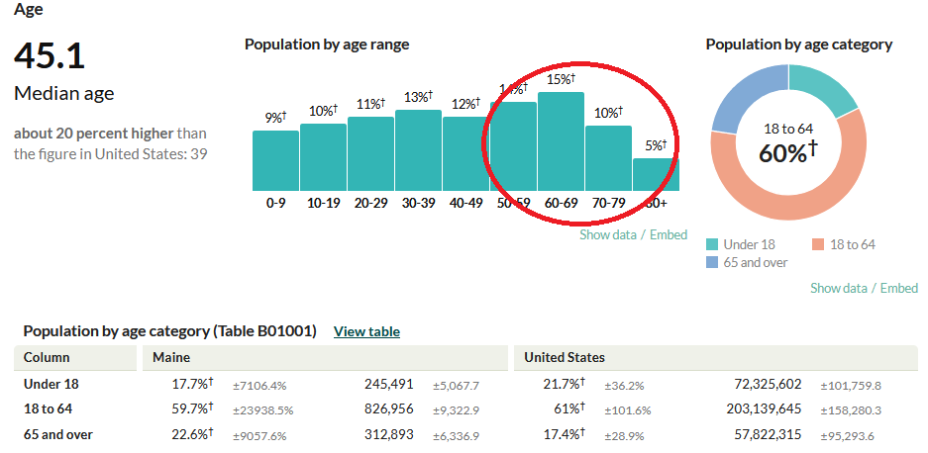
Why are we overlooking this solution?

Slide 9
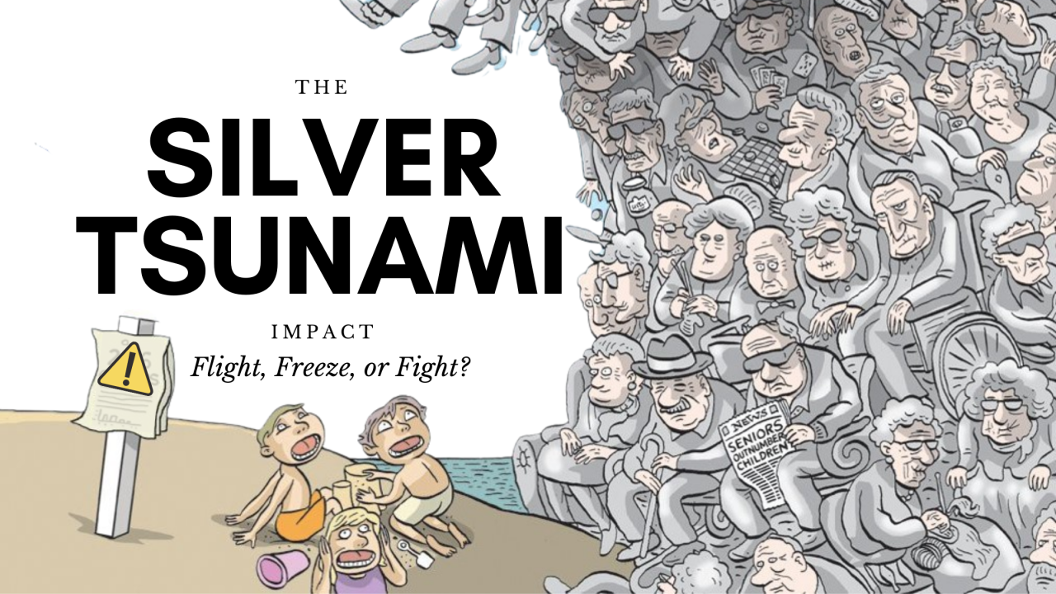
The wave we’ve been sold
Cartoon by Graham Mackay – approved to be shared.

Slide 10
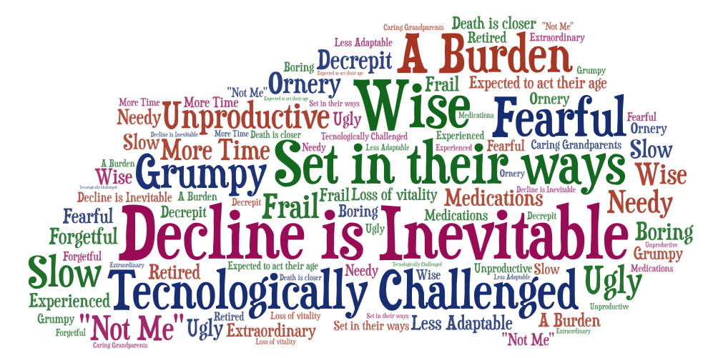
Messages about Aging and Older People
Word Cloud from a group sharing on messages, stereotypes, assumptions, attitudes, or beliefs about aging and
older people.

Slide 11
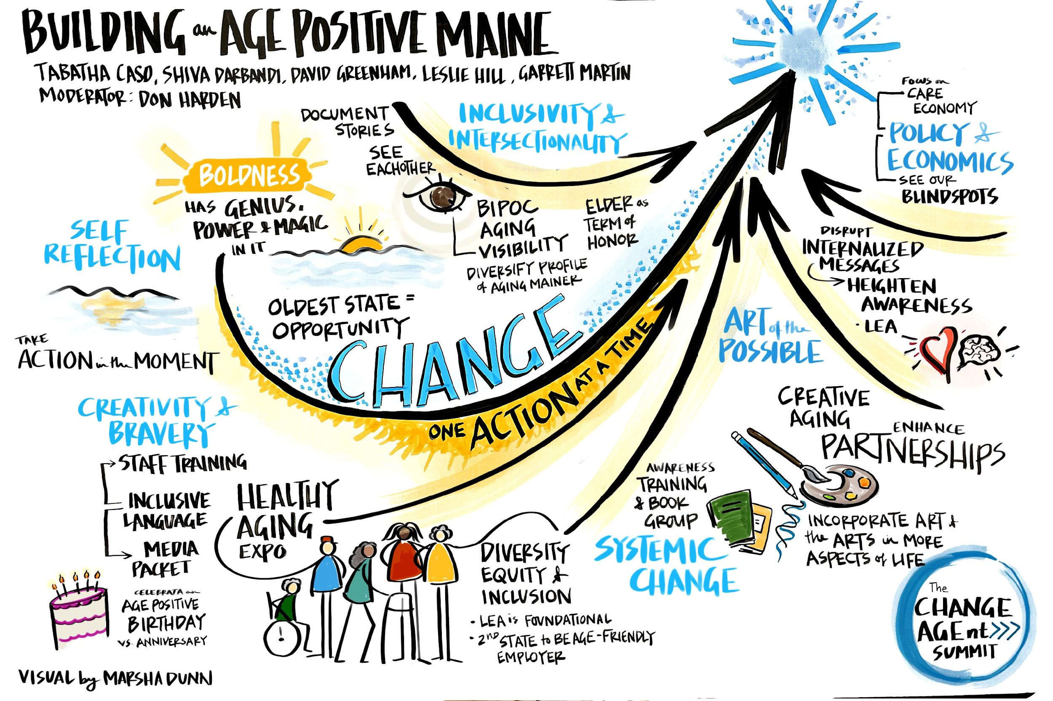
The wave we’re riding

Slide 12
Effects of Age-Positive View/Culture
Older people who embrace positive views about aging and who have purpose:
Live 7.5 years longer than those with less positive perceptions of aging
Are 44% more likely to recover after experiencing a new disability
Experience less depression and anxiety
Have less cardiovascular disease, produce less cortisol (a stress hormone) over time, and autopsy findings show less dementia
Have fewer chronic conditions

Slide 13
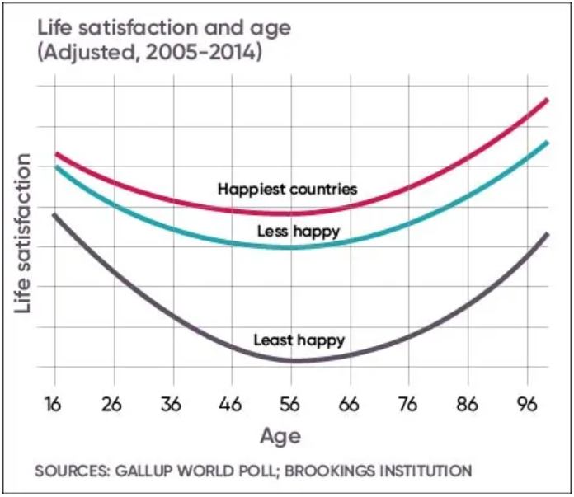
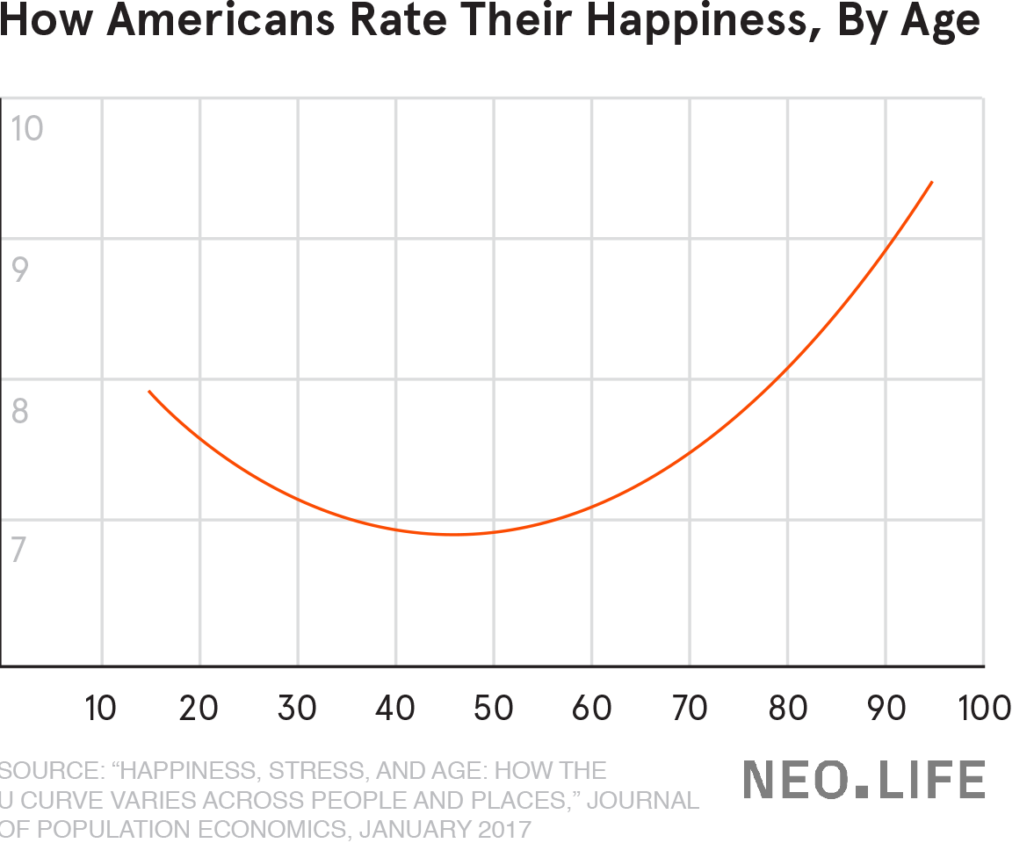
Life gets happier with age
Even joy and gratitude have been proven to reduce stress, increase sleep, and reduce serious health events like strokes.

Slide 14
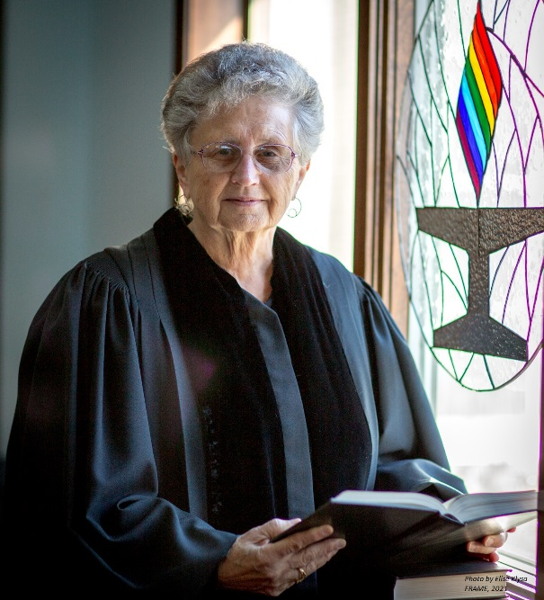
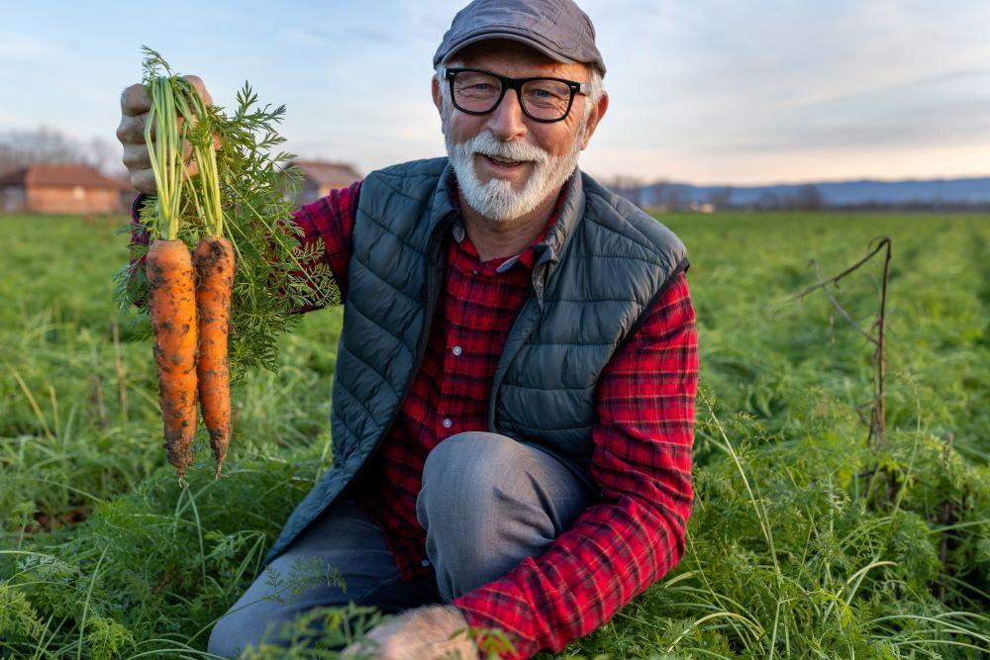
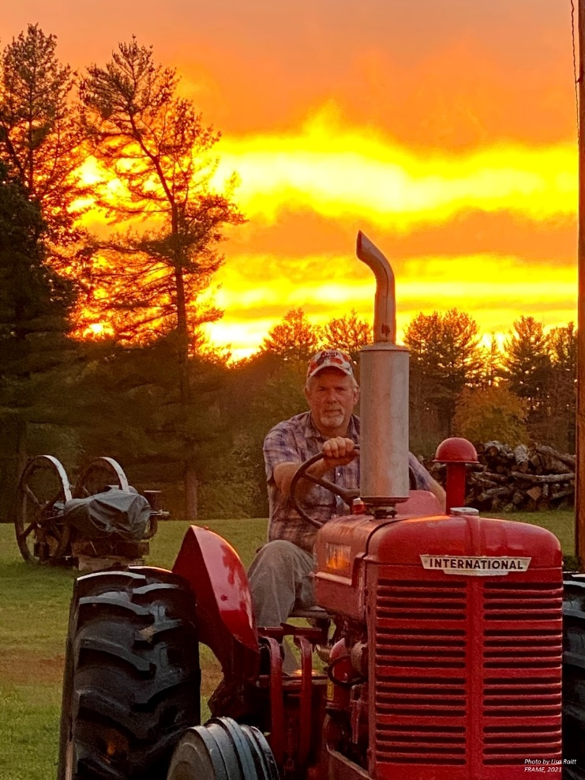
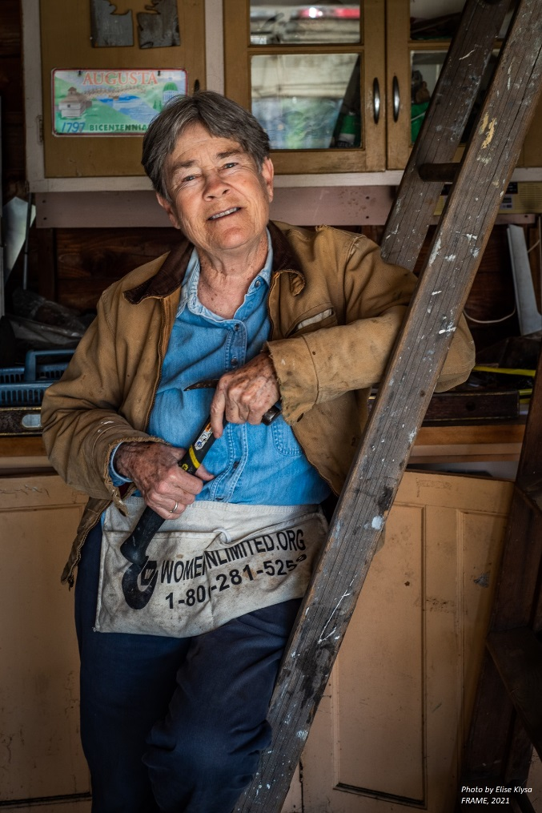
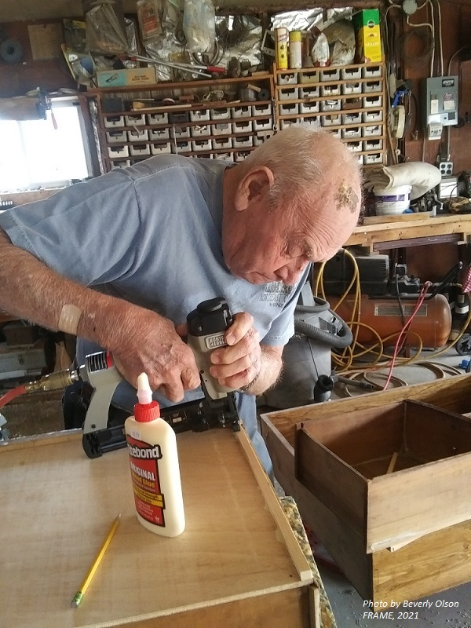
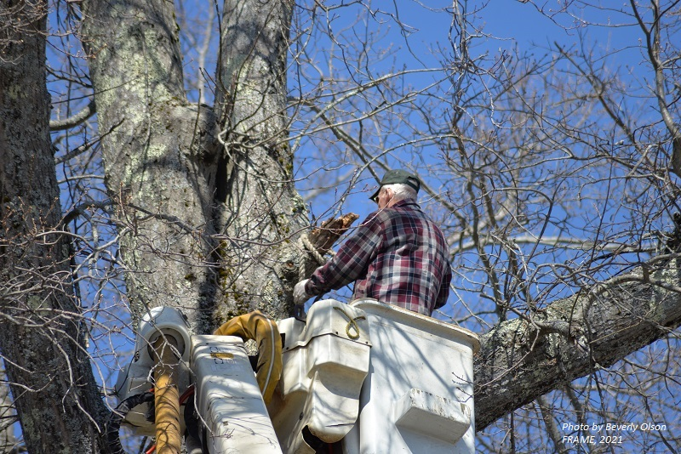
How can we harness our full power in aging?

Slide 15
Start by Ending Ageism
“Ageism pervades many institutions and sectors of society, including those providing health and social care, the workplace, the media and the legal system.”
“Ageism…is associated with a shorter lifespan, poorer physical and mental health, slower recovery from disability and cognitive decline.”
WHO Global Report on Ageism, March 2021

Slide 16
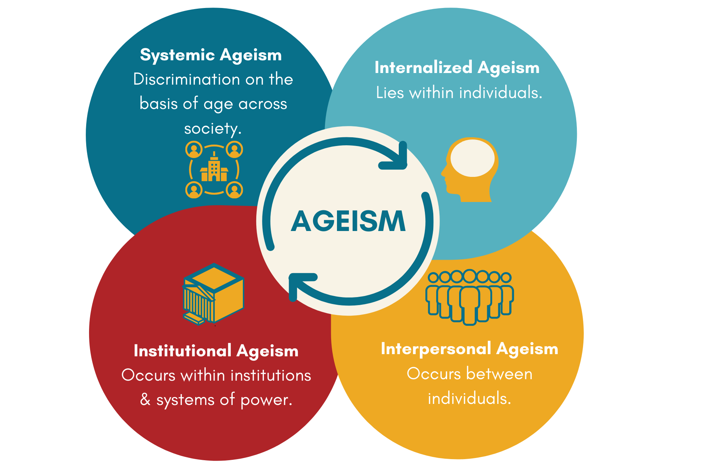
Ageism at Work

Slide 17
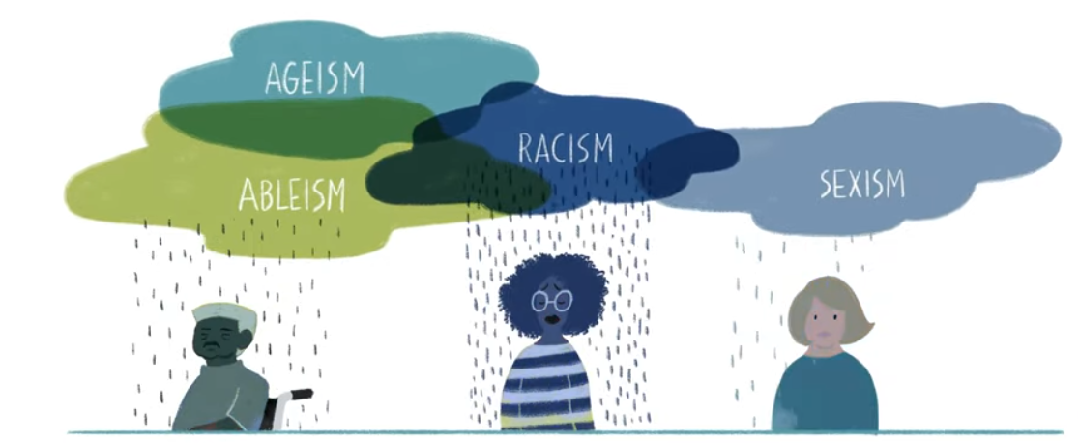
Ageism and other systems of discrimination
Disparities from other systems of discrimination (race, gender, rurality, class, sexual orientation, ability, etc.) all get worse as people age.
Other systems of discrimination are ALSO operating at all four levels and ALSO affect messages, resources and rules.

Slide 18
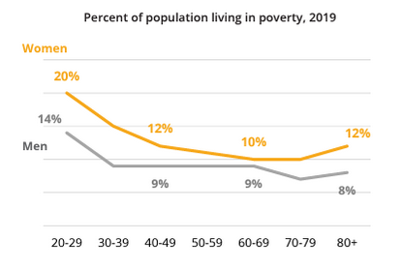
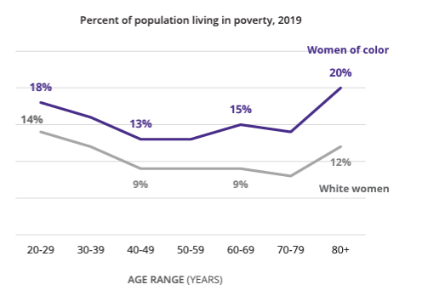
The intersection of age, gender, race and poverty
Notes:
Women are more likely to live in poverty than men across the board
And women of color are more likely to live in poverty as white women and that increases as we are

Slide 19
Pair Share – Turn to a Neighbor
We’re good at activating age-negative stereotypes, how can we be better at activating and holding age-positive beliefs?

Slide 20
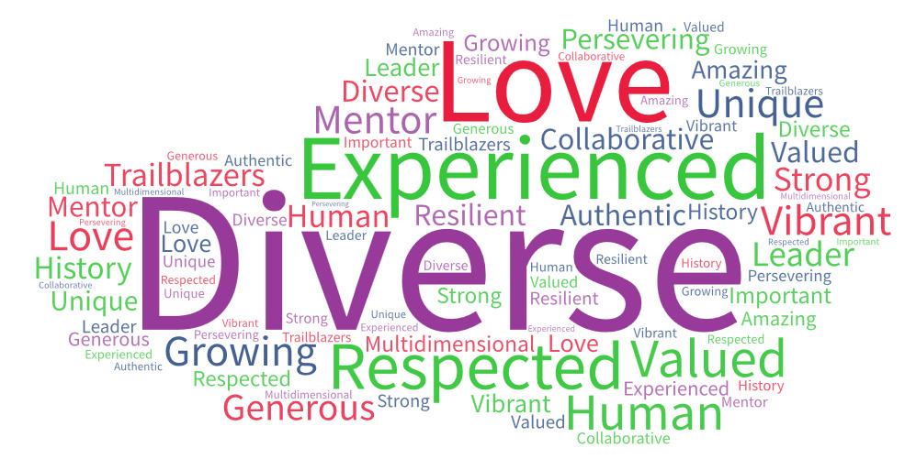
Flipping the Script on Ageism
Word Cloud from a group sharing positive messages about aging and
older people.

Slide 21
Reducing Internalized Ageism
It can be unlearned – but not from a single training; it takes lots of repeated practice.
Prejudice is a habit of the mind.
Shame mindset – “I am biased, I am a bad person” – does not result in change.
Growth mindset – “I have been shaped by a biased system, I’m not okay with that, and I’m going to change it” – does result in change.

Slide 22
Reducing age-bias starts with us!
Don’t participate in sharing ageist messages.
Call people (gently) out for ageist remarks.
Include yourself - we’re all aging. Shift to “us” instead of “them.”
Live your age - lead by example by embracing your own age and the accumulated skills and knowledge that come with aging.
Use neutral words to describe older people - avoid “senior” “elderly” “elder” - let’s just call them people - or older people if you have to.
Avoid painting all older people with the same brush.
Build defenses against the ageism present in everyday culture.
Take every chance to learn more about age-bias.

Slide 23
Pair Share – Turn to a Neighbor
How could our own internal age-bias (stereotypes about older people) get in the way of the mission/vision/goals of our organization – how might ageism be impacting your workforce, the people you serve, or both?

Slide 24
Ageism at Work
Devaluing someone’s ability (too old to understand new technology)
Discrediting someone’s capacity (talking to caregiver instead)
Disrespecting or patronizing “elder speak” (sweetie, honey)
Ignoring the person’s points of view in decision-making
Using an overly accommodating tone and simple vocabulary
Overcompensating for an older person’s presumed needs
Superimposing your beliefs about quality of life on an older patient
Notes:
What about going through this list, which is general - through the workplace.

Slide 25

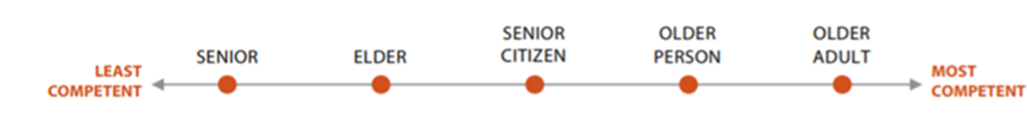

What Americans think…
How do American’s view words describing older people:
From FrameWorks Institute

Slide 26
Language Matters

Slide 27
AMA Manual of Style
“Discrimination based on age (young or old) is ageism.
Because terms like seniors, elderly, the aged, aging dependents, old-old, young-old, and similar "other-ing" terms connote a stereotype, avoid using them.
Terms such as older persons, older people, older adults, older patients, older individuals, persons 65 years and older...”
Notes:
Open notes – patients will be reading what we write.

Slide 28
Elderspeak
Refers to the way some people speak to older adults:
Automatically Speaking Slowly & Loudly
Using a high-pitched voice
Using terms of endearment such as honey, dear, sweetie
Speaking to an adult as if they were a young child
Speaking to the caregiver instead of the older person

Slide 29
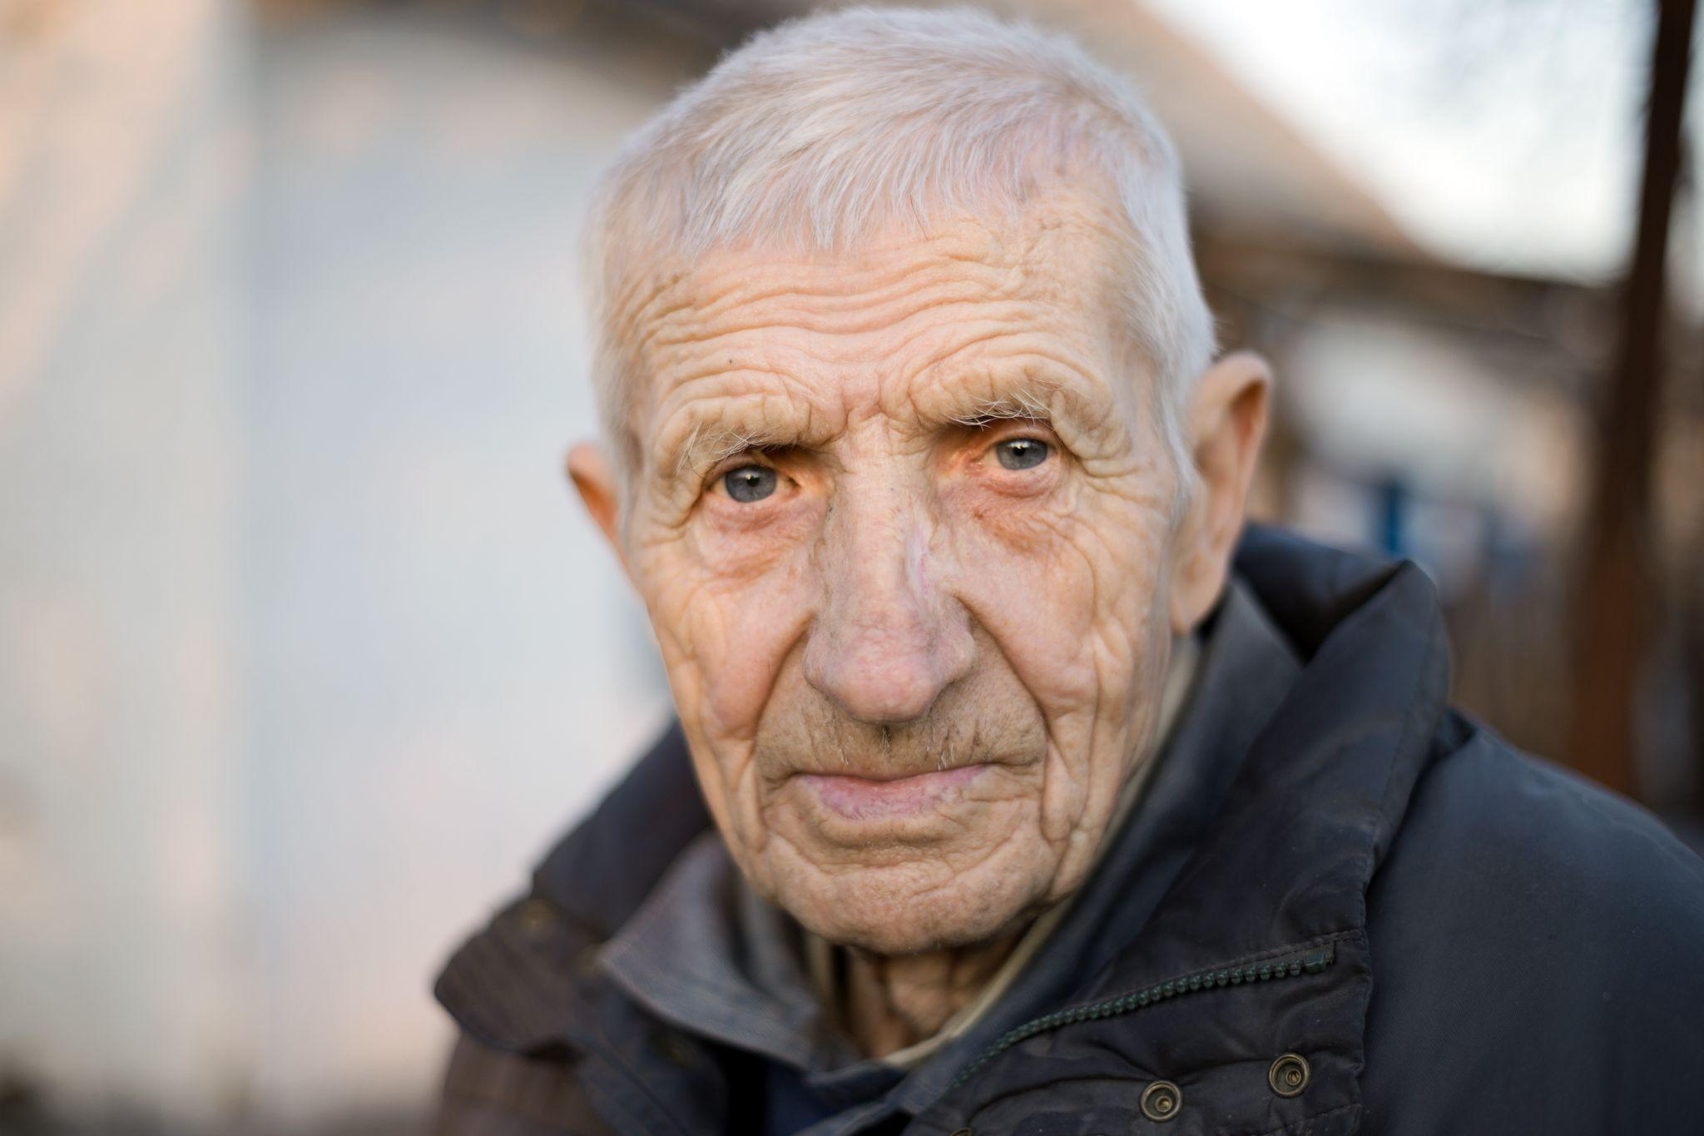
Elderspeak: Why not?
It’s degrading and patronizing
Contributes to depersonalization
Implies power/ powerlessness
Conveys presumed incompetence
Increases challenging behavior

Slide 30
Elderspeak: Avoid it!
Focus on the older person (as much as possible, even if they have limited capacity)
Individualize – don’t rely on stereotypes
Avoid speech mannerisms of elderspeak
Ensure that people around you know about elderspeak and avoid it

Slide 31
Preventing Ageism in your Organization
Include ageism in your organization’s Diversity, Equity, & Inclusion program
Train HR managers and supervisors on ageism and implicit age-bias
In a clinical setting, make sure clinicians are trained and implementing disrupting practices
Address unintended and overt age discrimination directly:
Hold employees accountable for interpersonal acts of age-bias.
Call out age-based stereotypes, bias, humor, comments, and jokes.
Language matters: use “older people/person” or “older adults”
Avoid painting all older people with the same brush – check out the messages you send by the images you use on webpages/social media.

Slide 32
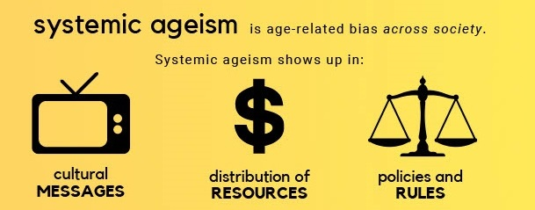
Overcoming Systemic Ageism

Slide 33
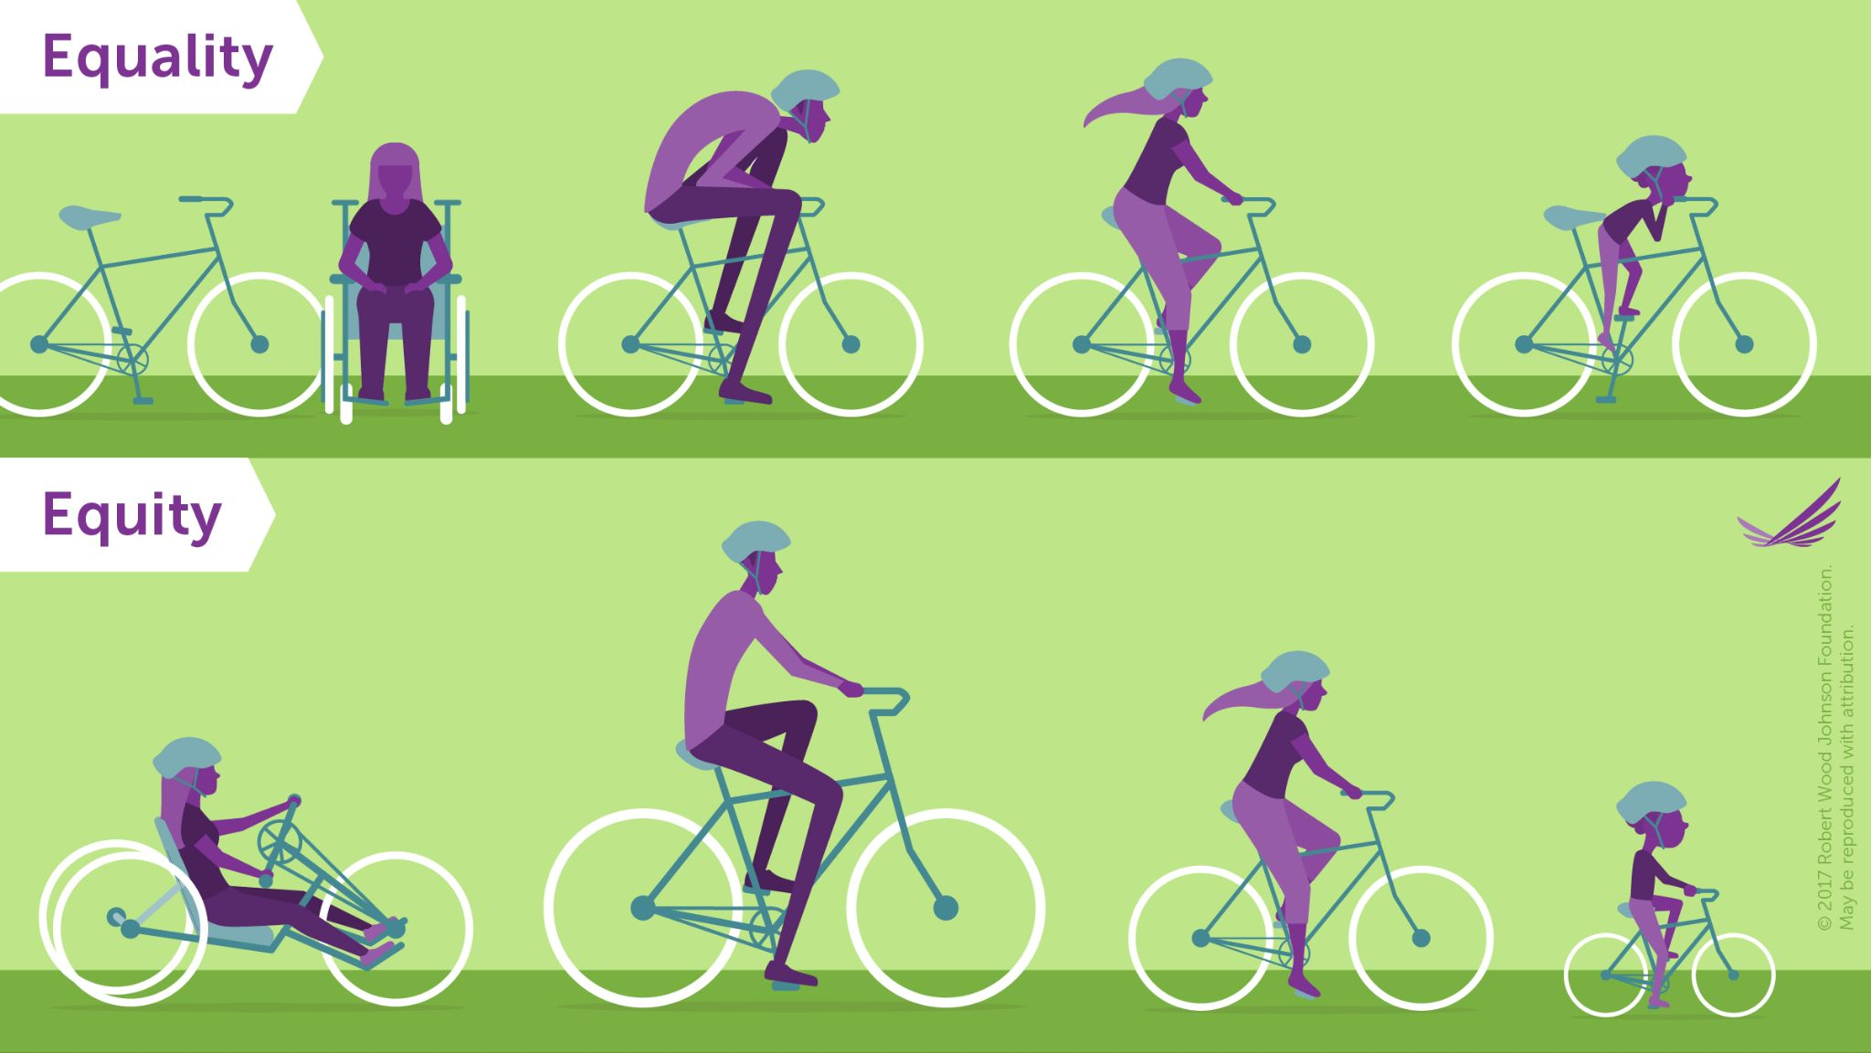
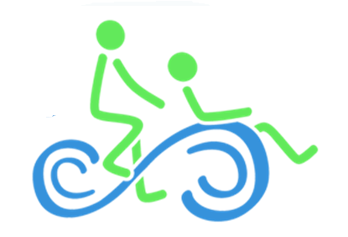
Age Equity

Slide 34
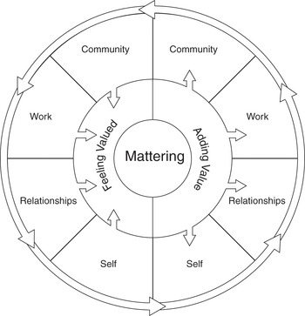
Getting to what “matters” – An Age Positive Culture
Mattering = feeling valued and adding value
Feeling valued = inclusion and belonging
Adding value = purpose
Purpose, inclusion & belonging = better physical and mental health, longer more productive life!
Cambridge University Press, Understanding & Promoting Mattering Framework

Slide 35
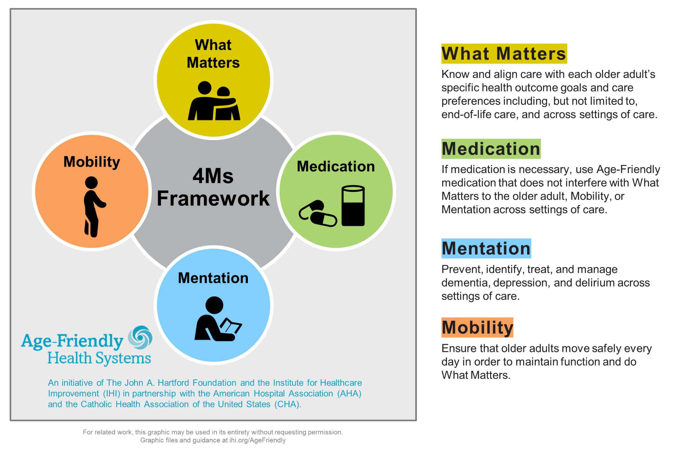
An Age-Equity Lens in Healthcare
Equity acknowledges difference and explores how an organization can be deliberately inclusive to promote fairness and correct systemic injustices.
We have not built care systems to intentionally meet the needs of older people.
An “age equity lens” offers tools we can use to interrupt the impact of unintended age-bias.

Slide 36
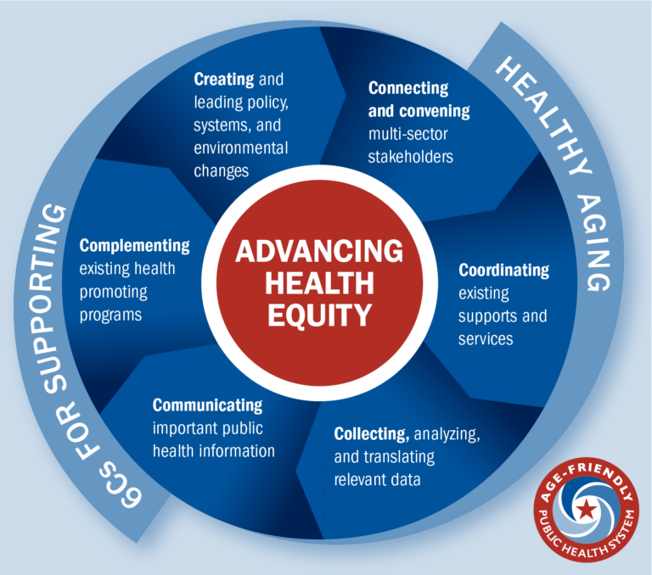
Use the Age-Friendly Public Health Framework
For more information, visit: https://www.tfah.org/initiatives/age-friendly-public-health/

Slide 37
What if we shifted & realized our power?
What if…
we change our perspective about our own aging and embrace the view that an age-positive culture is key to a longer, healthier life?
we disrupt our stereotypes about older people and embraced older people fully as a critically important part of Maine’s future?
we build pathways to purpose and a sense of belonging for everyone?
We think the future will be brighter and that our communities, economy and workforce will be stronger! What’s to lose?

Slide 38

Age+ ME – How to Join the Movement
Maine is the first state in the country to launch a statewide initiative to end ageism. Join us through one of our programs or bring us into your work.
Leadership Exchange on Ageism – 14-hour intensive peer learning experience – 200 leaders have graduated
Disrupting Ageism Intensive – 7-hour in-service for leadership teams
Power in Aging Presentations – 90 minutes for everyone – great start!
Community Conversations – 4 week in-community program
Reducing Ageism in Healthcare – training for HC teams
Ageism Audits – surfacing ways to improve w/TA

Slide 39
Thank you!
Questions?

