Slide 1
Having the Leqembi® Conversation
Cliff Singer, MD, DLFAPA, AGSF
Center for Cognitive and Mental Health
Robert C. Strauss Neurocognitive Research Program
Northern Light Acadia Hospital

Slide 2
Disclosers
I have no financial ties to Eisai or any other conflict of interest, financial or otherwise with regards to lecanemab.
I am the principal investigator of several clinical trials involving other potentially disease-modifying drugs and non-drug interventions.

Slide 3
Learning Objectives:
At the end of this session, participants will…..
Have improved confidence in opening the discussion on new anti-amyloid therapy options for Alzheimer’s disease.
Be able to list three inclusion and three exclusion criteria for who is appropriate for these treatments.
Demonstrate knowledge of potential benefits and risks of these new treatments.
Be able to discuss alternate options to anti-amyloid monoclonal antibodies for patients with Alzheimer’s disease.

Slide 4
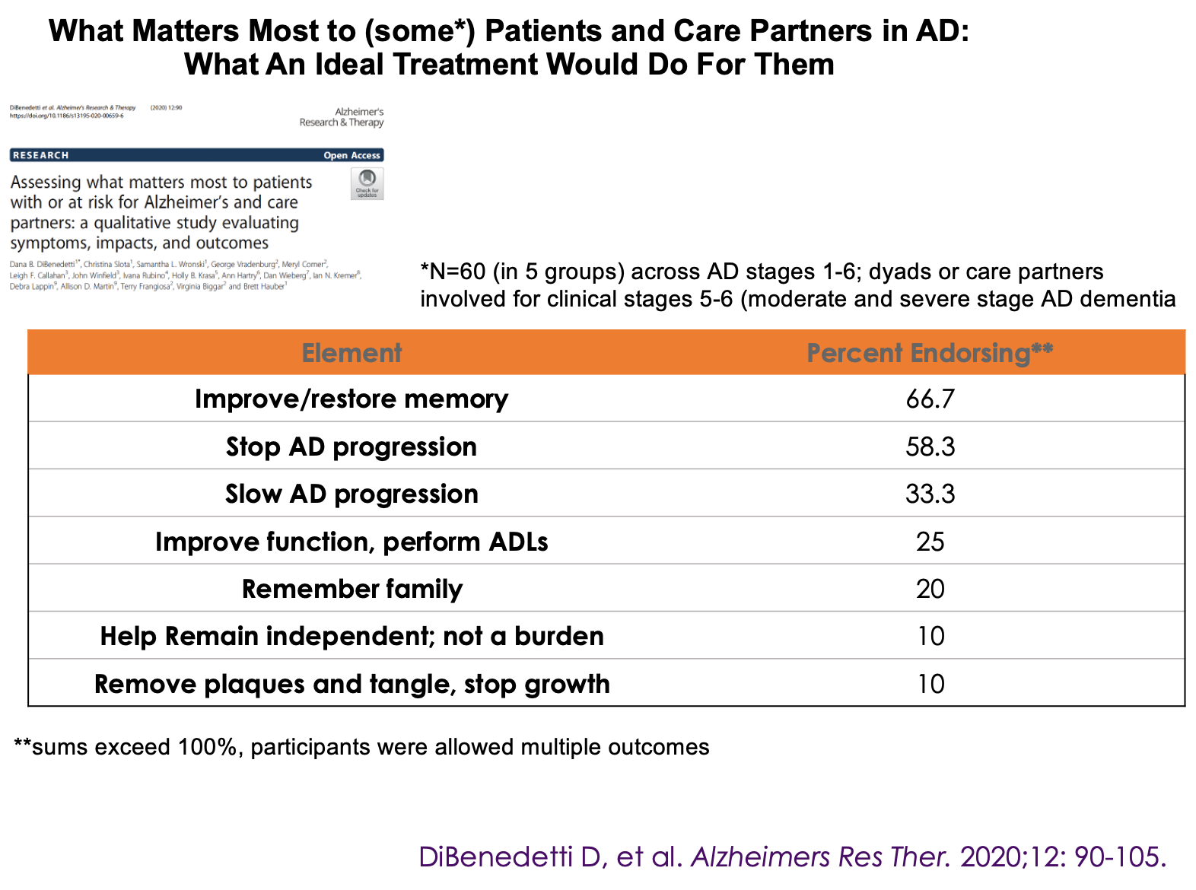
What Matters Most

Slide 5
Primary Protein Biomarkers of Common Dementias
Hampel H et al. Trends in Neurosciences 2023; 46:3:176-198
Aβ (amyloid)
Alzheimer’s disease
Lewy body disease
Alpha-synuclein
Lewy body disease
Parkinson’s disease
Multisystem Atrophy
Each condition also
has associated
genetic biomarkers
Tau
Alzheimer’s disease
Progressive supranuclear palsy
Corticobasal degeneration
Frontotemporal dementia bv
Primary progressive aphasia
TDP-43
ALS
FTD/MND
Semantic dementia
LATE

Slide 6
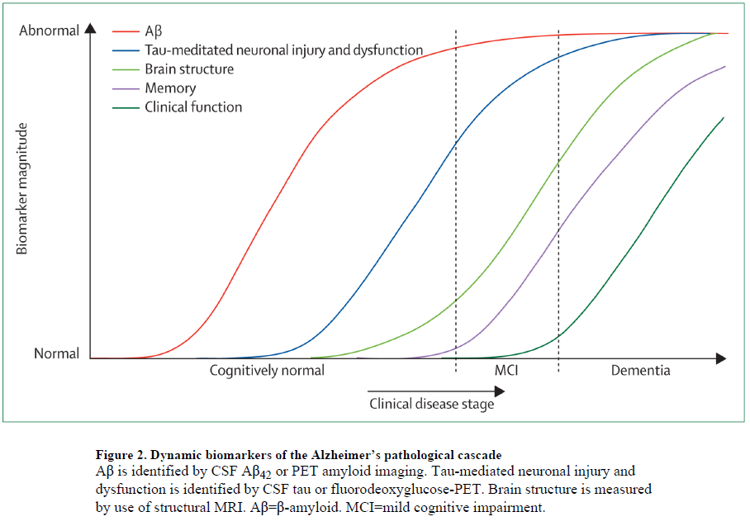
Hypothetical Progression of AD Pathology
Jack CR et al. Lancet Neurology 2010

Slide 7
Prevalence of Neuropathology by Age
Jack C et al. Lancet Neurology 2014

Slide 8
AD is More Complicated Than Beta-amyloid
Neuroinflammation
Increased deposition of Aβ in the brain to form amyloid plaques
Han S, et al. Sci Rep. 2017;7:43577
Medina M et al. Alzheimer's Dement. 2017 Sep 19;3(4):571–578
Love S and Miners JC. Acta Neuropathol. 2016;131(5):645–658; 4. Jackson J et al. Front Neurosci. 2019;13:735.
Progressive neuronal and synaptic degeneration
Hyperphosphorylated tau and neurofibrillary tangle formation
AD
Pathogenesis
Neuronal dysfunction
Oxidative stress and injury
Cerebrovascular disease

Slide 9
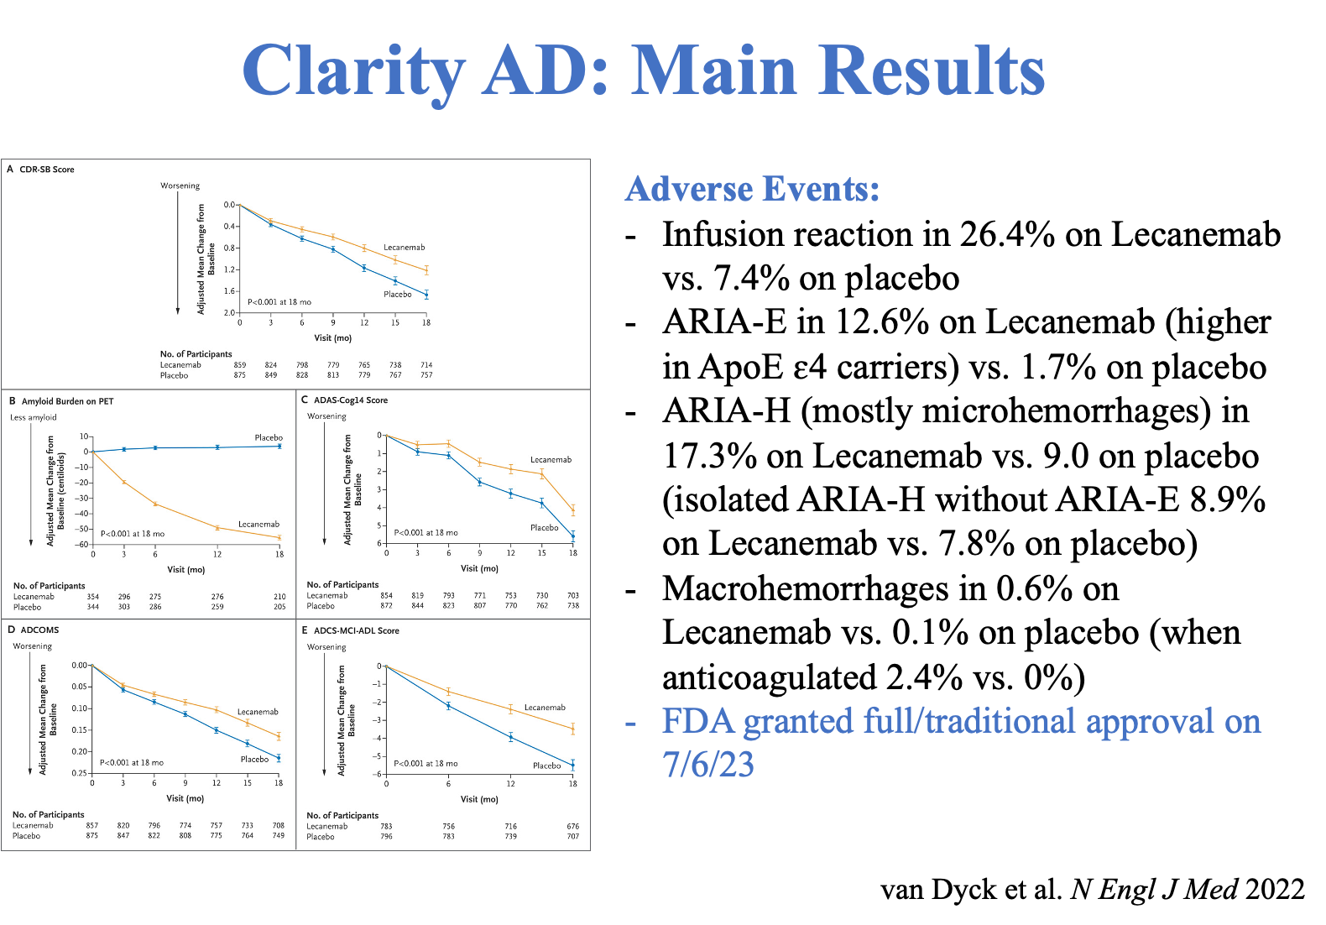
FDA Approval for Lecanemab Was Based on Clarity Data

Slide 11
Talking Points for Education and Consent
Lecanemab belongs to a class of drugs known as “mono-clonal antibodies” (MCA). These are drugs that stimulate the body’s immune system to attack and digest specific proteins that can cause disease. Lecanemab is currently the only MCA available to treat Alzheimer’s disease (AD). This is a true advance in treatment options.
Lecanemab works by binding to different forms of a protein called beta-amyloid that is thought to initiate the process of AD that eventually leads to dementia.
  The binding to beta-amyloid targets it for removal by the brain’s immune system.
Because lecanemab interferes with the process of AD, it is known as a “disease modifying” drug, rather than just helping with cognitive symptoms, as standard treatments do.
Lecanemab, like other drugs in its class that are not available for clinical use, is highly effective at removing amyloid from the brain
  There is some evidence that this also slows the spread of tau in the brain (in the form of neurofibrilary tangles)

Slide 12
Talking Points for Education and Consent II
4. While lecanemab appears to slow disease progression, it may not improve symptoms, although it can delay the decline of function.
5. There is some debate whether the degree to which lecanemab slows disease progression is really meaningful in daily life.
  It is estimated that lecanemab treatment, on average, provides an additional 5 to 6 months of sustained function over an 18-month course of treatment. Whether treatment beyond 18 months yields more benefit is not yet known.
6. Lecanemab is given every two weeks through an arm vein at an infusion center. Each treatment takes about one hour.
7. Treatment should be given for at least 18 months. Studies are underway to determine whether treatment beyond 18 months is necessary.
8. Lecanemab seems to be more effective when it is given to people with earlier stages of AD; mild cognitive impairment or at most, mild dementia.

Slide 13
Talking Points for Education and Consent III
9. To be legible for lecanemab, a person’s AD needs to be confirmed by special testing that may involve a spinal tap (“lumbar puncture” or LP) to confirm levels of beta-amyloid in cerebrospinal fluid (CSF) that are consistent with AD as a primary cause of cognitive symptoms.
  The test will also determine levels of tau for stage of disease and best response to treatment
11. In some cases, a blood test to confirm amyloid and tau levels may be an acceptable substitute for the CSF analysis, but Medicare may not pay for this test.
12. A previous amyloid PET scan (special brain imaging to confirm amyloid plaque deposits in the brain) may be acceptable in lieu of LP or plasma test

Slide 14
Talking Points for Education and Consent IV
13. Before treatment, a blood test will be done to determine your genotype.
APOƐ4 homozygous status will likely exclude you.
14. A recent brain MRI is also necessary to determine eligibility for lecanemab.
  Evidence of cerebral amyloid angiopathy, previous hemorrhage, multiple lacunar strokes will make treatment unacceptably high risk.
15. Treatment with lecanemab carries substantial risk.
  The risk of brain swelling (edema) or brain bleeds (micro-hemorrhages) is in the range of 10- 40% depending on your genes and other factors.
  16. Brain MRIs will be done every few months to look for these complications, known as “ARIAs”. These complications can occur without symptoms.
      Routine brain imaging is necessary to detect ARIA.

Slide 15
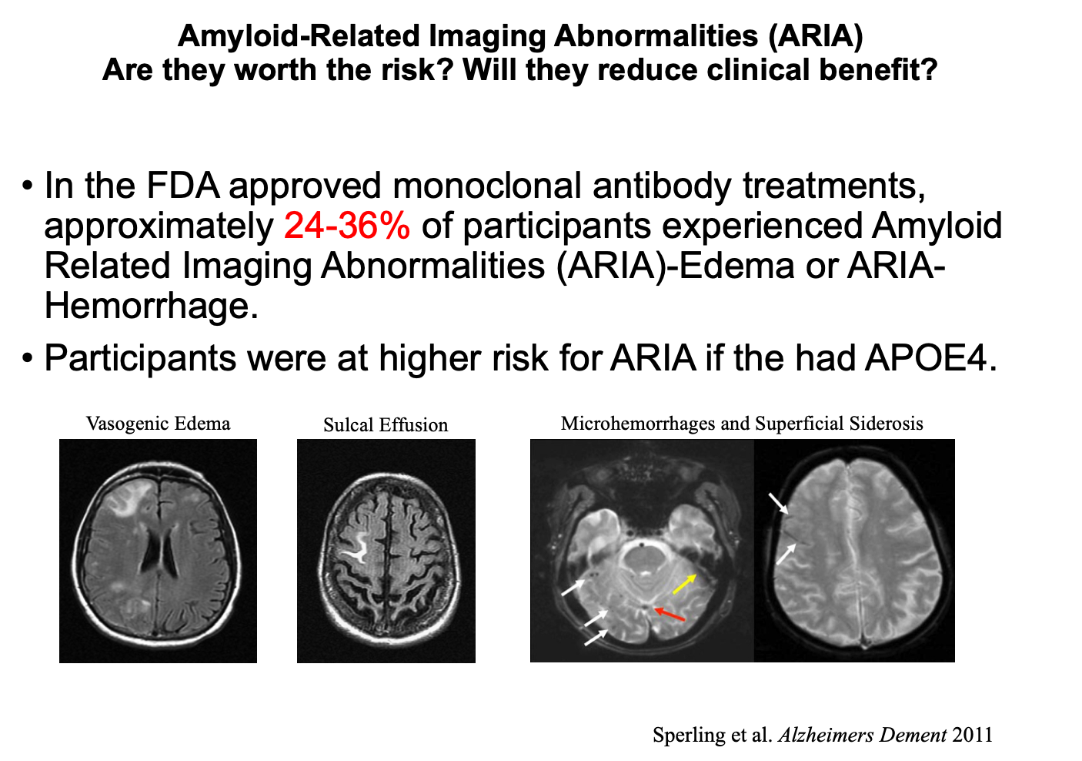
ARIA

Slide 16
Talking Points for Education and Consent V
14. Once ARIA are detected, treatment will be discontinued, at least temporarily.
The most frequent symptoms of ARIAs are headache, confusion, dizziness, changes in vision, nausea, or difficulty walking. These symptoms are generally mild and temporary, resolving in days or a few weeks. Depending on the severity of symptoms, treatment can be cautiously restarted once symptoms and the edema on brain scans clears.
Treatment with lecanemab is expensive. The drug itself costs about $26,000 per year, 80% of which would be paid by Medicare. If you have a Medicare supplement plan, it may or may not pay.
If you choose to be treated with lecanemab, you will also have to consent to have some of your health information shared with either Medicare or a Medicare-approved registry, such as Alz-NET. This is because the Center for Medicare and Medicaid (CMS) has approved payment for this type of treatment only with “coverage with evidence development” (CED) to continue to collect data on safety and efficacy of innovations in treatment
Email me (csinger@northernlight.org) for pdf copies of this information.
EisaiPatientSupport.com/Leqembi is a good source as well (albeit branded).

Slide 17
Inclusion-Exclusion Criteria for Lecanemab
Inclusion:
Biomarker-confirmed AD as primary cause
MCI or mild-dementia stage (CDR=0.5 or 1)
Genotype Ɛ3/4, 3/3, 2/4, 2/3, 2/2
Exclusion:
Genotype Ɛ4/4
Anticoagulation (anti-platelet OK)
CDR>1

Slide 18
Starting a Program
Antiamyloid monoclonal antibody therapy for AD; Ramanan VK et al. Neurology 2023: 101:842-852

Slide 19
Schedule for Lecanemab Treatment
Visit #: Week: | Screening | Consent | Baseline 0 | 4 2 | 5 4 | 6 6 | 7 8 | 8 10 | 9 12 | 10 14 | 11 16 | 12 18 | 13 20 | 14 22 | 15 24
Inc/Exc Criteria | X
Consent |  | X
Treatment # |  |  | 1 | 2 | 3 | 4 | 5 | 6 | 7 | 8 | 9 | 10 | 11 | 12 | 13
Interim history |  |  | X | X | X | X | X | X | X | X | X | X | X | X | X
Review of systems |  |  | X | X | X | X | X | X | X | X | X | X | X | X | X
Concomitant meds |  |  | X | X | X | X | X | X | X | X | X | X | X | X | X
Alz-Net data entry | X |  | X | X | X | X | X | X | X | X | X | X | X | X | X
MRI | X |  |  |  |  |  | X |  | X |  |  |  |  |  | X
CSF | X
Genotype | X
Labs | X |  |  |  |  |  |  |  | X |  |  |  |  |  | X
Protocol for Visits:
Screening: Review history, diagnostic assessment, inclusion/exclusion criteria, review MRI, CSF biomarkers, genotype, labs, etc. and Alz-Net data entry
Consent: Education regarding risks and benefits of treatment with lecanemab
Baseline: First infusion at infusion center, but must do interim hx, ROS, concomitant meds prior to treatment, then phone call hours after treatment, Alz-Net data entry
Subsequent visits: Interim hx, ROS, concomitant meds prior to treatment, then phone call hours after treatment, Alz-Net data entry

Slide 21
Controversies
Risk:benefit ratio
Generalizability of findings given demography of cohort in Clarity
Real world benefit?
May not address the main process in neurodegeneration
Accelerates loss of volume?
Need for on-going treatment?
Differential effects according to sex?
From Dr. Alice-Lee Vestner: “(4) The effect was extremely heterogenous in the subgroup analysis. For example, all endpoints showed 100−300% more effect in men. For the primary endpoint the effect in women was only 12%, vs. 43% for men, an enormous 3.5-fold difference in impact (Figure S1B). This need to be understood either biologically, as an artefact relating to the biases discussed above, or at least, as a point of note for the label regarding the lesser effect and therefore lower benefit-risk ratio in women (who are more at risk of AD) if eventually approved.” (Kepp, 2023)

Slide 22
Alternatives to Lecanemab
Wait for new and different drugs
Participate in clinical trials
Continue standard therapies
Follow healthy brain aging prescription

Slide 23

The Future of AD Treatment in Maine:
Precision Medicine in Oncology as a Model
Cancer specialists have led the way in precision medicine.
Maine Cancer Genomics Initiative (MCGI) is a state-wide consortium of oncologists meeting to determine the most appropriate treatments and targeted drug therapies for cancer patients.
  Started with a grant from the Alfond Foundation, it is led by JAX and includes all the leading cancer centers and specialists in Maine.

Slide 24
Maine Alzheimer’s Disease Clinical Alliance
Primary Care
Patients and Family
Dementia Assessment Clinics
Standardized clinical, imaging, genomic and fluid biomarker data set
Clinical, Data, Genomic and Education Cores
Oversite of Protocol-Driven Disease Modifying Therapies
Back to Standard Medical Treatment
Community Support Services
Clinical Trials

Slide 25
Final Summary
Antiamyloid monoclonal antibody therapy for AD; Ramanan VK et al. Neurology 2023: 101:842-852

Slide 26
References
Lecanamab in early Alzheimer’s disease. Phase 3 study results- CH vanDyck et al. NEJM January 5, 2023 388:1:9-21. www.nejm.org/doi/full/10.1056/NEJMoa2212948
www.fda.gov/news-events/press-announcements/fda-converts-novel-alzheimers-disease-treatment-traditional-approval
Lecanemab: Appropriate use recommendations. J Cummings et al. J Prevention Alz Dis. 2023. https://link.springer.com/article/10.14283/jpad.2023.30
Lecanemab in patients with early Alzheimer’s disease. Phase 2 results. E McDade et al. Alzheimer’s Research and Therapy, 2022; 14:191. https://doi.org/10.1186/s13195-022-01124-2
Medicare statement coverage of Leqembi
https://www.cms.gov/newsroom/press-releases/statement-broader-medicare-coverage- leqembi-available-following-fda-traditional-approval
Accelerrated brain volume loss caused by anti-β-amyloid drugs: A systematic review and metaanalysis. F Alves et al. Neurology 2023 May 16; 100:20: e2114-e2124. doi: 10.1212/WNL.0000000000207156
7. The Anti-Amyloid Monoclonal Antibody Lecanemab: 16 Cautionary Note. Kasper KP et al. J Alz Disease 2023 DOI: 10.3233/JAD-230099

