Slide 1
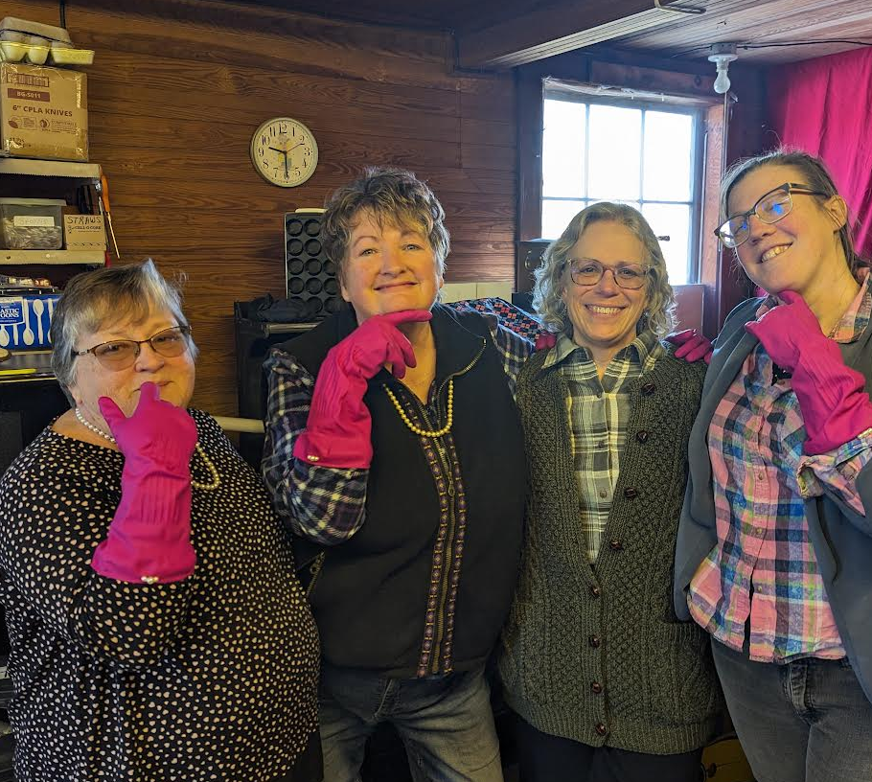
Lifelong Maine – Age-Friendly Communities
Magic Happens
When Age-Friendly
meets Dementia Inclusion May 24, 2024
Patricia Oh, PhD, MSW
University of Maine Center on Aging, Director, Lifelong Maine
Co-Director, Consortium on Aging Policy Research and Analysis
Advisor, AARP Livable/Maine

Slide 2
???
What is the first thing you think of when I say age-friendly? --lifelong communities?

Slide 3
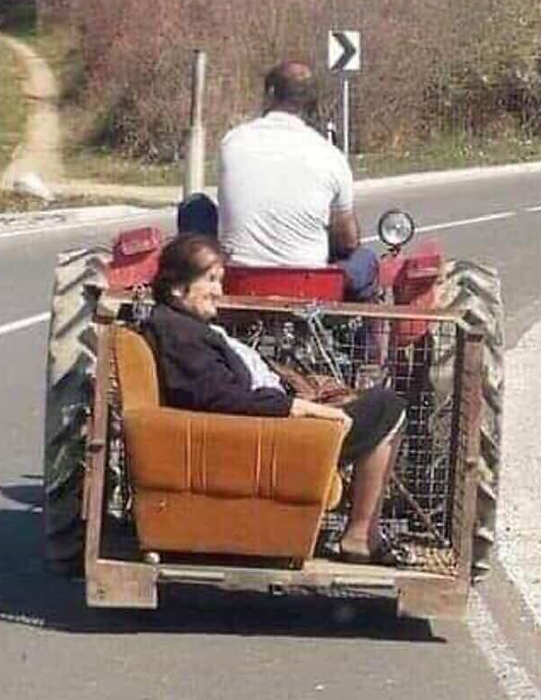
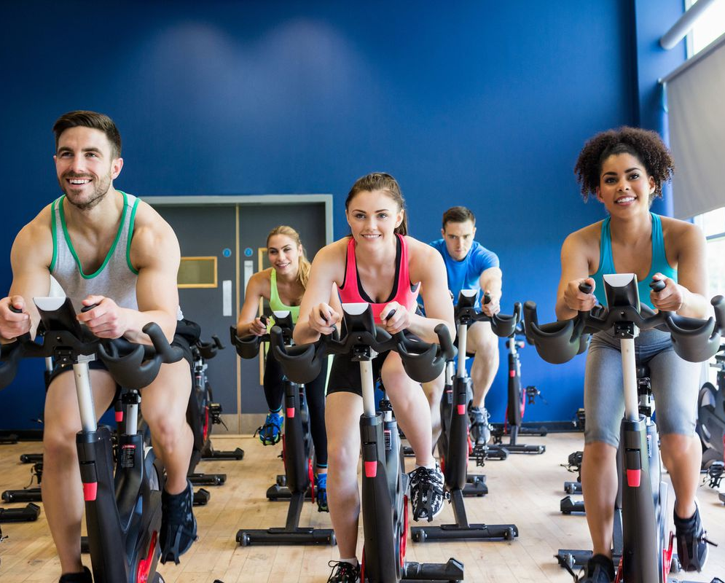
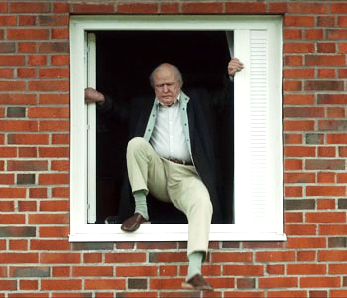
Age-Friendly
Having invested so much to get people to live longer, we’ve barely given any thought to how we can live better.
~Joe Coughlin, MIT Age Lab
Having invested so much to get people to live longer, we’ve barely given any thought to how we can live better.
~Joe Coughlin, MIT Age Lab

Slide 4
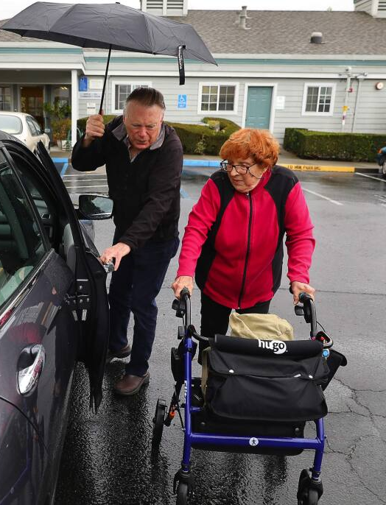
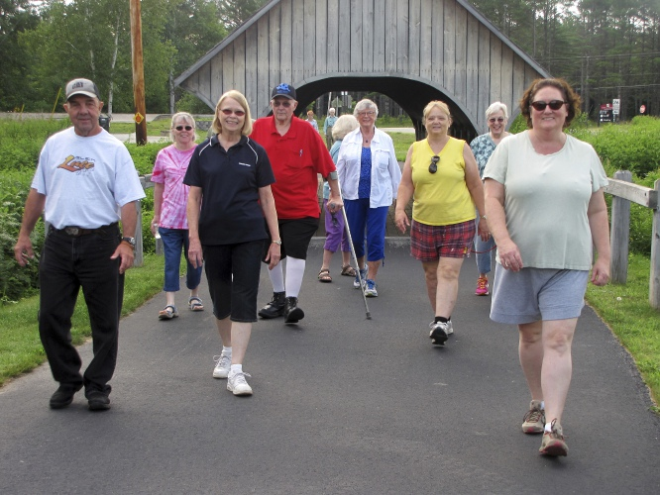
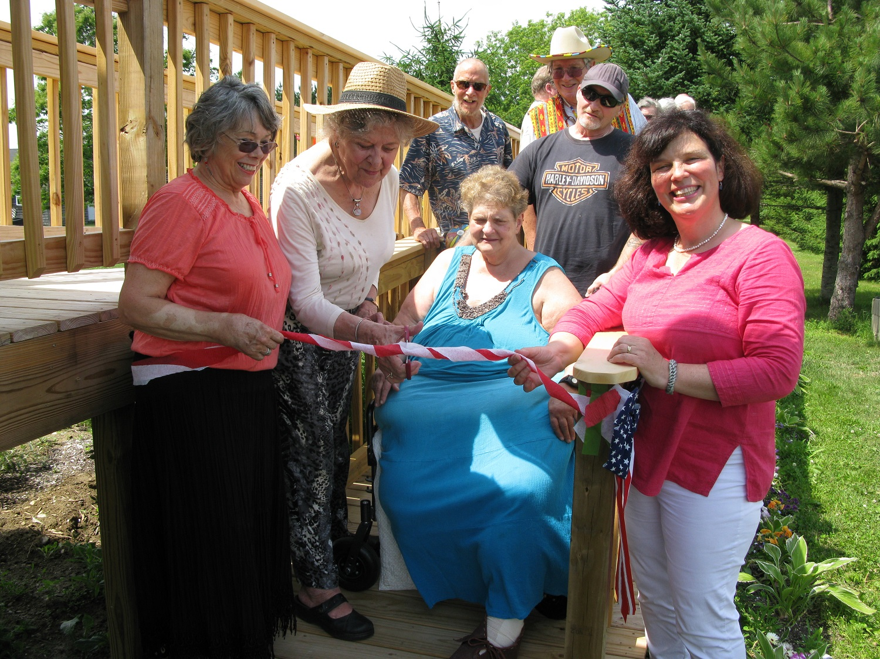
Age-Friendly
Making our communities more responsive to longer healthier lives and inclusive of people living with chronic illness or disabilities so that people of all ages and abilities can live active, healthy, socially engaged lives.

Slide 5
Age-Friendly Movement
820+ US Communities enrolled in AARP NAFSC, 2024
https://extranet.who.int/agefriendlyworld/who-network/ https://www.aarp.org/livable-communities/network-age-friendly-communities/

Slide 6
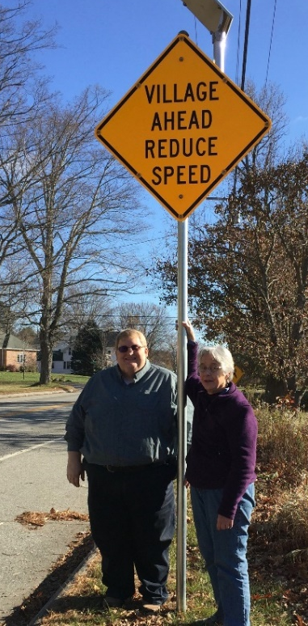
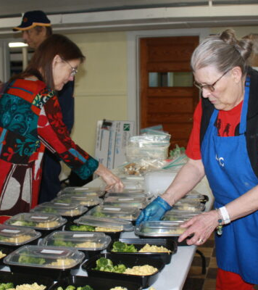
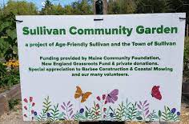
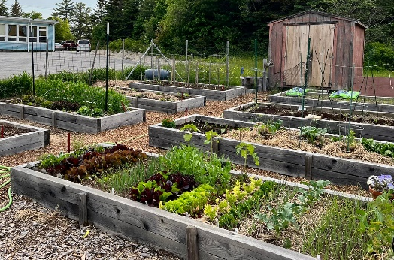
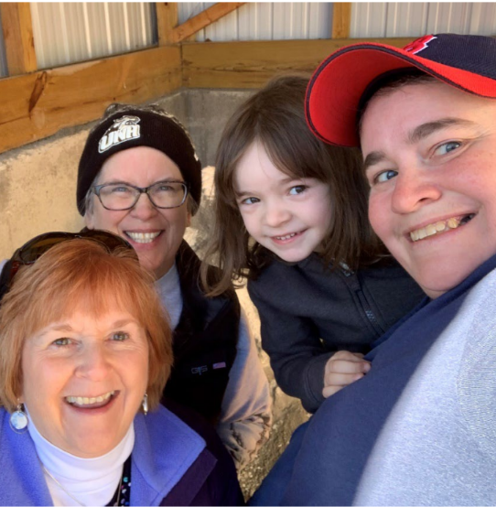
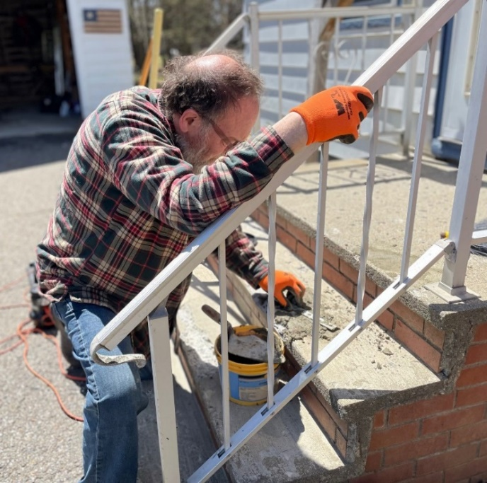
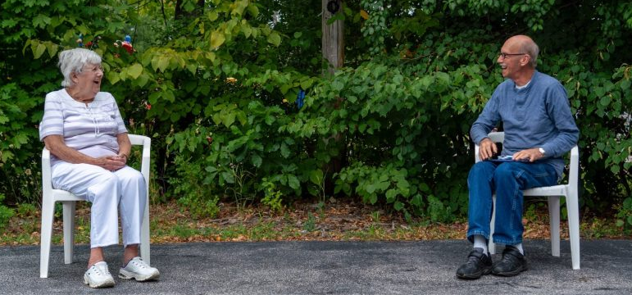
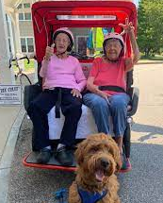
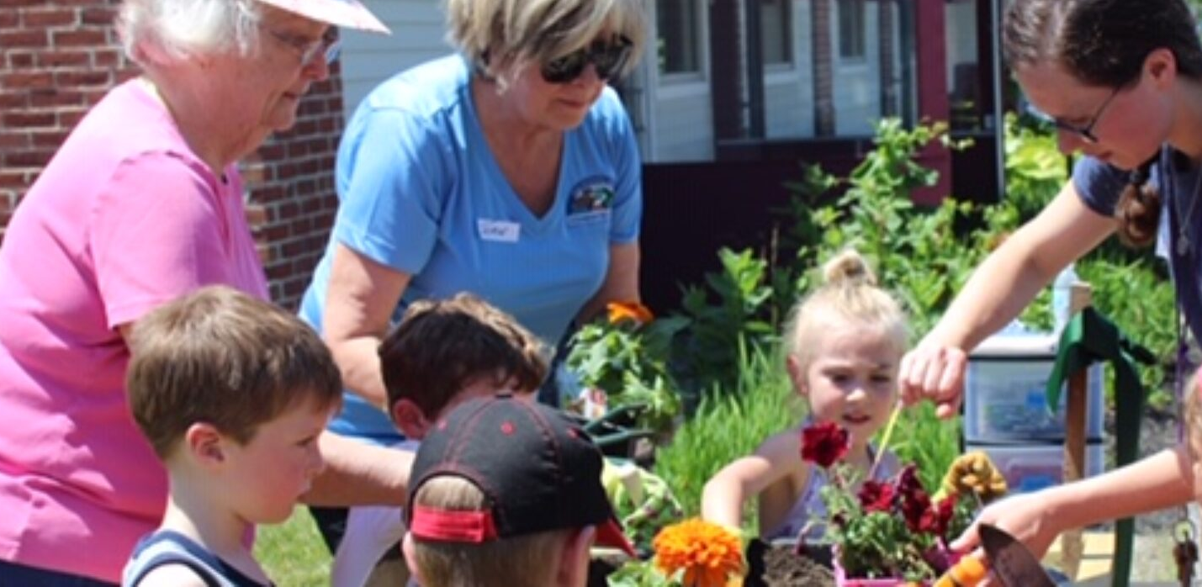
Age-Friendly Framework
Domains of Livability
Transportation
Housing
Social Participation
Communication & Information
Civic Engagement & Employment
Community Support & Health Services
Outdoor Spaces and Buildings
Respect & Social Inclusion
Traffic Calming Wayne
Purple Ladle Program Limestone
Window Inserts Jackman
Community Garden Sullivan
Sand Buckets Berwick
Spring Clean-Up Day
Houlton
Tech Handy Helper, Intergenerational fun, and Bike Rides
Saco

Slide 7
Age-Friendly Process
Choose a Quick Action Project to energize the team and gain community buy-in
Engage
Plan
Establish a core team
Collaborate with municipal and community partners
Develop a common vision
Complete an assessment
Identify community strengths
Write an Action Plan and share with the community
Age-Friendly
Community Environments
Celebrate
Act
Publicity, publicity, publicity
Celebrate accomplishments with the community and partners
Develop and implement programs and activities to make change

Slide 8
Snapshot of Lifelong Maine
38
Dementia Inclusive Projects
69 food programs
74 social programs
2000+ volunteers
Plan
Establish a core team
Collaborate with municipal and community partners
Develop a common vision
41 home repair & chore programs
Act
67% influence policy
Celebrate
36 transportation programs
500K+ Mainers benefit
Publicity, publicity, publicity
Celebrate accomplishments with the community and partners
Develop and implement programs and activities to make change
Thanks to the efforts of our communities, these numbers are continually growing!
Notes:
¹Snapshot last updated January, 2023

Slide 9
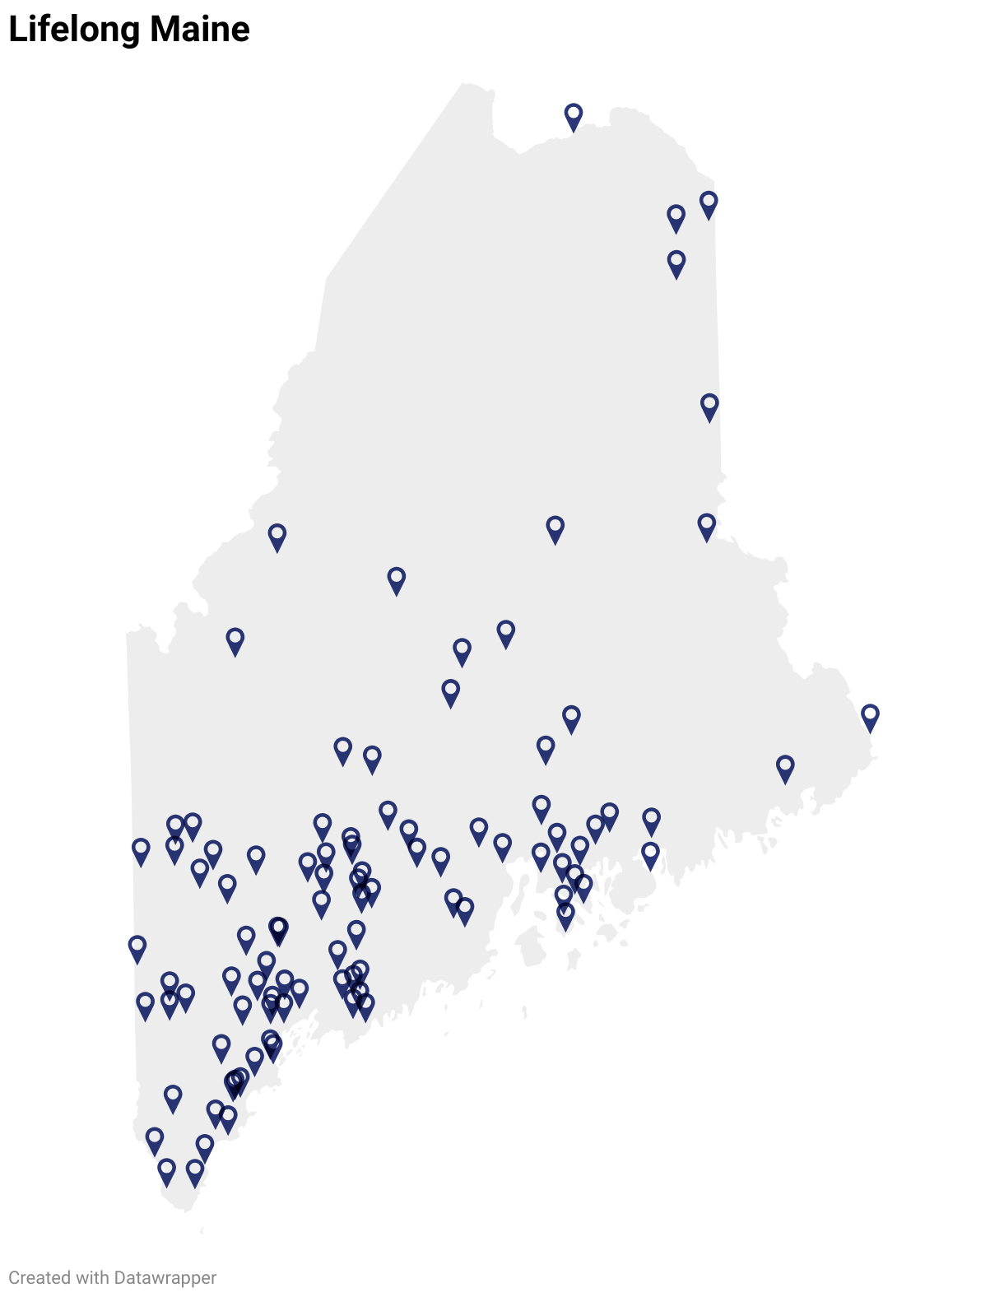
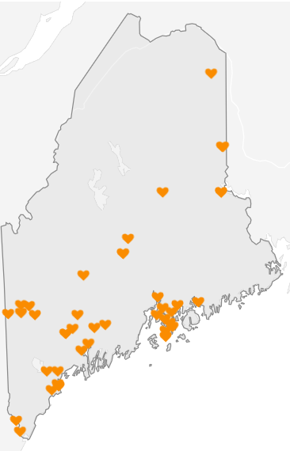
Lifelong Maine – Dementia Inclusion
90 Members, AARP NAFSC
96% small towns, rural communities
2:3 are volunteer-led
38 accepted the dementia inclusion challenge
Dementia-Inclusive Community Projects

Slide 10
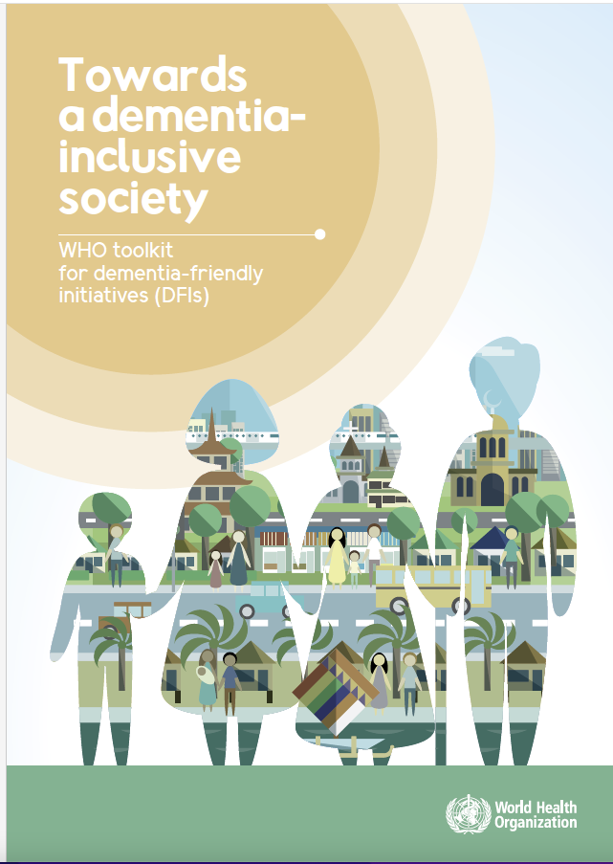
Dementia Inclusive Society
“one where people with dementia and their carers experience no stigma and discrimination and fully enjoy participation, inclusion, empowerment, respect, dignity, equality, freedom, accessibility, independent living, and quality of life.”

Slide 11
???
Think of someone you know with dementia…
What barriers exist in the community for that person to live their best life?

Slide 12
Living Well with Dementia
Paradigm shift: From a focus on cure and managing the symptoms of dementia to Living Well
Notes:
How to live with dementia - grounded in science

Slide 13
Lifelong Maine Fellows Program
Matching Experienced Lifelong Community Leaders with Communities starting their journey or launching a new program

Slide 14
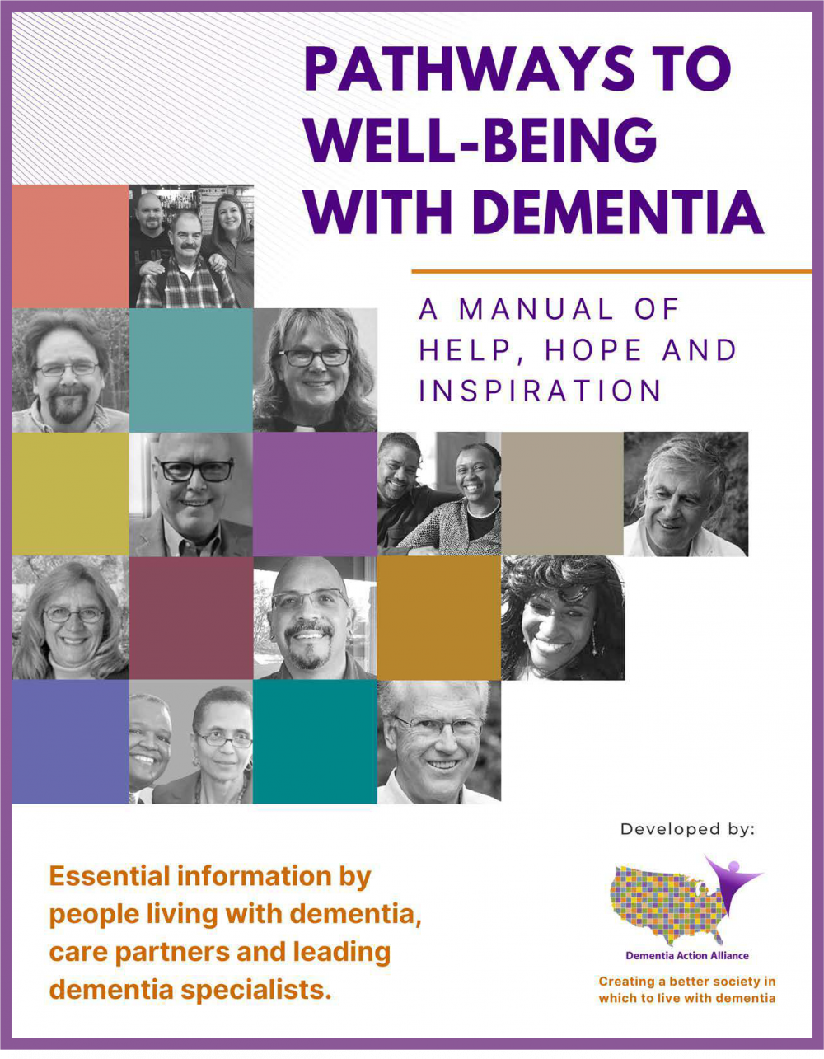
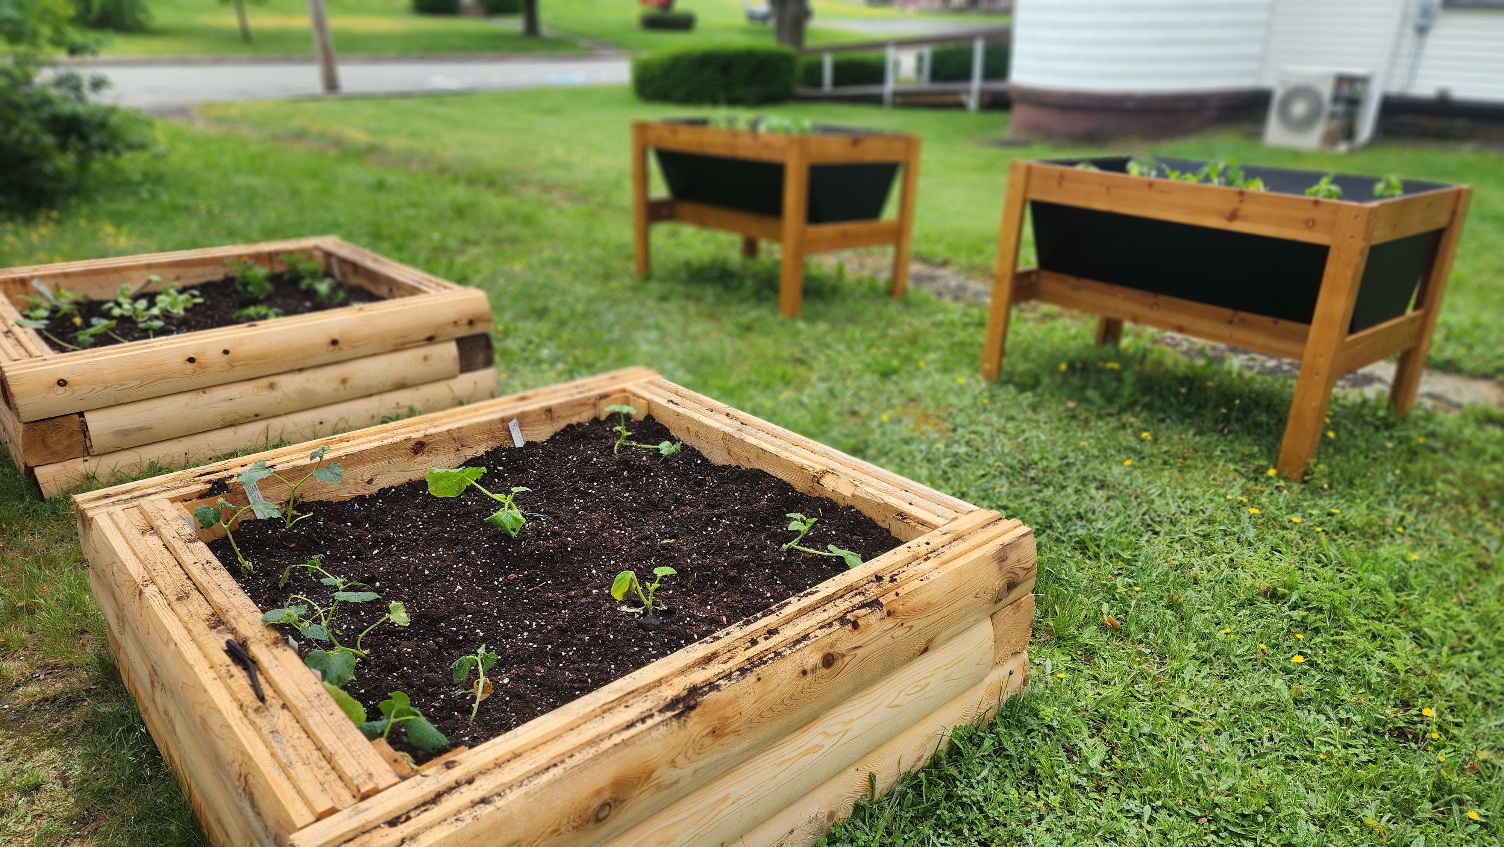
Dementia Inclusion Pilot
38 participating communities
Story walks with benches
Walking groups, wayfaring and historic signs
Community garden - elevated beds
Information kiosks, social media campaigns
Memory kits, books, puzzles
Dementia inclusive signs in public spaces
First responder - dementia inclusive training
Community conversations
New Partners: Libraries, Museums, First Responders, Historical Societies, Veteran’s Administration, Parks, Land Trusts, and more!
Notes:
⁴Transportation survey conducted February 2022, n=38. Data about number of volunteer transportation programs updated January 2023 Data for community focus taken from submitted action plans and progress reports.

Slide 15
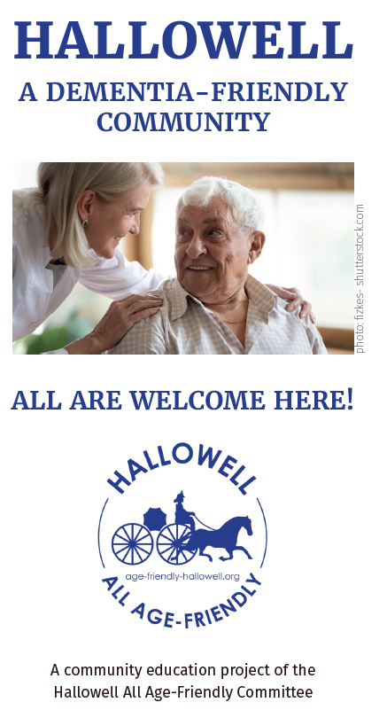
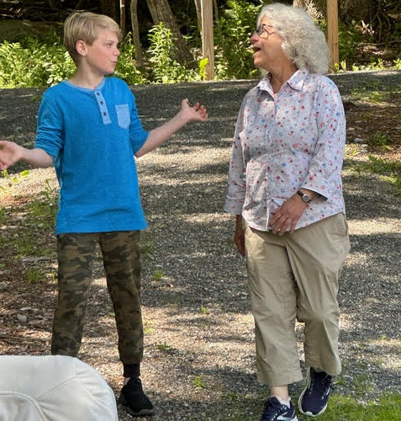
And the adventure continues…
Dementia Inclusive Dining
Engaging Businesses
Dementia Inclusion in Volunteer Training Materials
Dementia Inclusive Recreation Opportunities
Raising Awareness State-Wide

Slide 16
???
What kind of project would make your community more dementia inclusive?

Slide 17
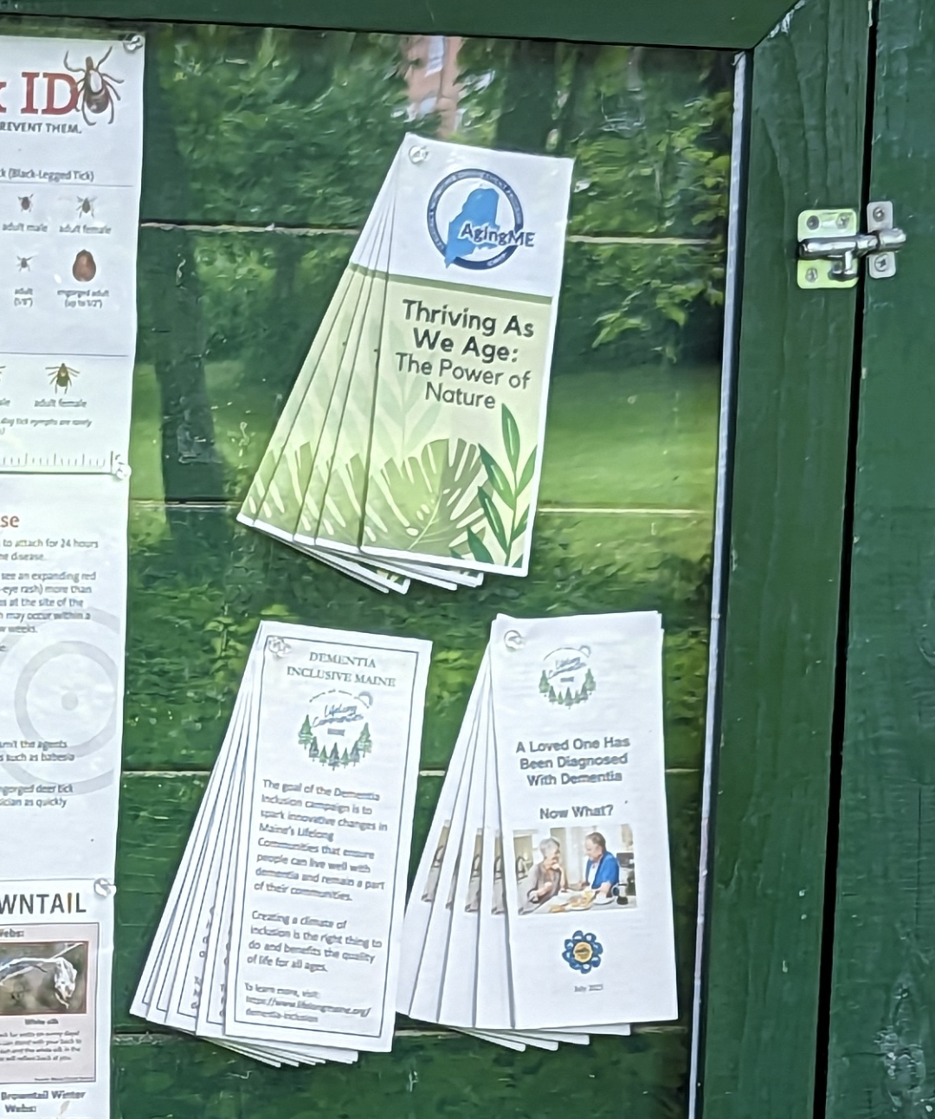
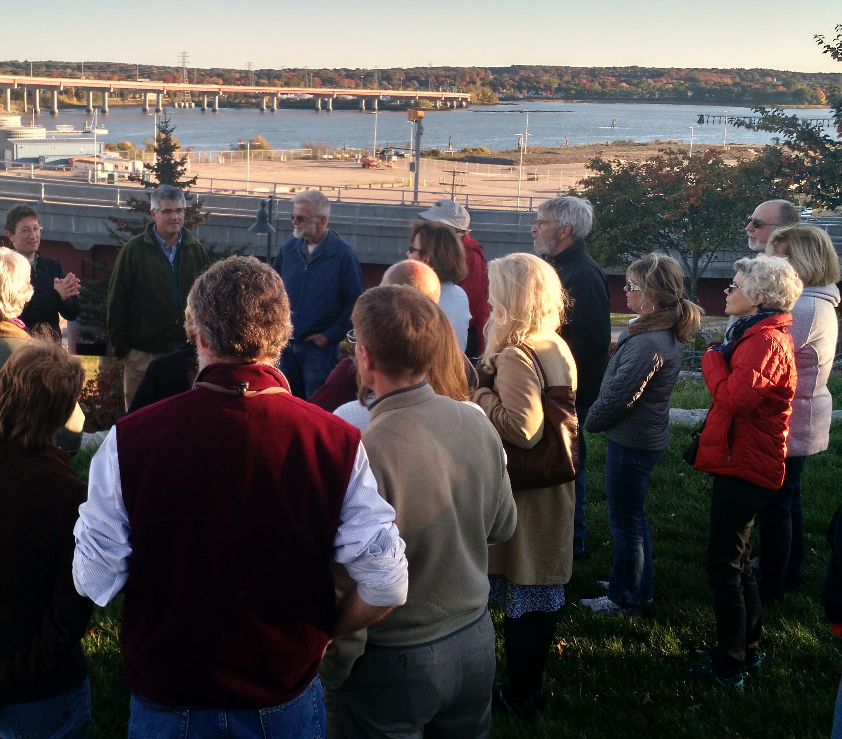
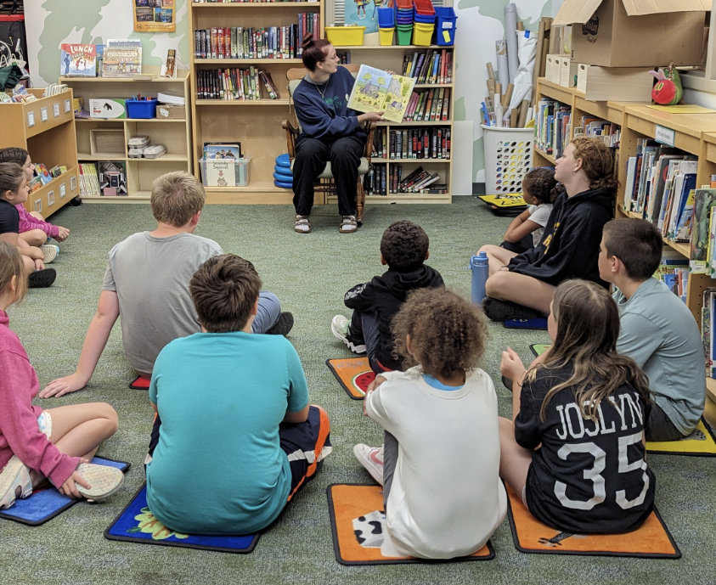
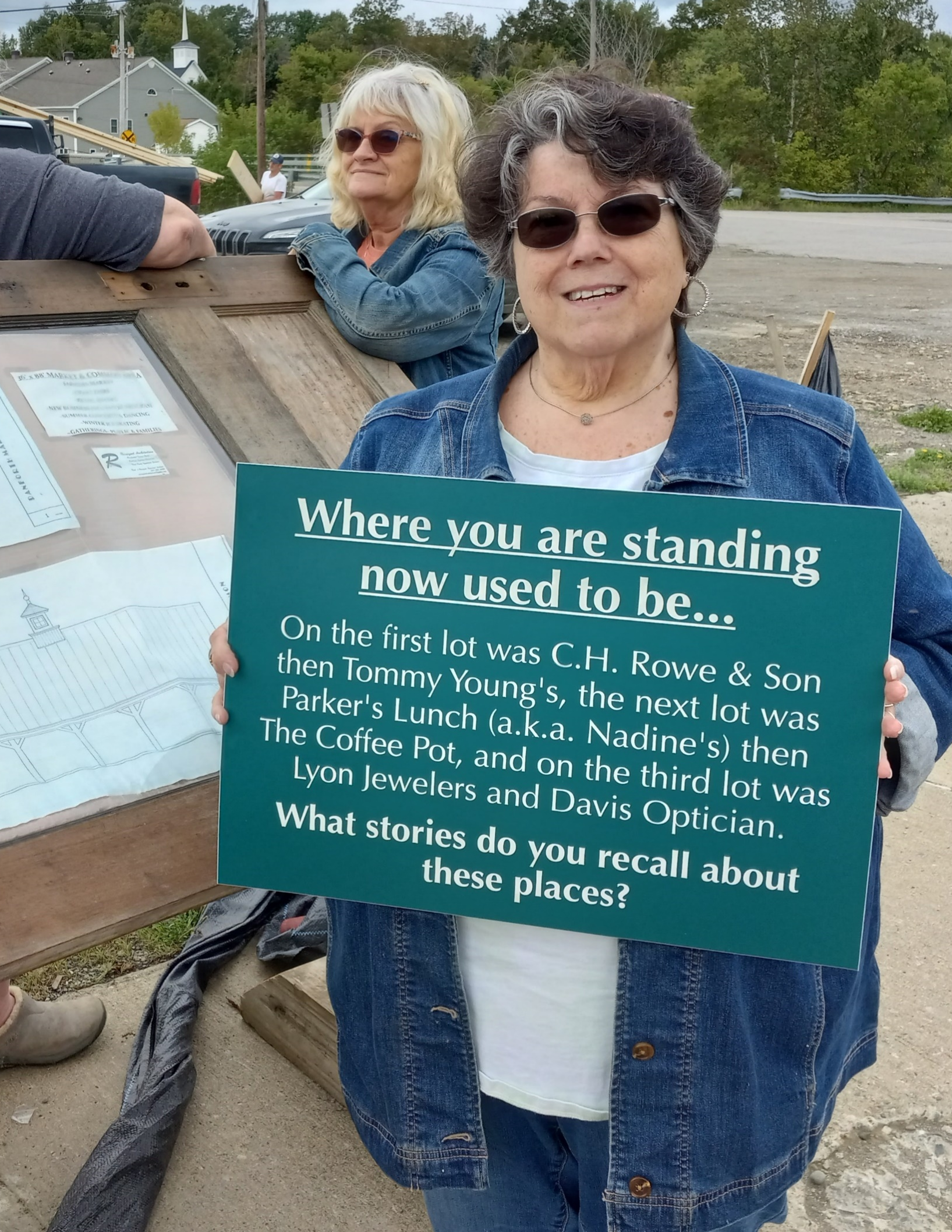
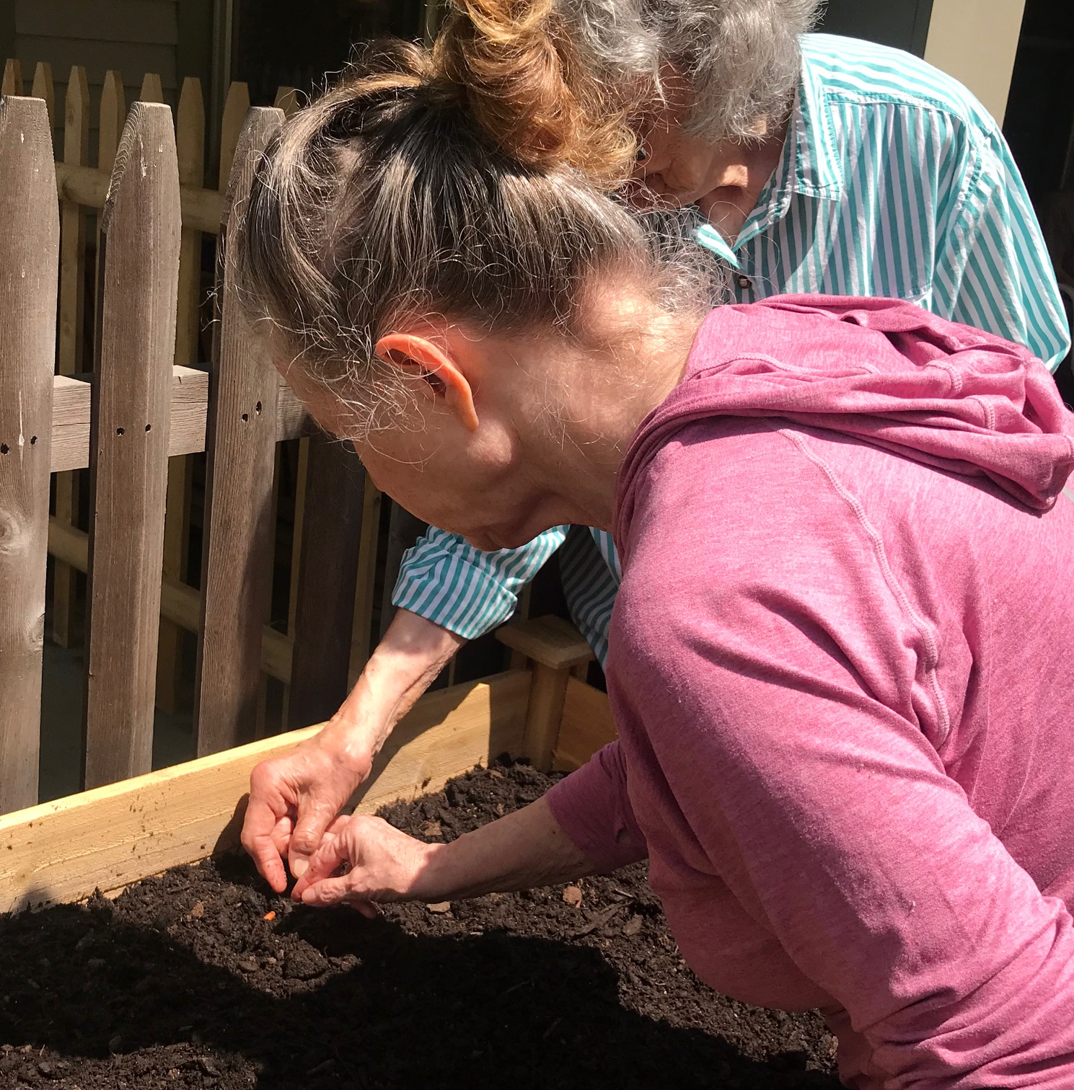
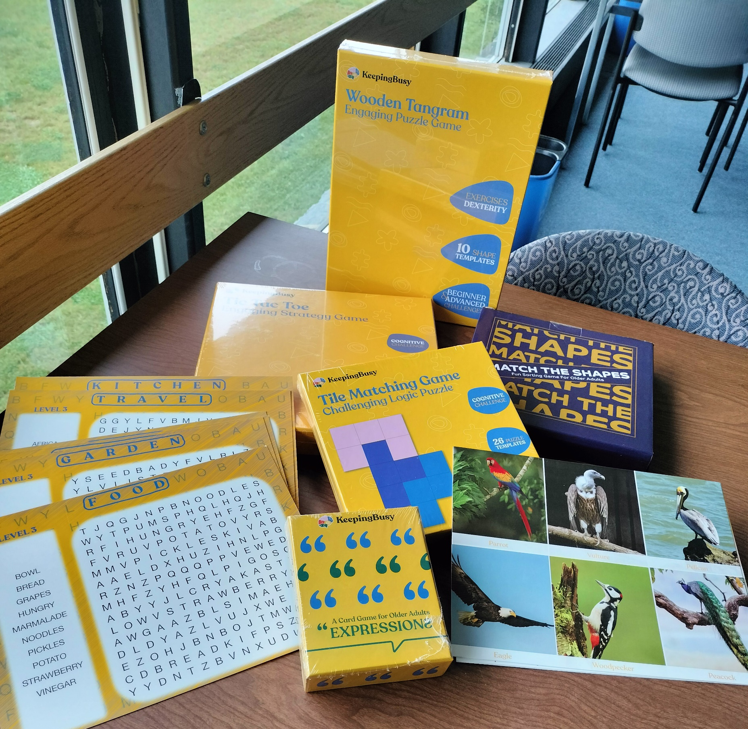
Lessons Learned
There are many ways to be dementia inclusive
Age-Friendly experience paves the way for dementia inclusion
Engages new partners
Local and statewide impact
Communities are ready to embrace the message that dementia is a diagnosis, not the whole person

Slide 18
???
What are some things in your community that are already inclusive of people with different abilities (including cognitive changes)?

Slide 19
Give voice
Foster participation and inclusion
Next Steps
Download
WHO ToolKit &/or
Public Library DI Toolkit
Add to the richness of your Age-Friendly initiative to make it Dementia Inclusive

Slide 20
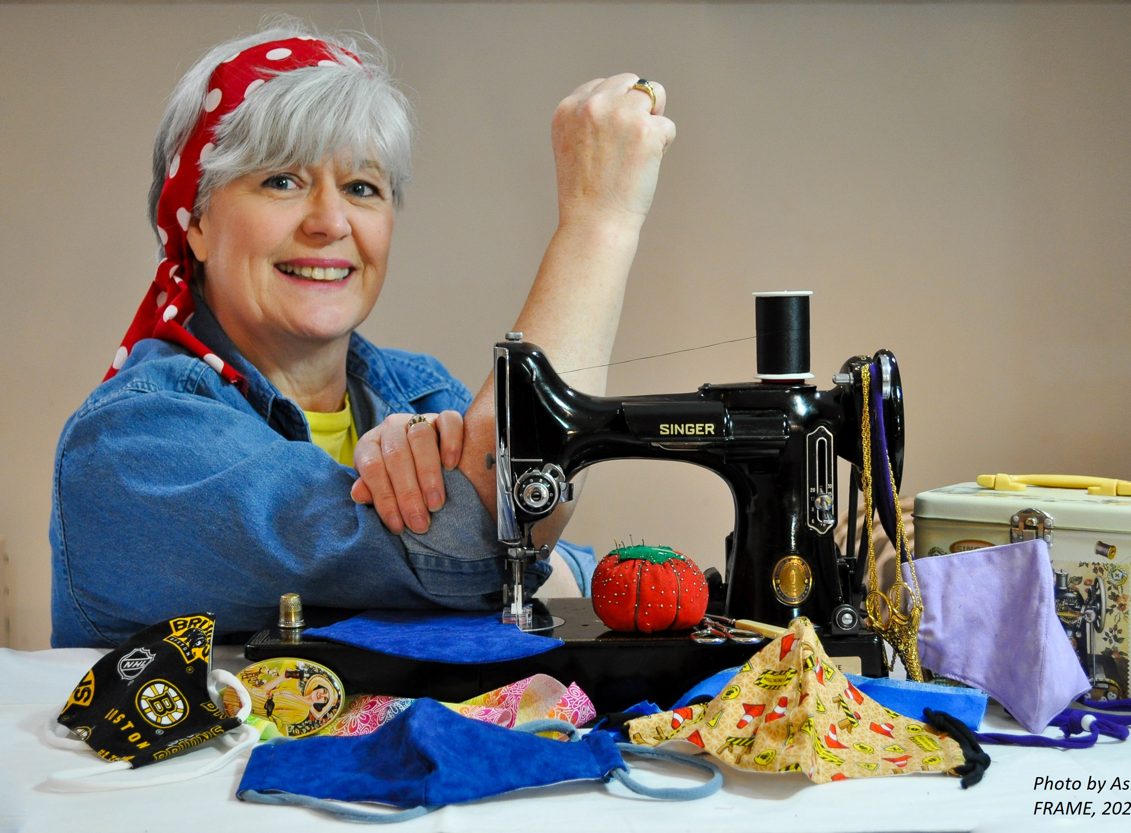
Patricia Oh
patricia.oh@maine.edu 207.837.5883 https://www.LifelongMaine.org
For more information:
The FRAME photo library contains free pictures you
can use in your messaging about age-friendly
35
Notes:
questions

