Slide 1

Respite for ME Grants Pilot Program:
Expanding Covered Respite Services for Family Caregivers in Maine
Catherine Slye, MA, LSW
OADS, Family Caregiver Services
Ruth White, MHR, MSB
Manager, Aroostook Agency on Aging
May 23, 2024

Slide 2
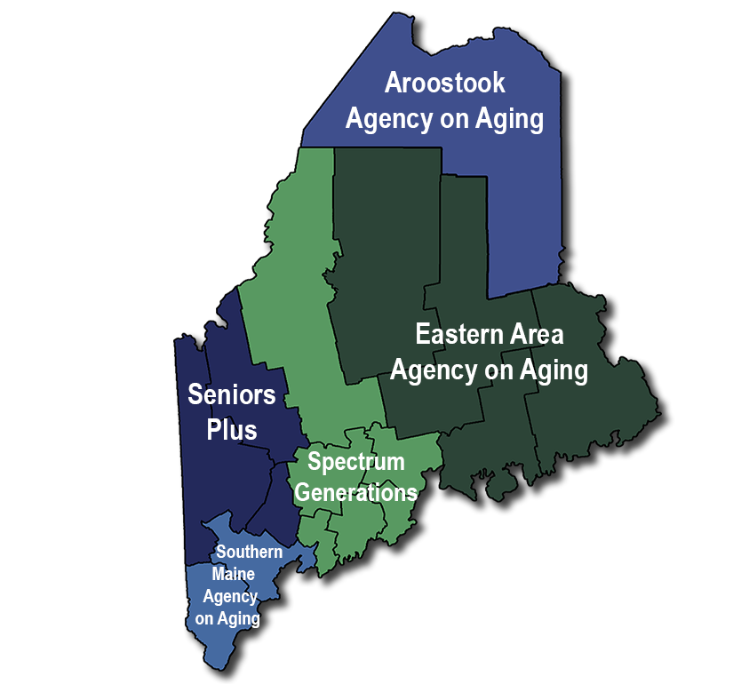
History of Respite Services for Older Adults
OADS oversees two, full time Respite programs available to caregivers of older adults and adults with disabilities.
OADS allocates federal and state funds to the five local Area Agencies on Aging, who facilitate the two programs to the public.

Slide 3
General Requirements for all Respite Programs
Caregiver and care recipient both reside at home in Maine
  Cannot reside in Assisted Living, Skilled Nursing Facility, Residential Living, etc.
Caregiver is informal provider of care, meaning they do not receive any money for the care they provide
Care recipient cannot be receiving services through any other state or federal Home and Community Services program, unless the care recipient is on a waiting list for services
Caregivers may only access one program per federal fiscal year
  October 1 through September 30

Slide 4
National Family Caregiver Support Program
The National Family Caregiver Support Program (NFCSP) is federally funded and provides services to two categories of caregivers
Caregivers of Older Adults
  Anyone 18+ who cares for someone 60+
  Anyone 18+ who cares for someone with an Alzheimer’s Disease and Related Dementias (ADRD) diagnosis
    Person with diagnosis can be any age
Older Relative Caregivers, also known as Kinship Caregivers
  Anyone 55+ who is caring for a relative child 18 or younger, who is not their biological or adoptive child
  Anyone 55+ who is caring for a relative with a disability 18-59 years old
    Can be a biological or adoptive child

Slide 5
National Family Caregiver Support Program
Services funded:
  Information and Assistance
  Case Management
  Public Education
  Support Groups
  Training and Counseling
  Respite*
    Adult Day Care
    In Home and Out of Home – Day and Overnight
  Supplemental Services*
    Home Modifications – lifetime limit of $5000
    Assistive Technology
    Consumable Supplies
    *financial allotments vary per AAA

Slide 6
National Family Caregiver Support Program
Respite and Supplemental Services funds are prioritized for older caregivers:
  With the greatest social and economic need;
  Providing care to those 60+, or any age with ADRD;
  Whose recipient is functionally impaired due to inability to perform at least 2 Activities of Daily Living without substantial assistance, including verbal reminding, physical cueing, or supervision; or
  Due to cognitive or other mental impairment, recipient requires substantial supervision because they pose a serious health or safety hazard to themself or others

Slide 7
Respite Care Services for Adults with Alzheimer’s Disease or Related Disorders
The Respite Care Services for Adults with ADRD program, referred to as State Respite, is state funded and provides services to one category of caregivers
  Caregivers must be caring for someone who has a physician’s medical diagnosis of ADRD
Care recipients can have no more than $50,000 in assets as an individual or $75,000 as a couple
Individuals may be responsible for a 20% copay
Current caregivers may access up to $5303 per federal fiscal year
  October 1 through September 30
  Rate subject to change annually

Slide 8
Respite Care Services for Adults with Alzheimer’s Disease or Related Disorders
Services funded:
  Respite Adult Day
  Respite In Home
    Day and Overnight
  Respite Out of Home
    Day and Overnight
  Assistive Technology as a means of Respite
    Safety cameras or specialty door locks
  Home Modifications
    Lifetime limit of $2000

Slide 9
Family Caregiver Grant Pilot Program
In 2021 S.P. 577 – L.D. 1733 established the Family Caregiver Grant Pilot Program
Allocated $5.1 million American Rescue Plan Act funds, of which $4.5 million is direct grants to caregivers
Due to funding, caregivers must complete an attestation or provide proof that they were negatively financially impacted by COVID – 19
The pilot program brought the definition of caregiver into alignment with the NFCSP

Slide 10
Family Caregiver Grant Pilot Program
The primary goals of the pilot program are to:
  Increase the number of families served by the Respite Care Fund
  Alleviate costs associated with providing in-home care of an adult
  Provide a family caregiver grant to increase economic security for family caregivers
  Examine the needs and preferences of the families served by the Respite Care Fund and the pilot program

Slide 11
TCARE®
In June of 2021 H.P. 1208 – L.D. 1624 charged Maine Long Term Care Ombudsman Program ( LTCOP) with convening a stakeholder group to address the needs of Maine’s caregivers
The subsequent Stakeholder report to the Joint Standing Committee on Health and Human Services in January 2022 proposed Maine adopt the TCARE ® protocol with a subset of Maine caregivers
TCARE® protocol was incorporated as a requirement for all caregivers participating in the pilot program

Slide 12
TCARE®
TCARE® is the Tailored Caregiver Assessment and Referral care management protocol
It is grounded in the Caregiver Identity Theory and is designed to identify measures of caregiver burden and stress
TCARE® measures:
  Identity Discrepancy
  Intention to Place
  Relationship Burden
  Objective Burden
  Stress Burden
  Depression
  Uplifts

Slide 13
TCARE®
Each caregiver’s individual stressors are identified during the screen and assessment
The TCARE ® person-centered care plan identifies and prioritizes services and supports to assist each caregiver, based on stressors identified during assessment
A follow up assessment is completed 90 days after the caregiver spends their first grant dollars
Utilizing TCARE® as part of the pilot, Maine strives to:
  Increase caregiver wellbeing
  Decrease caregiver burden
  Decrease or delay the amount of care recipients placed in long term care facilities

Slide 14


Family Caregiver Grant Pilot Program
Stakeholders and OADS met from October 2021 through September 2022 creating procedures, guidance documents and training staff to become TCARE ® certified
ETHOS was hired to create a marketing campaign encompassing a logo, newspaper and radio ads, and social media
The pilot program was renamed Respite for ME Grants Pilot Program and launched October 1, 2022, for two federal fiscal years

Slide 15
Respite for ME Grants: Covered Services
Covered Services include:
  Respite
    Adult Day Care
    In Home and Out of Home - Day and Overnight
  Home Modifications and/or Repairs
    Safety and Accessibility
  Assistive Technology
    Durable Medical Equipment, Personal Emergency Response Systems and more
  Incontinence and Wound Care Supplies
  Counseling and Training
  Legal and Financial Consultation
  Chore and Homemaker
  Transportation
  Self Care

Slide 16
Respite for ME Grants: Covered Services
Self Care
  Health and Wellness
    Chiropractor, Occupation and Physical therapy, Nutritional Counseling, Palliative Care, Reiki, Acupuncture, Reflexology
  Fitness Classes
    Yoga, Pilates, Tai Chi, Weight Training, Swimming, Dance, Zumba, Sports lessons, Fitness Memberships
  Fitness Equipment
    Treadmill, Elliptical, Stationary or regular bike, Rowing machine, Canoe, Kayak, Weightlifting equipment and accessories
  Dental Work
    Preventive and routine services that are necessary for oral health and maintenance

Slide 17
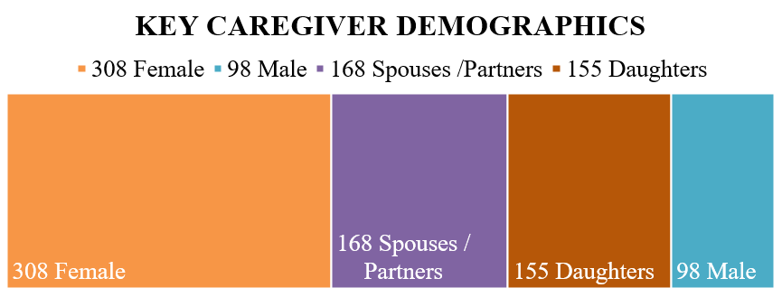
Respite for ME Grants: Year One
Year one of the program ran from October 1, 2022, through September 30, 2023
Eligible caregivers could spend up to $2,000 each and be reimbursed for covered services
A total of 406 caregivers enrolled

Slide 18
Respite for ME Grants: Year One
Caregiver age ranged across the lifespan
  58 caregivers aged 30 - 50 years
  92 caregivers aged 51 - 60 years
  131 caregivers aged 61 - 70 years
  91 caregivers aged 71 - 80 years
  34 caregivers aged 81 – 90+ years
Education ranged from less than 8th grade to Graduate degree or higher
  27.9 % received their GED or High School diploma
  49.4% attended some form of secondary education
  18.7 % attended a Masters or Doctoral degree program

Slide 19
Respite for ME Grants: Year One
Employment Status
  21% work Full Time
  19.5% work Part Time or Seasonally
  40% are Retired
  14.3 % are Unemployed
Income ranged from under $10,000 to over $75,000 annually
  11.5% reported being in the $15,000-$24,999 range
  29.6% reported being in the $25,000-$34,999 range
  22.4% reported being in the $35,000-$49,999 range
  12.6% reported being in the $50,000 and over range

Slide 20
Respite for ME Grants: Year One
Why Caregivers chose the program:
  284 were only eligible for Respite for ME Grants
  87 over assets for State Respite
  22 eligible for both but chose program for flexibility in payments and services
Primary Referral Sources:
  Word of Mouth
  Newspaper
  Flyer
On average it took 13 days from initial application to being deemed eligible for the program
On average it took 31 days for caregivers to start accessing services once deemed eligible

Slide 21
Respite for ME Grants: Year One
339 caregivers accessed funds
243 caregivers completed follow up surveys
  45% showed a positive change in TCARE® scores
  55% showed no change or a negative change in TCARE® scores
  222 of 226 responded that “Yes” the grant funds helped them
  18 caregivers had changed their intent to place from initial “No”, to “Yes” at the 90 day follow up
  9 caregivers had changed their intent to place from initial “Yes”, to “No” at the 90 day follow up

Slide 22
Respite for ME Grants: Year One

Slide 23
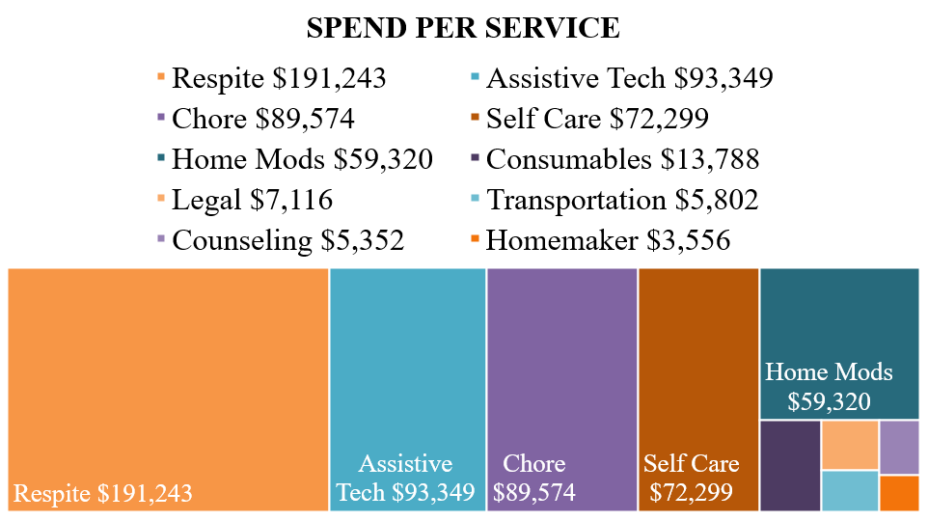
Respite for ME Grants: Year One

Slide 24
Respite for ME Grants: Year Two
Year two of the program began October 1, 2023, and runs through September 30, 2024
This is the second and final year of the pilot program
Eligible caregivers can spend up to $5,171 each on a multitude of covered services
As of May 1, 2024 :
  572 caregivers have enrolled
  328 are unique to the program for year 2
  241 have returned, some with new Care Recipients
  A total of 734 unique caregivers so far have been served over the course of October 1, 2022, through April 30, 2024

Slide 25
Respite for ME Grants: Year Two
Caregiver age ranges across the lifespan
  72 caregivers aged 30 - 50 years
  128 caregivers aged 51 - 60 years
  188 caregivers aged 61 - 70 years
  136 caregivers aged 71 - 80 years
  48 caregivers aged 81 – 90+ years
Education ranges from less than 8th grade to a Graduate degree or higher
  25% received their GED or High School diploma
  56.3% attended some form of secondary education
  17.5 % attended a Masters or Doctoral degree program

Slide 26
Respite for ME Grants: Year Two
Employment Status
  23% work Full Time
  17% work Part Time or Seasonally
  43.5% are Retired
  13% are Unemployed
Income ranges from under $10,000 to over $75,000 annually
  13.6% reported being in the $15,000-$24,999 range
  45 % reported being in the $25,000-$34,999 range
  18% reported being in the $35,000-$49,999 range
  27.6% reported being in the $50,000 and over range

Slide 27
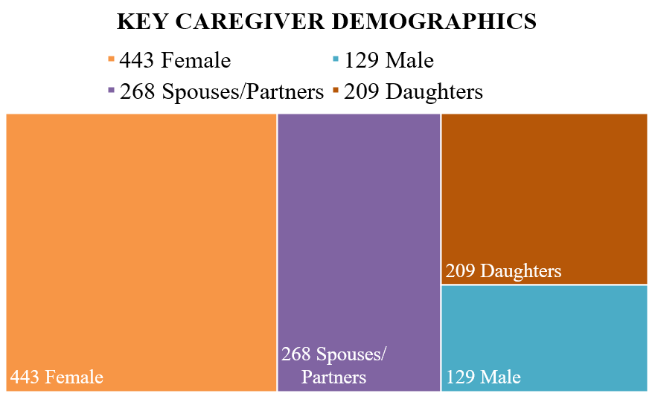
Respite for ME Grants: Year Two

Slide 28
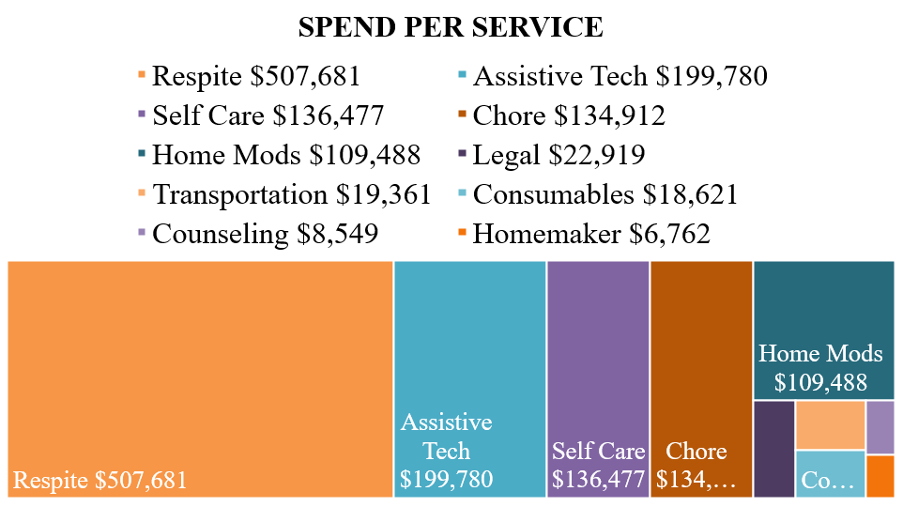
Respite for ME Grants: Year Two

Slide 29

Words of Appreciation: Care Recipient
“Just a word of support and many thanks to your program for caregivers. It has enabled us to pay for the help we so desperately need and allowed my husband to pursue his love of playing the organ at a local church.
He now can enjoy a little time away from me and know I am being well cared for. He has been my sole caregiver since my stroke 4-1/2 years ago.
He has devoted himself to my care day and night.
It has been quite a burden for him to keep up with everything inside and out!
We can't say enough good things about Becky H. She has gone out of her way many times to insure we understand everything and helped us in every way possible. It's so nice to know someone actually cares!
Thank you again for this wonderful program!
Keep up the good work.”

Slide 30

Words of Appreciation: Caregiver
“I received the Respite for ME check this week and I wanted to tell you how very grateful I am! This money allowed me to make sure that my mother is comfortable and safe, by getting her a sofa bed while she is doing home physical therapy to improve her walking and stair climbing ability. I was able to install a 2nd stair railing banister and grab bars for the stairs as well. I also got her a much needed and wanted recliner. I even got a massage for myself which was so very needed and appreciated.
This program is truly amazing and helped me provide things for my mother that she needs and deserves. I love having her live with me, but it can be hard and challenging at times. This provided us both with things we truly needed. I cannot say enough.
Thank you so very much!!”

Slide 31

Words of Appreciation: Caregiver
“I want to thank you for all your help with the R4ME program. I have been recently enrolled and the amount of stress/relief it has already provided me has been tremendous. I consider myself at a young age for caregiving, and the amount of financial stress I have, has been somewhat relieved with this program. I would like to be working, but as a caregiver this is unrealistic at this time. I want to keep my husband home as long as possible, and this program has allowed me with options. Trying to figure out my future (financially), how to navigate doctors’ appointments and to keep him home safely, this program has been so beneficial already. Thank you!!”

Slide 32

Words of Appreciation: Caregiver
“I want to thank you from the bottom of my heart for helping me to get this grant. I have learned so much about things I can do to help my mom and myself from your agency and CITE. The things I have purchased have been so helpful, particularly the large-scale digital clock and the Echo show. I’ve been able to drop in on my mom using the Echo show when she has been unable to make her phone work. There is a bit of learning curve, but Mom actually called me using it yesterday, and she was so proud of herself. Being able to check on her using the Echo show has saved me so much time, stress and worry already. I also took my mom to a local adult daycare. I was quite anxious taking her there, I did not know how she would feel about the entire situation. It was such an incredibly positive experience for her, she came home glowing. I really did not know how much she would benefit from being in a friendly, supportive environment away from home. There is no way I could afford to take her there without this grant, so I would never have known it would benefit both of us.
I am hoping that you all understand how much
good your work does... I will never forget how
you gave me help when I felt hopeless. Thank you again.”

Slide 33

Words of Appreciation: Caregiver
Staff assisted the caregiver of a care recipient who is legally blind. The family was able to use grant funds to travel from Aroostook county to Massachusetts to try out an Assistive Technology for people with visual impairment. The care recipient did not choose to purchase the device, because it did not fit his needs. However, the family was grateful to be able to use grant funds to assist with transportation costs and make an educated decision. The family is thankful to have access to grant funds and is currently working with the IRIS network of Maine to find a more suitable device. The family “considers the program a blessing and cannot thank the program enough”.

Slide 34

Aroostook Agency on Aging
County Served: Aroostook
Aroostook Area Agency on Aging Website
Phone: 207-764-3396
Toll Free: 1-800-439-1789
Fax: 207-764-6182
Address: 260 Main Street, Suite B,
Presque Isle, ME 04769
Hours of Operation: Monday-Friday
8:00 a.m. to 4:30 p.m.

Slide 35

Eastern Area Agency on Aging
Counties Served: Hancock, Penobscot, Piscataquis, and Washington
Eastern Agency on Aging Website
Phone: 207-941-2865
Toll Free: 1-800-432-7812
Fax: 207-941-2869
Address: 240 State Street, Brewer, ME 04412
Hours of Operation: Monday-Friday
8:00 a.m. to 4:30 p.m.

Slide 36

SeniorsPlus
Counties Served: Androscoggin, Franklin, and Oxford
SeniorsPlus website
Phone: 207-795-4010
Toll Free: 1-800-427-1241
Fax: 207-795-4009
Address: 8 Falcon Road, Lewiston, ME 04243
Hours of Operation: Monday-Friday
8:30 a.m. to 4:30 p.m.

Slide 37

Southern Maine Agency on Aging
Counties Served: Cumberland (except Harpswell and Brunswick only) and York
Southern Maine Agency on Aging website
Phone: 207-396-6500
Toll Free: 1-800-427-7411
Fax: 207-517-6240
Address: 30 Barra Road, Biddeford, ME 04005
Hours of Operation: Monday-Friday
8:00 a.m. to 4:30 p.m.

Slide 38

Spectrum Generations
(Central Maine Area Agency on Aging)
Counties Served: Cumberland (Harpswell and Brunswick only), Kennebec, Knox, Lincoln, Sagadahoc, Somerset, and Waldo
Spectrum Generations website
Phone: 207-622-9212
Toll Free: 1-800-639-1553
Fax: 207-622-7857
Address: One Weston Court Suite 109, Augusta, ME 04330
Hours of Operation: Monday-Friday
8:00 a.m. to 4:30 p.m.

Slide 39
Additional Resources
Respite for ME Grants Year One Evaluation Report: Respite-for-ME-Evaluation-Report-2022-2023.pdf (maine.gov)
Family Caregiver Grant Pilot Program Public Law: getPDF.asp (mainelegislature.org)
TCARE® ACL Accreditation: Tailored Caregiver Assessment and Referral (TCARE) (acl.gov)

Slide 40
Questions?
Catherine Slye, MA, LSW
Family Caregiver Specialist, OADS
catherine.slye@maine.gov
Ruth White, MHR, MSB
Manager Service Coordination,
Aroostook Agency on Aging
ruth.white@aroostookaging.org

