Slide 1
AN UPDATE ON NURSING HOME QUALITY IMPROVEMENT EFFORTS IN MAINE AND NATIONALLY:
What’s Ahead?
Lauren Michalakes, MD, MPH
Maine Office of Aging & Disability Services
Mary Lou Ciolfi, JD, MS
UMaine Center on Aging
Consortium for Aging Policy Research & Analysis
Maine Geriatrics Conference
May 2024

Slide 2
COVID-19 Focused Attention

Slide 3
Through the end of 2020, the death rate for non-nursing home residents was about 87 per 100,000. The death rate for nursing home residents is more than 108 times that number at roughly 9200 per 100,000
https://www.pbs.org/newshour/health/additional-1700-coronavirus-related-deaths-reported-in-new-york-nursing-homes
Notes:
See https://www.ncbi.nlm.nih.gov/pmc/articles/PMC8776351/#cit_1

Slide 4
In 2021, the National Academies for Sciences, Engineering, & Medicine convened national experts
One year later, in April 2022, the NASEM Committee issued a 600 page report

Slide 5
Deliver comprehensive, person-centered, equitable care that ensures the health, quality of life, and safety of nursing home residents; promotes resident autonomy; and manages risks
Ensure a well-prepared, empowered, and appropriately compensated workforce
Increase transparency and accountability of finances, operations, and ownership
Create a more rational and robust financing system
Design a more effective and responsive system of quality assurance
Expand and enhance quality measurement and continuous quality improvement
Adopt health information technology in all nursing homes

Slide 6
DHHS Activities to Improve Quality of Care Delivered in Nursing Homes
In October 2022 DHHS Leadership met with members of The NASEM Committee on the Quality of Care in Nursing Homes
Heard directly from national leaders on findings and recommendations to improve care delivered in nursing homes
Backdrop for OMS plan to reform payment for nursing homes and residential care facilities
Notes:
Lauren

Slide 7
The Moving Forward Coalition
www.movingforwardcoalition.org

Slide 8
The Moving Forward Coalition
Action Planning

Slide 9
The Moving Forward Coalition
Goal Committee One
Be receptive to residents’ individual wishes and willing to work with residents to make this happen
We want to be able to make our own decisions about how we live
Deeply knowing the resident is vital to appreciating what is most meaningful for us
Getting closer to meaningful person-centered care:
What are your Goals, Preferences, and Priorities?

Slide 10
The Moving Forward Coalition
Goal Committee One
What are your
Goals, Preferences, and Priorities?

Slide 11
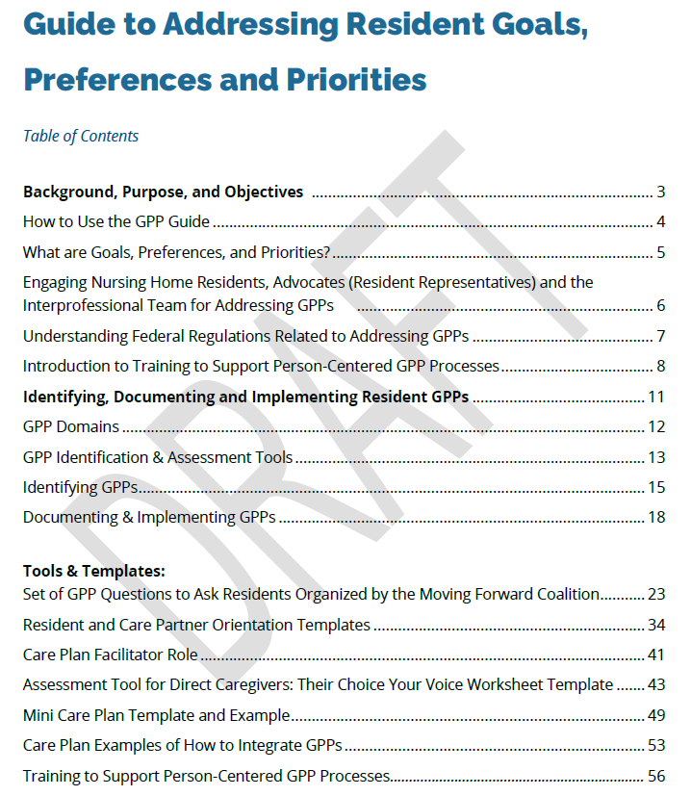
The Moving Forward Coalition
Goal Committee One
Getting closer to meaningful person-centered care.

Slide 12
The Moving Forward Coalition
Goal Committee One
Getting closer to meaningful person-centered care.

Slide 13
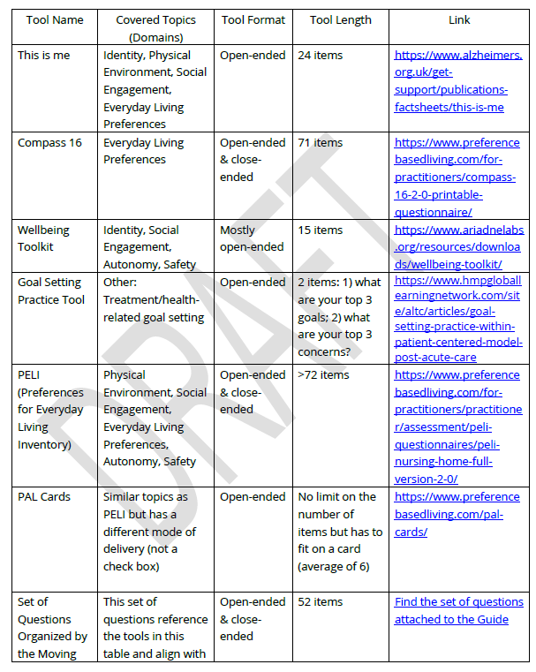
The Moving Forward Coalition
Goal Committee One
Getting closer to meaningful person-centered care.

Slide 14
The Moving Forward Coalition
Goal Committee One
Getting closer to meaningful person-centered care.

Slide 15
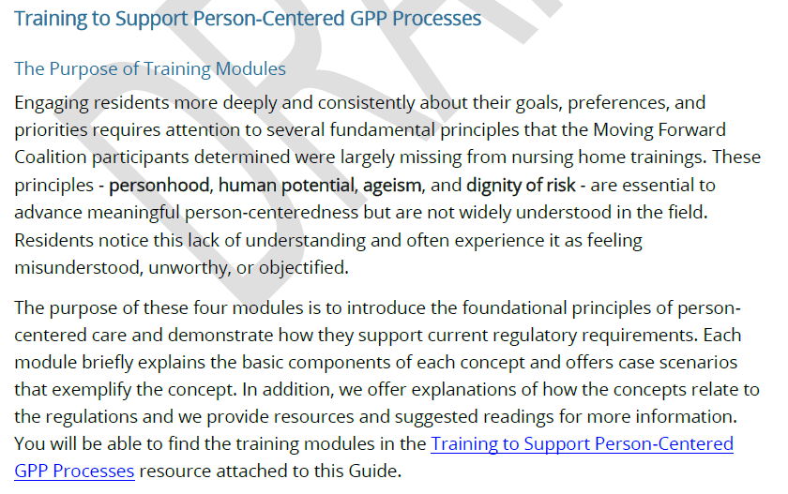
The Moving Forward Coalition
Goal Committee One
Getting closer to meaningful person-centered care.

Slide 16
The Moving Forward Coalition
Goal Committee Six
Strengthening Resident Councils

Slide 17
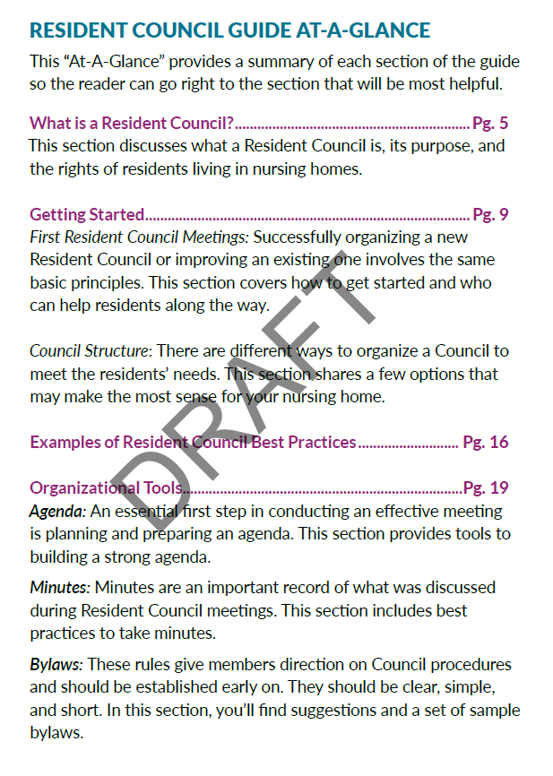
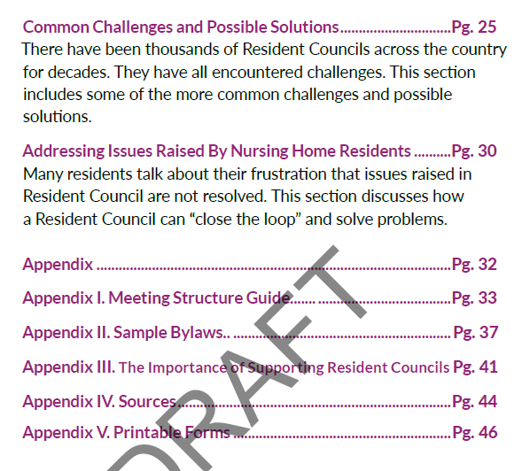
The Moving Forward Coalition
Goal Committee Six
Strengthening Resident Councils

Slide 18
The Moving Forward Coalition
Goal Committee Two
Expanding Nursing Assistant Career Pathways
Focus on apprenticeship

Slide 19
The Moving Forward Coalition
Focus on apprenticeship
Goal Committee Two
Nationally recognized, portable credential
Development of replicable national standards across the country
Replication allows for evaluation
Allows access to resources and funding sources that are specific to apprenticeship
Industry intermediaries to support admin & technical aspects
Incentive funds via intermediaries
Federal and state grants
Expanding Nursing Assistant Career Pathways

Slide 20
The Moving Forward Coalition – Years 3 and 4 (Proposed)
Larger pilot of Resident Council Guide
Pilot & Evaluation of GPP Guide
Development of DCW infrastructure
Improve national recognition of DCW training

Slide 21
OMS Payment Reform for Nursing Home Care
Transition from fee-for-service to value-based payment model
Rewards providers for meeting quality goals
Notes:
Lauren

Slide 22
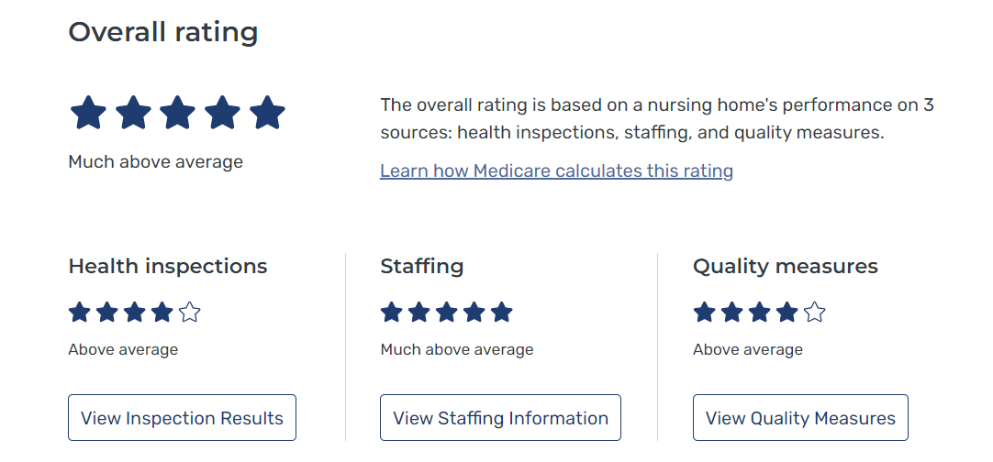
Measuring Quality in Nursing Homes: Care Compare
5-Star Quality Rating System

Slide 23
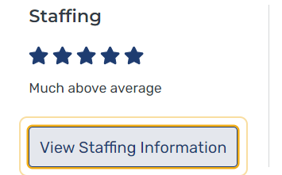
Care Compare Staffing Measures
Number of total nurse staff hours per resident per day
RN hours per resident per day
LPN per resident per day
CNA per resident per day
Total staff turnover rate
RN staff turnover rate
Administrator staff turnover rate
1 = Far Below Average
2 = Below Average
3= Average
4 = Above Average
5 = Far Above Average

Slide 24
Care Compare Quality Measures
Number of hospitalizations per 1000 long-term stay resident day
2. Number of outpatient emergency department visits per 1000 long-stay resident days
% of long-stay residents who got an antipsychotic medication
% of long-stay residents experiencing one or more falls with major injury
% of long-stay high-risk residents with pressure ulcers
% of long-stay residents with a urinary tract infection
% of long-stay residents who have or have had a catheter inserted and left in their bladder
% of long-stay residents whose ability to move independently worsened
% of long-stay residents whose need for help with daily activities has increased
1 = Far Below Average
2 = Below Average
3= Average
4 = Above Average
5 = Far Above Average

Slide 25
What We Want to Learn
What’s the Best Way to Measure Quality in Nursing Homes?
Do 5-Stars help families make best choices for their family members?
Do facilities feel the 5-Stars fairly reflect the care they provide?
Which measures should be inserted and aligned with a value-based payment model?

Slide 26
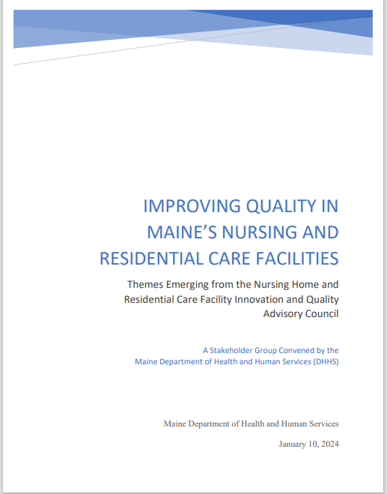
Nursing Home and Residential Care
Innovation and Quality Advisory Council
Nursing Home Providers
Medical Directors
Advocates
Experts in Long Term Care
Experts in the needs of older adults in need of residential care
Met 8 times in 2023
Explored factors and themes most important in the delivery of high quality
Nursing home care

Slide 27
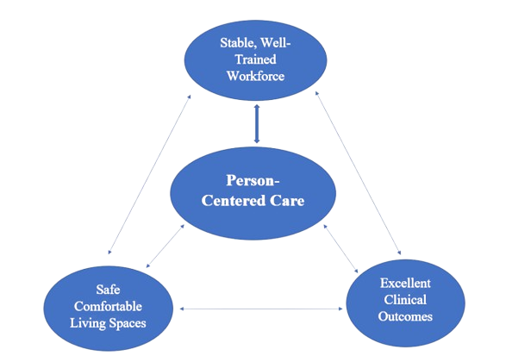
Themes Explored by The Innovation and Quality Advisory Council
The delivery of person-centered care
The delivery of excellent clinical care
The importance of a consistent, well-trained, well supported workforce
The importance of safe, comfortable living spaces
A supportive culture that empowers staff, supports collaboration and the building of a community

Slide 28
Themes contributing to high quality care in nursing homes
At the center is the delivery of person-centered care (PCC)
PCC supported by staff, safe spaces and the ability to deliver excellent clinical care
Themes overlap and intersect, creating synergy
But nothing happens without a stable, well-trained workforce!

Slide 29
Considerations in Choosing Measures of new
Value-Based Payment Model
Evidence based
Relevant to population served
Addresses identified gaps
Reliable data source
Low administrative burden
Ability to act on
Align with national or regional standards
Important to resident

Slide 30
Possible Measures in Consideration
Utilization of services: ED visits and hospitalizations, staffing, % turnover, % utilization of contract staff
Higher rates of both correlate with lower quality care
Implementation of a resident-reported outcome
Consideration of CoreQ
Clinical measures on Care Compare that reflect opportunities for improvement in Maine facilities
Rates of antipsychotic use
Rates of falls with injury
Rates of UTIs
Bringing back to Innovation and Quality Advisory Council for input

Slide 31
For more information about LTSS Reform Efforts in Maine go to Long-Term Services and Support System Reform | Department of Health and Human Services (maine.gov)
Fore more information on Maine’s involvement in NASHP’s Nursing Home Policy Academy go to Nine States Selected to Participate in NASHP’s Nursing Home Learning Collaborative - NASHP
For information on Maine’s supplemental budget, including Nursing Home Payment Reform go to Maine Department of Health and Human Services Supplemental Budget Summary | Department of Health and Human Services

Slide 32
Let’s talk about these questions:
What’s the Best Way to Measure Quality in Nursing Homes?
Do 5-Stars help families make best choices for their family members?
Do facilities feel the 5-Stars fairly reflect the care they provide?
Which measures should be inserted and aligned with a value-based payment model?

Slide 33
Thank you!
Please reach out
lauren.michalakes@maine.gov
marylou.ciolfi@maine.edu
Notes:
Lauren

